Slide 1
Key Stage 2 SATs Presentation 15th January 2024 Mrs Smith

Slide 2
Aims of the presentation
to consolidate knowledge of the National Curriculum
to learn how attainment and progress will be measured using assessment without levels
to understand the organisation and rationale of the Key Stage Two examinations (KS2)
to explore learning resources and ways to help children at home

Slide 3
Assessment and Reporting
The 2014 curriculum is rigorous and sets noticeably higher expectations than previous curricula, which is why all schools have had to work hard to meet and adapt to it since its introduction
Your child will be taught with the highest expectations and cover all required elements of the curriculum, similar to previous years
Since 2016, test scores have been reported as ‘scaled scores’

Slide 4
Scaled Scores: What is meant by ‘scaled scores’?
It is planned that 100 will always represent the ‘national standard’.
Each pupil’s raw test score will therefore be converted into a score on the scale, either at, above or below 100.
Using the scaled score, the lowest a child can score is 80, with the highest being 120.
A child who achieves the ‘national standard’ (a score of 100) will be judged to have demonstrated sufficient knowledge in the areas assessed by the tests.
Each child receives:
A raw score (number of raw marks awarded)
A scaled score in each tested subject
Confirmation of whether or not they attained the national standard

Slide 5
Scaled Score Examples
On publication of the test results in July:
A child awarded a scaled score of 100 is judged to have met the ‘national standard’ in the area judged by the test.
If a child’s score is between 110 -120 they have exceeded the national standard and demonstrated a higher than expected knowledge of the curriculum for their age.
A child awarded a scaled score of less than 100 is judged to have not yet met the national standard and performed below expectation for their age.

Slide 6
Higher Attaining Pupils
In the past, Key Stage 2 tests were aimed at children achieving levels 3-5 (with a national expectation to reach at least level 4).
This meant that additional level 6 tests were produced for children who demonstrated higher than expected attainment (above level 5).
Under the current system, there are not any separate tests for the
most-able children.
Instead, each test will have scope for higher-attaining pupils to show their strengths.
This means that some questions towards the end of the tests may be more difficult for many children but they should be encouraged to attempt as much of the test as they are able to

Slide 7
The Tests
Key Stage 2 SATs take place nationally in the week commencing Monday 13th May 2023 (Starting Monday 13th May- Thursday 16th May)
Statutory tests will be administered in the following subjects:
Punctuation, Vocabulary and Grammar (45 minutes)
Spelling (approximately 15 minutes)
Reading (60 minutes)
Mathematics
- Paper 1: Arithmetic (30 minutes)
- Paper 2: Reasoning (40 minutes)
- Paper 3: Reasoning (40 minutes)
All tests are externally marked.
Writing will be teacher assessed internally. The revised ‘pupil can’ statements for English writing place a greater emphasis on composition and the statements that relate to the more ‘technical’ aspects of English writing (grammar, punctuation and spelling) have been made less prescriptive.

Slide 8
SATs Week: Week Beg 13th May
Date/ Day | Test Paper Am | Test Paper Am
Monday 13th May | Punctuation, Grammar and Vocabulary (45 minutes) | Spelling (approximately 15 minutes)
Tuesday 14th May | English Reading Test (60 minutes)
Wednesday 15th May | Maths Paper 1; Arithmetic (30 minutes) | Maths Paper 2: Reasoning (40 minutes)
Thursday 16th May | Maths Paper 3: Reasoning (40 minutes)

Slide 9
What we are doing now - Preparation
Building confidence
Having a go at practice tests
Addressing gaps in learning
High quality Teaching and learning from experienced staff
Interventions – in class, home learning, class teacher and TA support additional learning opportunities, and catch up time etc
Focus lessons on Spellings, Reading, Maths and Writing
Tuition Groups after school
SLT staff delivering interventions

Slide 10
Reading
The reading test consists of a single test paper with three unrelated reading texts. Children are given 60 minutes in total, which includes reading the texts and answering the questions.
A total of 50 marks are available.
Questions are designed to assess the comprehension and understanding of a child’s reading.
During the reading paper, a child’s inference and deduction skills are thoroughly tested. They will also be expected to answer questions on authorial choices: explaining why an author has chosen to use particular vocabulary, grammar and text features.
Some questions are multiple choice or selected response; others require short answers and some require an extended response or explanation.

Slide 11
KS2 Reading
There will be a selection of question types, including:
Ranking/ ordering, e.g. ‘Number the events below to show the order in which they happen in the story’
Labelling, e.g. ‘Label the text to show the title of the story’
Find and copy, e.g. ‘Find and copy one word that suggests what the weather is like in the story’
Short constructed response, e.g. ‘What does the bear eat?’
Open- ended response, e.g. ‘Look at the sentence that begins Once upon a time. How does the writer increase the tension throughout this paragraph? Explain fully, referring to the text in your answer.’

Slide 12
KS2 Reading
IN SCHOOL
We have been practising these skills in class- daily reading sessions
We will have done plenty of SATs practice questions and activities by May
These skills are the focus of our reading sessions.
AT HOME
Read with your child: get your child to read aloud to you, and then ask them questions such as the examples given.
Encourage your child to read often and widely! Newspapers, books, magazines, internet.
Read aloud to your child whilst your child follows the text: listening is an important part of reading; it will help your child learn the importance of punctuation and reading with expression.

Slide 13
Sample KS2 Reading Texts

Slide 14
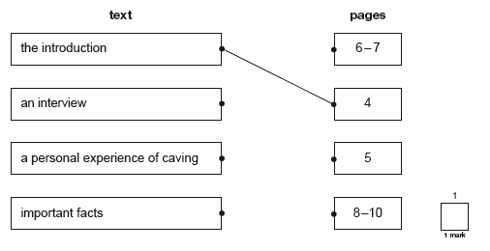
Sample KS2 Reading Texts
Some questions will ask children to find answers directly from the reading booklets they are given.

Slide 15
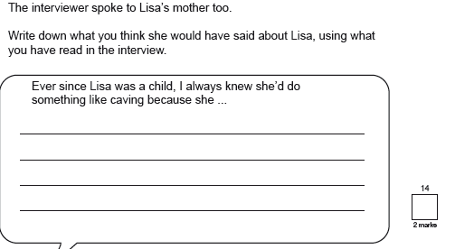
Others will require the children to deduce answers by using words or phrases as evidence

Slide 16
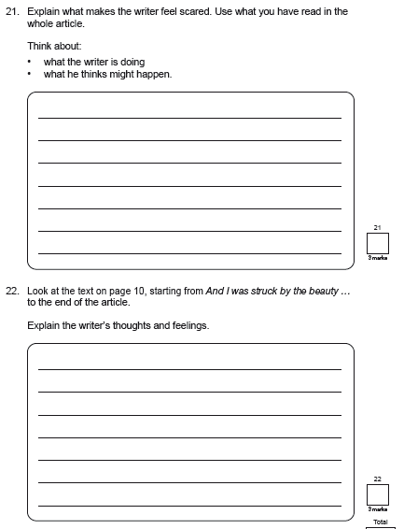
Some questions will ask the children to evaluate what they have read, again using the text to back up their answers

Slide 17
Grammar, Punctuation & Spelling
A spelling test is administered containing 20 words, which lasts approximately 15 minutes.
A separate test is given on grammar, punctuation and vocabulary.
This test lasts for 45 minutes and requires short answer questions including some multiple choice.
Marks for these two tests are added together to give a total for grammar, punctuation and spelling.

Slide 18
KS2 Grammar, Punctuation and Spelling
The grammar and punctuation test will include two sub-types of questions:
Selected response, e.g. ‘Identify the adjectives in the sentence below’
Constructed response, e.g. ‘Correct/ complete/ rewrite the sentence below,’ or, ‘The sentence below has an apostrophe missing. Explain why it needs an apostrophe.’

Slide 19
Spelling, Grammar and Punctuation
IN SCHOOL
We include grammar and punctuation in every English lesson and Topic lessons.
Weekly spelling focus
Focus on specific spelling patterns and spelling words
Spelling focus every day
Grammar and punctuation focus lessons
AT HOME
Check and practice weekly spellings
Practise Y5/6 spellings and spelling patterns
When reading to and/or with your child discuss the use of inverted commas to mark speech, the use of parenthesis (brackets) to add additional information, the use of capital letters etc.

Slide 20
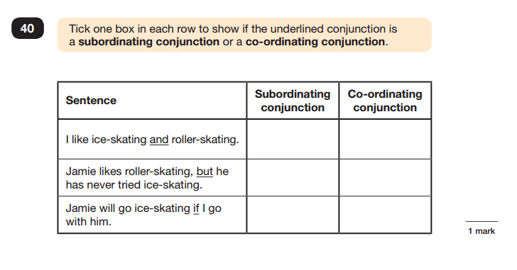
Sample Questions

Slide 21
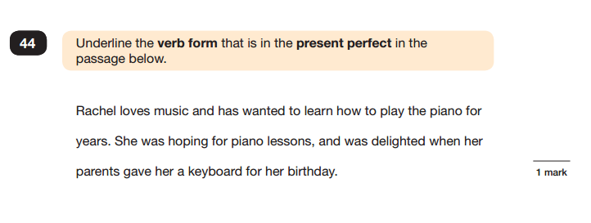
Sample Questions

Slide 22
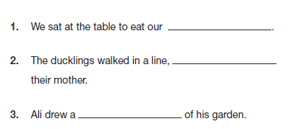
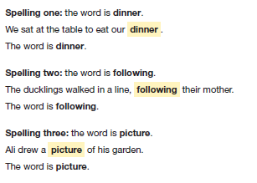
Spelling Task
The paper looks like this:
The teacher reads this:

Slide 23
Teacher Assessment of Writing
Teacher assessment replaced a writing test
All the written work produced over the year is considered in making a judgement on a child’s writing level.
About a quarter of schools are moderated each year by the local authority to ensure assessments are accurate.

Slide 25
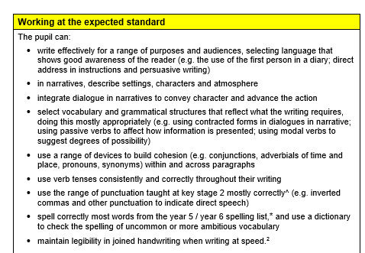

Slide 26
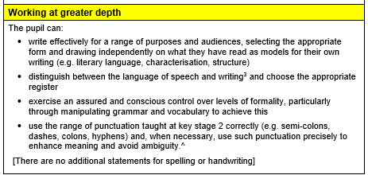
In order to achieve working at greater depth, you must achieve all bullet points in the at expected standard.
Correct spelling is required in the grammar and punctuation paper in the majority of cases, especially:
Verb forms
Contractions
Prefixes and suffixes
Plurals

Slide 27
Mathematics
Children will sit three tests: Paper 1, Paper 2 and Paper 3
Paper 1 is for ‘Arithmetic’ lasting for 30 minutes, covering calculation methods for all operations, including use of fractions, percentages and decimals.
Questions gradually increase in difficulty. Not all children will be expected to access some of the more difficult questions later in the paper.
Papers 2 and 3 cover ‘Problem Solving and Reasoning’, each lasting 40 minutes.
Pupils will still require calculation skills but will need to answer questions in context and decide what is required to find a solution.

Slide 28
KS2 Mathematics
Paper 1 will consist of fixed response questions, where children have to give the correct answer to calculations, including long multiplication and division.
Paper 2 and 3 will involve a number of question types, including:
Multiple Choice
True or False
Constrained questions, e.g. giving the answer to a calculation, drawing a shape or completing a table or chart
Less constrained questions, where children will have to explain their approach for solving a problem

Slide 29
KS2 Mathematics
IN SCHOOL
Daily Maths lessons
Intervention groups with Teachers and Teaching Assistant
Focus on Calculations
Basic Skills Focus lessons
Reasoning Focus lessons
Online Maths Revision – Class Blog
TT Rockstars
One to One Tuition for identified pupils
AT HOME
Knowing their timetables- if you know your timetables children can use them accurately and quickly for multiplication and division.
Formal method for the four operations practice: it is important your child can complete methods accurately. (Methods for year 6 child; column addition, column subtraction, short multiplication, long multiplication, short division, long division including expressing remainders as fractions, decimals and remainder form)
Arithmetic speed practice

Slide 30
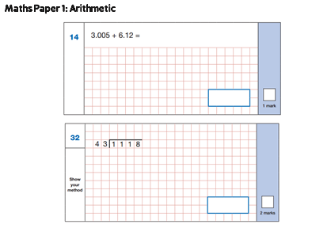
Sample Questions

Slide 31
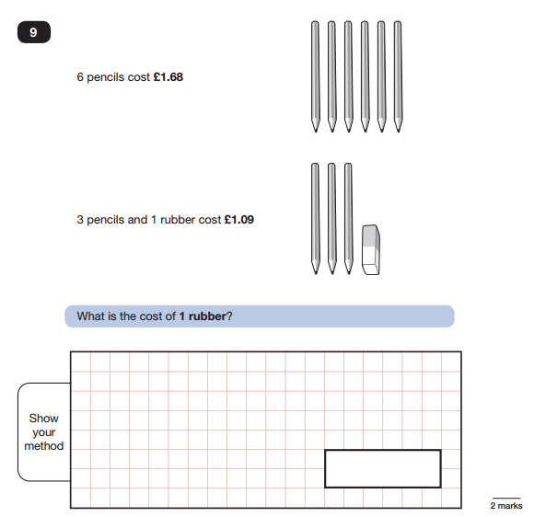
Sample Questions
Maths Paper 2 / Paper 3 : Reasoning

Slide 32
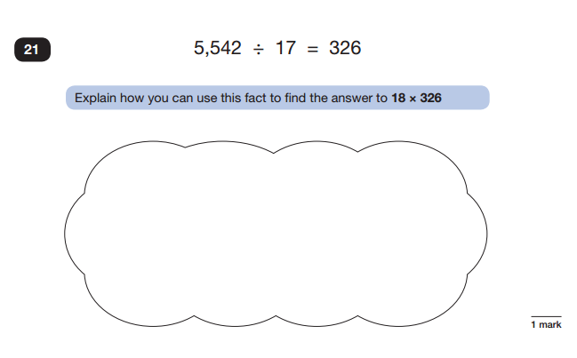
Sample Questions
Maths Paper 2 / Paper 3 : Reasoning

Slide 33
What help can children have?
In the reading test, children must read the text and questions by themselves, but MAY have help recording their answers, if this is done in a normal classroom situation.
In maths, teachers can read questions to any child who asks. Some children will have the whole paper read to them, on a one to one basis.
Teachers can encourage, but not guide or say that an answer is correct or incorrect.
Some children can be given up to 25% extra time if they have identified learning needs. This has to be applied for in advance.
Words on a test paper can be transcribed where a marker may not be able to read a child’s answer.

Slide 34
How to Help Your Child
First and foremost, support and reassure your child that there is nothing to worry about and they should always try their best. Praise and encourage!
Ensure your child has the best possible attendance at school. Ensure they arrive on time, every day during SATs week.
Support your child with their home learning tasks, including revision tasks, Go Read, Spelling Shed, Maths Shed and TT Rockstars
Reading, spelling and arithmetic (e.g. times tables) are always good to practise.
Talk to your child about what they have learnt at school and what book(s) they are reading (the character, the plot, their opinion).
Make sure your child has a good sleep and healthy breakfast every morning!

Slide 35
The Impact of Covid-19
We understand that the Covid-19 pandemic has had a detrimental impact on education and have many strategies in place to ensure the ‘catch-up curriculum’ has been effectively implemented.
Intervention Groups throughout lessons
Experienced teaching team in Y6
After school tuition for identified children
Arithmetic and grammar based additional home learning
Reading club

Slide 36
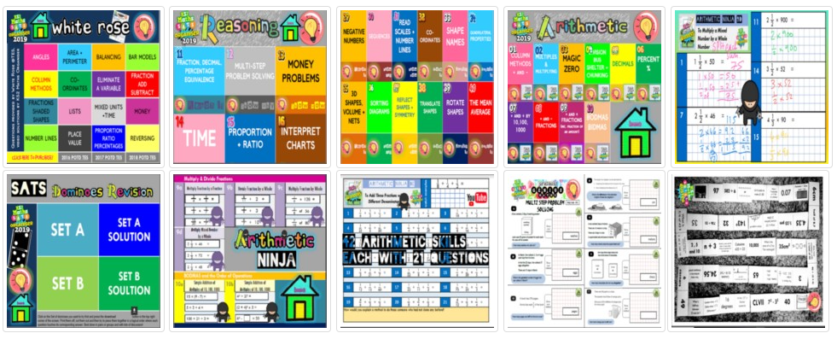
Help and Support
You can access Year 6 SATs papers online for free
There is a SATs Revision section on our class page that will give helpful tips, revision websites etc for both parents and pupils.

