Slide 1
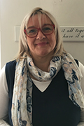
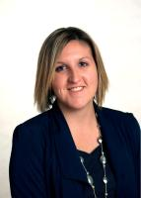
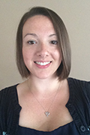
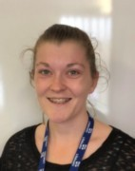
Welcome to Barley Class!

Slide 2
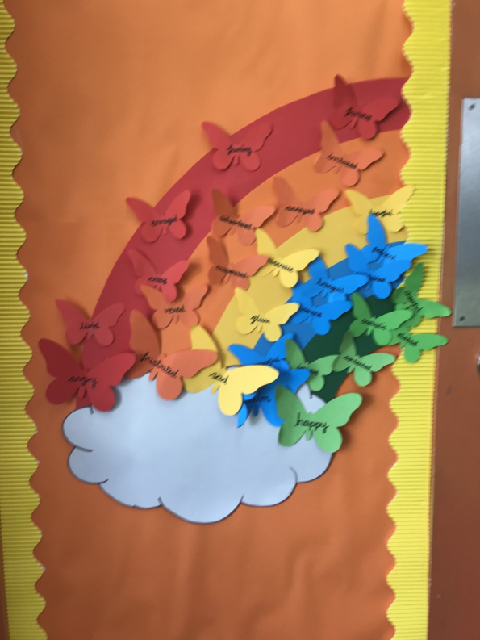
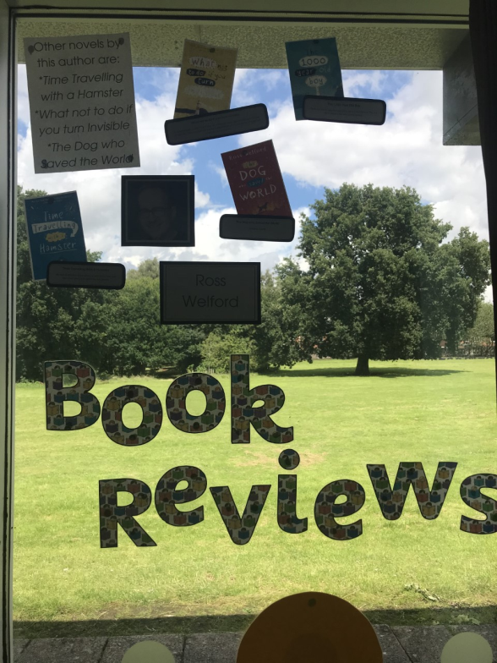
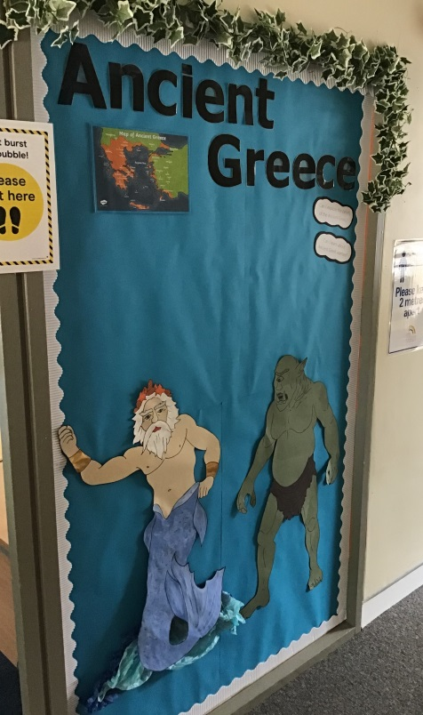
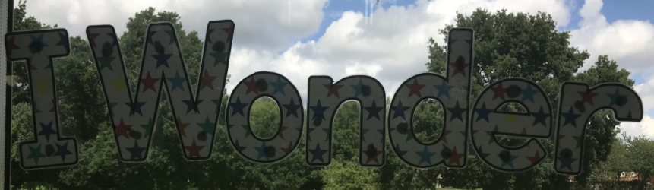
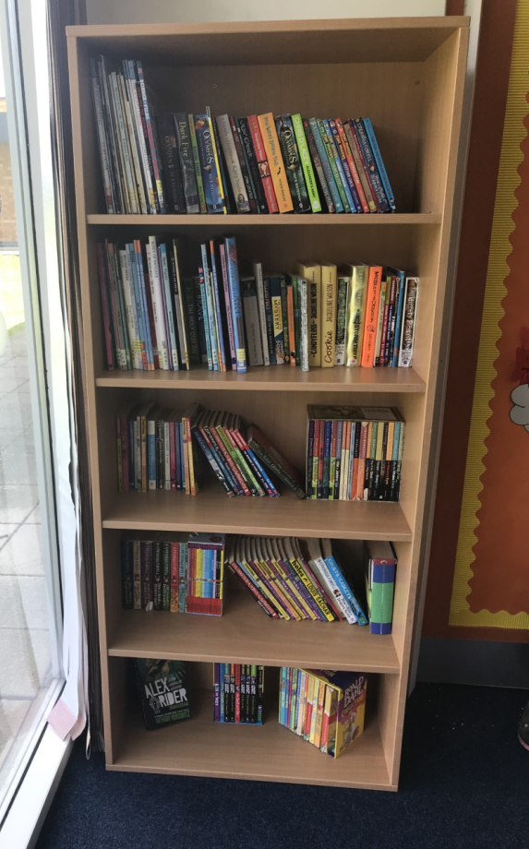
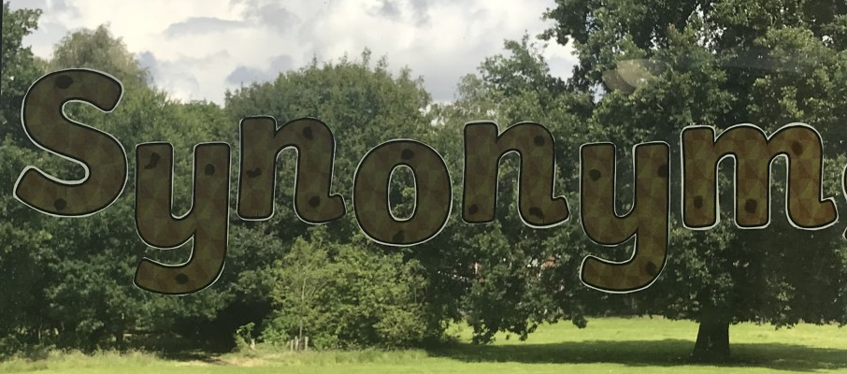
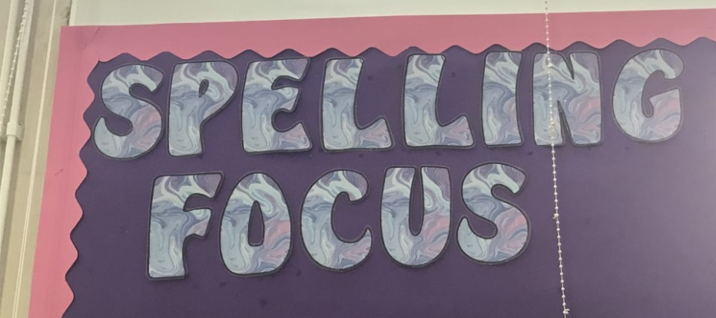
Our classroom is all ready for September

Slide 3
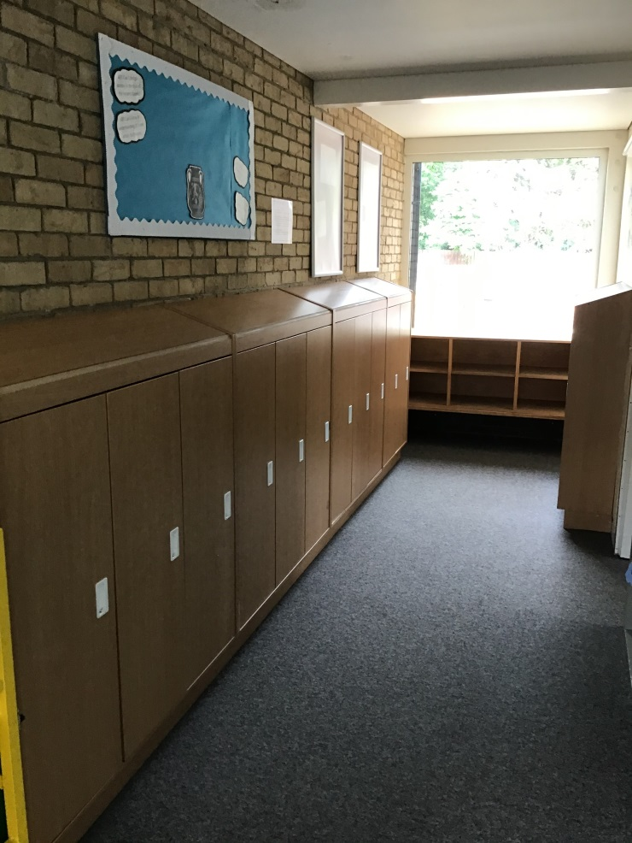
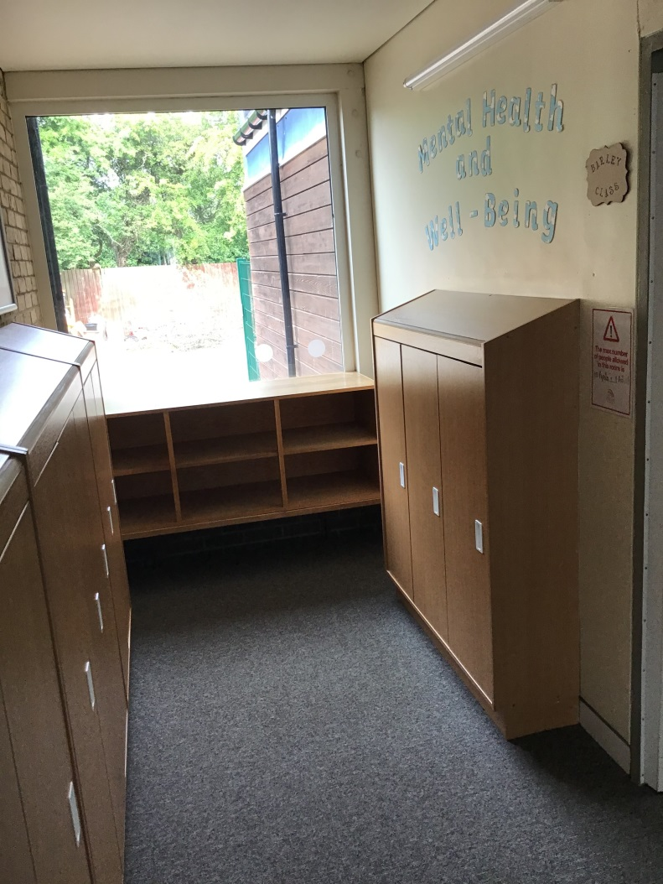
These are our lockers
(There isn’t a lot of space so please only bring to school what you really need – reading book, packed lunch, coat, PE kit, water bottle)

Slide 4
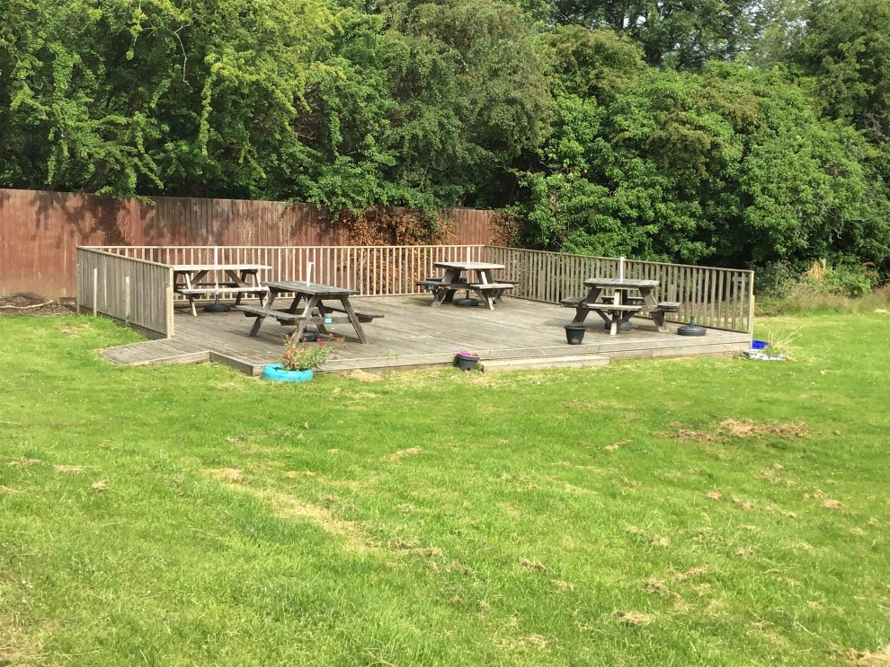
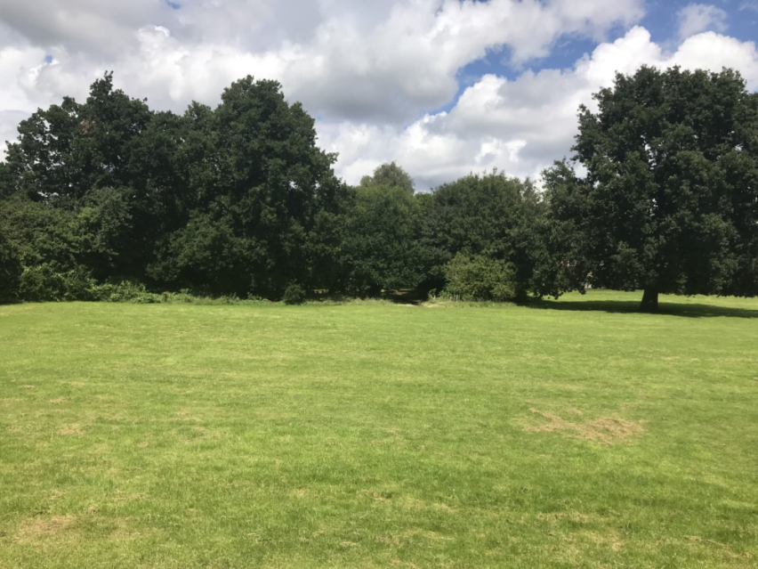
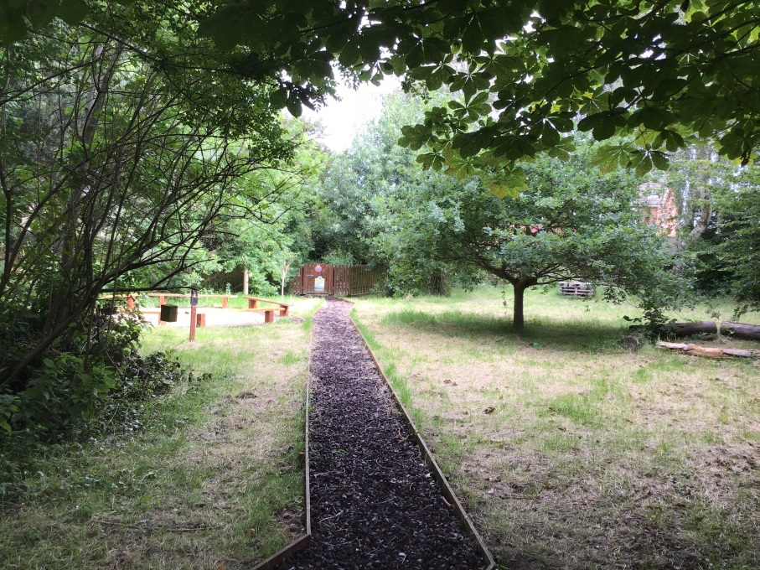
Our Classroom opens up onto the field which is fantastic for outdoor learning – especially the decking and nature areas

Slide 5

We will be using our Learning Powers to help us

Slide 6

Our Year 6 Autumn Term Learning Journey looks like this…
In English, we will be focusing at first on the book ‘The Adventures of Odysseus’ which is one of the world’s greatest adventure stories based on the travels and tribulations of Ancient Greek warrior, Odysseus.
We will find lots of writing opportunities from the book, while also focusing on learning new grammar and spelling rules.
Our reading focus will be on inferring, deducing and summarising information from texts that we explore.
Later in the term we will be exploring the fiction book ‘Who Let the God’s Out?’

Slide 7
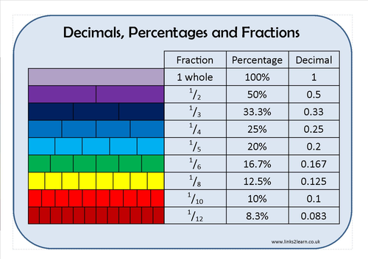
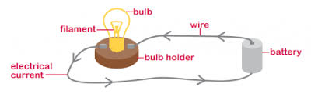
Our Year 6 Autumn Term Learning Journey looks like this…
In Maths, our first unit will be focusing on Place Value with numbers upto ten million and negative numbers.
We will be using formal method to calculate problems (addition, subtraction, multiplication and division).
This term we will also be working on simplifying, converting, multiplying and comparing fractions and decimals.
Remember to practice your times tables at home ☺
In Science, we will be looking Electricity and enhancing our Working Scientifically knowledge – fair tests, variables, conclusions, evaluations and using accuracy and precision in our investigations.

Slide 8
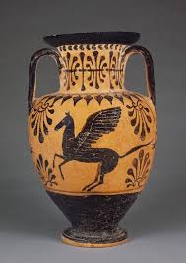
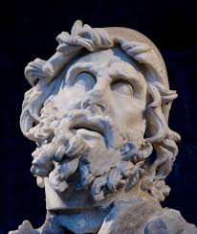
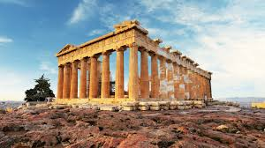
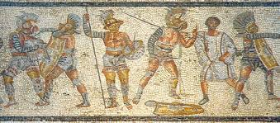
Our Year 6 Autumn Term Learning Journey looks like this…
Our topic this term is Ancient Greeks, we will be learning about life in Ancient Greece, how their way of life has impacted the modern world, democracy in Ancient Greece, Greek artists and architects, Greek warfare and much more.
Our Hook Day is on Monday 7th September, we will be using our map skills to identify Greece, learning and performing Greek dance, tasting Greek foods and making Ancient Greek style pottery.
Unfortunately, we will not be able to dress up for this Hook Day, due to hygiene precautions.

Slide 9
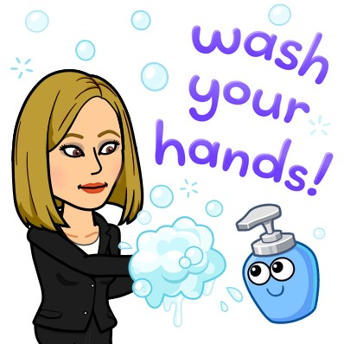


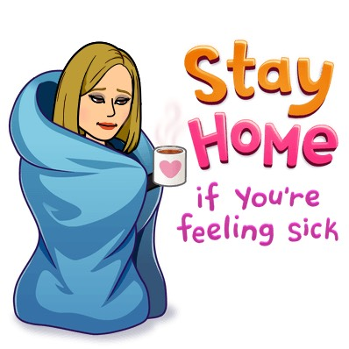
Staying safe in the classroom
We need good hygiene at all times

Slide 10
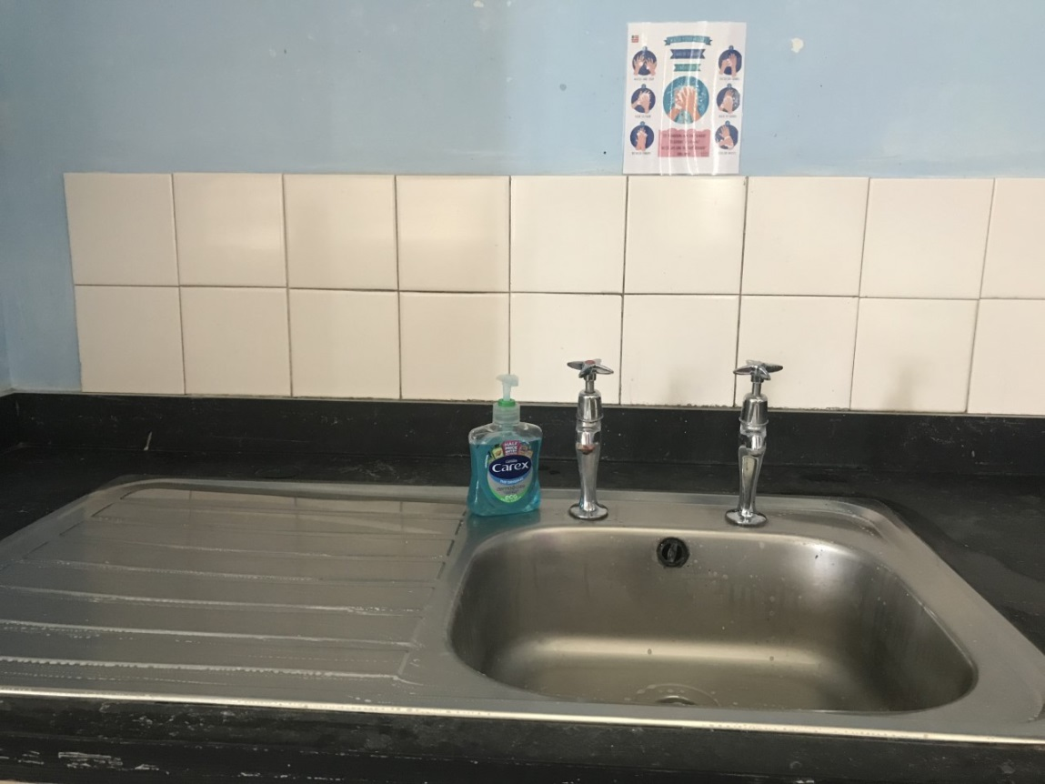
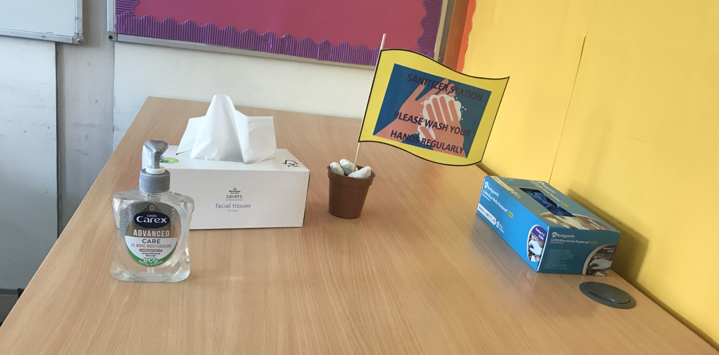
Every classroom has a hand washing station and there are hand gel stations round the school

Slide 11
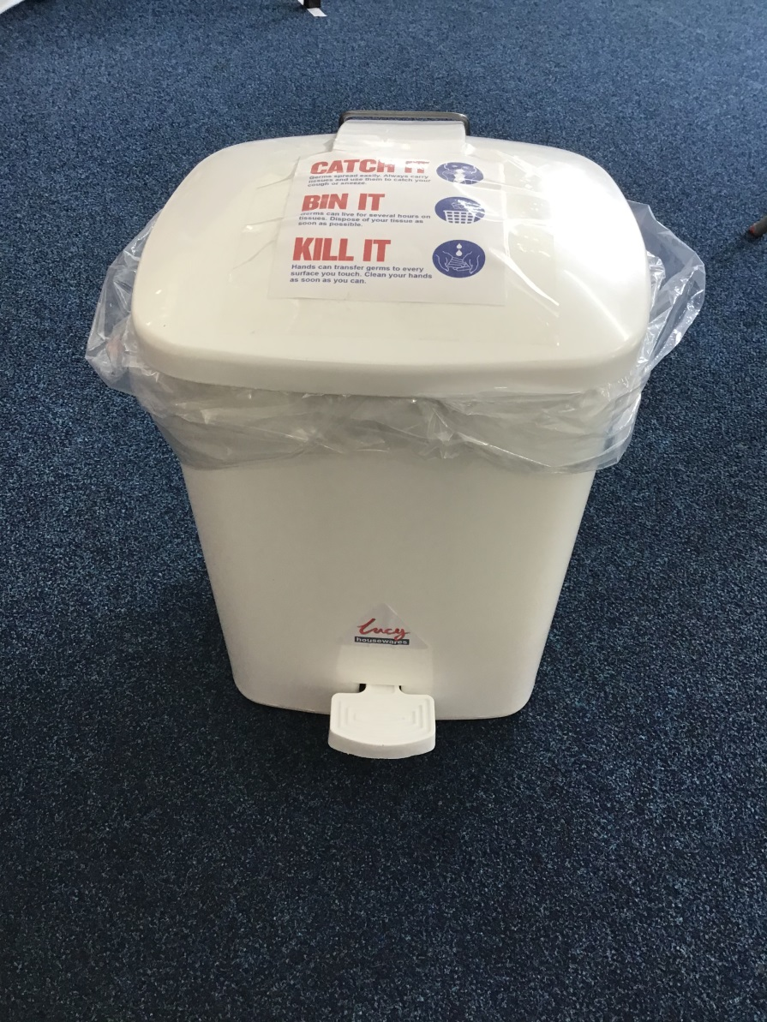
If you use a tissue please place in the special lidded bin

Slide 12
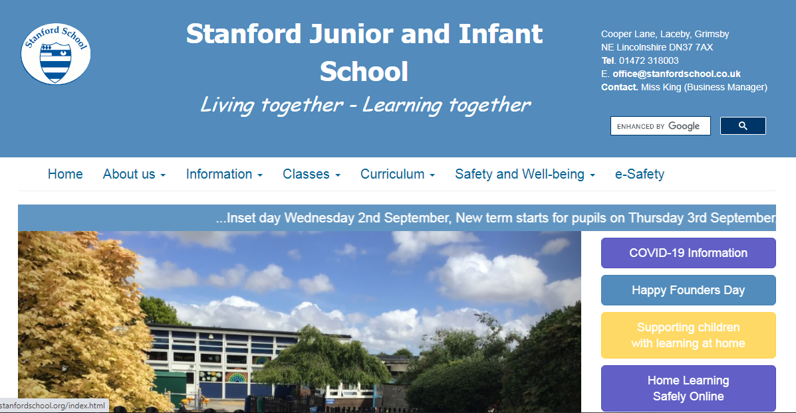
Remember to look at our Class blog for the most up-to-date information.
It will be lovely to receive your ‘All About Me’ messages from the school website.

Slide 13

Wishing you a safe and happy summer holidays!
I am looking forward to seeing you all in September!
Mrs Marsden x

