Slide 1

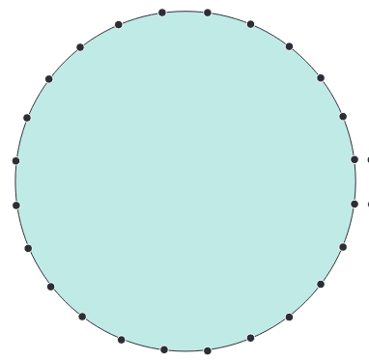

Investigate patterns made by joining multiples.
Starting at number 1, we are going to join each point to its double.
24
1
23
2
22
3
So we join
1 to 2
2 to 4
3 to 6
…
21
4
20
5
19
6
Double 14 is 28.
We count on 4 from 24 to where 28 would be, so we join 14 to 4.
18
7
17
8
We carry on until we reach 24, which joins to itself!
16
9
15
10
How would you describe the pattern?
Is it symmetrical?
14
13
11
12
Double 13 is 26.
We count on 2 from 24 to where 26 would be, so join 13 to 2.

