Slide 1



Number patterns and sequences.
The Fibonacci sequence is named after a 12th century mathematician who wrote about it.
Can you see how it works?
Add the last 2 numbers to make the next number.
Write the next three terms in the sequence.
1, 1, 2, 3, 5, 8, 13
, 21, 34, 55
I can tell you the total of those numbers really quickly.
The total is 143.
There is a relationship in the pattern that helps us to find the total of any 10 consecutive numbers in a Fibonacci sequence.
You multiply the 7th number by 11.
Does it work with these 10 numbers from the sequence?
3, 5, 8, 13, 21, 34, 55, 89, 144, 233
Yes!
55 x 11 = 605
3 + 5 + 8 + 13 + 21 + 34 + 55 + 89 + 144 + 233 = 605

Slide 2
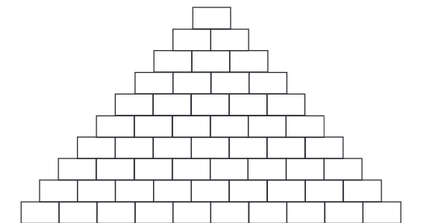
Number patterns and sequences.
Patterns have intrigued mathematicians for centuries. Blaise Pascal (1623–1662) discovered new patterns in what is now known as Pascal’s triangle.
1
How do we calculate what numbers to write on the next row?
1 1
1 2 1
1 3 3 1
1 4 6 4 1
1 5 10 10 5 1
1 6 15 20 15 6 1
1 7 21 35 35 21 7 1
1 8 28 56 70 56 28 8 1
1 9 36 84 126 126 84 36 9 1
Can you see any patterns?
Notes:
Use the Transformation game at http://www.kidsmathgamesonline.com/geometry/transformation.html. Clock on the picture to follow the link.
Do any children have a top tip for remembering how to read/plot co-ordinates in the correct order? E.g. along the corridor (x) then up the stairs (y), or x is across, y is in the ^{sky}.
Record today’s ‘Top Tip for Tests’ for display in the classroom.

Slide 3
Number patterns and sequences.
Add the first two numbers along this diagonal (1 + 3). Now add the next two numbers (3 + 6). Then the next two...
What sequence of numbers do you get?
This pattern is the sequence triangular numbers. They can be used to make triangles of dots.
1
1 + 3 = 4
3 + 6 = 9
6 + 10 = 16
10 + 15 = 25
15 + 21 = 36
21 + 28 = 49
28 + 36 = 64
1 1
1
3
6
10
1 2 1
1 3 3 1
1 4 6 4 1
1 5 10 10 5 1
1 6 15 20 15 6 1
Square numbers!
1 7 21 35 35 21 7 1
1 8 28 56 70 56 28 8 1
1 9 36 84 126 126 84 36 9 1
Notes:
Use the Transformation game at http://www.kidsmathgamesonline.com/geometry/transformation.html. Clock on the picture to follow the link.
Do any children have a top tip for remembering how to read/plot co-ordinates in the correct order? E.g. along the corridor (x) then up the stairs (y), or x is across, y is in the ^{sky}.
Record today’s ‘Top Tip for Tests’ for display in the classroom.

Slide 4
Number patterns and sequences.
Add the numbers each line passes through...
1
Do you recognise this number sequence?
1
1
1 + 1 = 2
1 1
1 + 2 = 3
1 + 3 + 1 = 5
1 2 1
1 + 4 + 3 = 8
1 3 3 1
1 + 5 + 6 + 1 = 13
1 + 6 + 10 + 4 = 21
1 4 6 4 1
1 + 7 + 15 + 10 + 1 = 34
1 + 8 + 21 + 20 + 5 = 55
1 5 10 10 5 1
1 6 15 20 15 6 1
It’s the
Fibonacci sequence!
1 7 21 35 35 21 7 1
1 8 28 56 70 56 28 8 1
1 9 36 84 126 126 84 36 9 1
Notes:
Use the Transformation game at http://www.kidsmathgamesonline.com/geometry/transformation.html. Clock on the picture to follow the link.
Do any children have a top tip for remembering how to read/plot co-ordinates in the correct order? E.g. along the corridor (x) then up the stairs (y), or x is across, y is in the ^{sky}.
Record today’s ‘Top Tip for Tests’ for display in the classroom.

