Slide 1
Interpret bar charts.
This graph shows the results of a survey where school children were asked to choose their ideal pet from a choice of rabbit, dog and cat.
We can draw lines down to the horizonal axis.
How many children chose a rabbit?
What size steps are on the scale?
20
40
60
80
120
140
160
180
50
150
How many more children chose cats than rabbits?
These questions are easier to answer, now we’ve labelled the bars on the graph.
How many children chose dogs or cats?
A tip for answering graph questions: Use a ruler to draw a line to the axis to read the number/ value from the scale.
Notes:
Discuss the scale of the graph. Click to label the first line 20, the next 40, and so on to 100, then draw a line down to the horizontal axis, and label it 50.

Slide 2
Interpret bar charts.
This graph shows the results of a survey where school children were asked to choose their ideal pet from a choice of rabbit, dog and cat.
We can draw lines down to the horizonal axis.
How many children chose a rabbit? 50
How many children chose a rabbit?
20
40
60
80
120
140
160
180
50
150
These questions are easier to answer, now we’ve labelled the bars on the graph.
How many more children chose cats than rabbits?
How many more children chose cats than rabbits? 50
How many children chose dogs or cats? 250
How many children chose dogs or cats?
A tip for answering graph questions: Use a ruler to draw a line to the axis to read the number/ value from the scale.

Slide 3
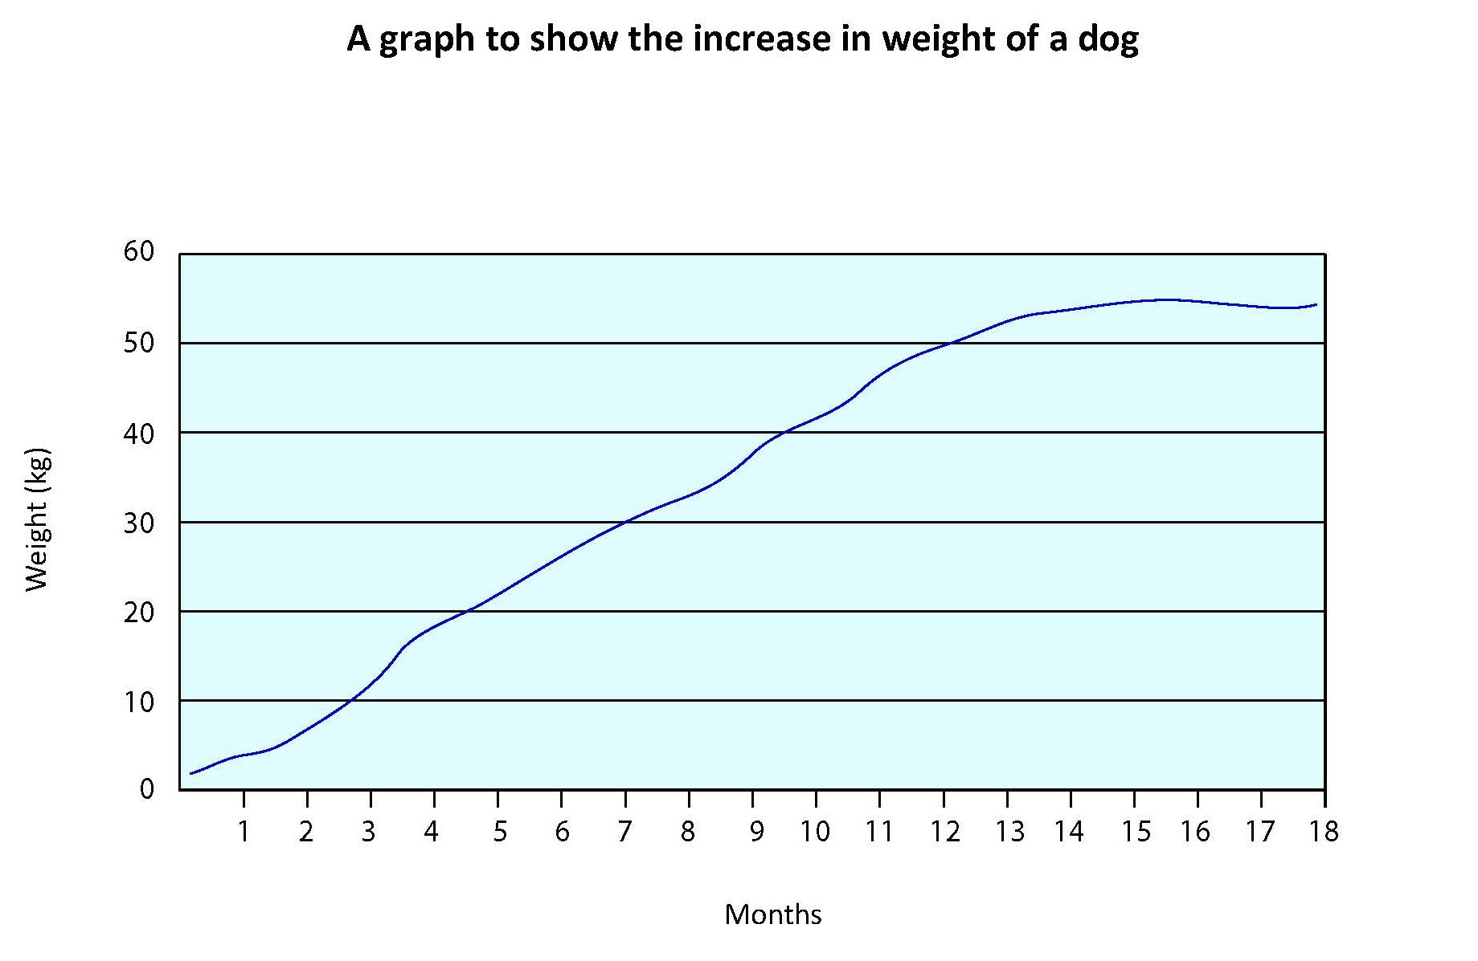
Interpret line graphs.
Estimate the dog’s weight at 2¹/₂ months old.
What is the puppy’s weight at 1 month old?
Estimate the dog’s weight at 4¹/₂ months old.
Estimate the age the dog reached 40kg.
What is the puppy’s weight at 3 months old?
Again it would be helpful to use a ruler to draw lines on the graph up from the horizontal axis to the line, then across to the vertical axis to read the weight. Or, draw from the vertical axis to the line and down to the horizonal axis to read the age.

Slide 4
Interpret line graphs.
A What is the puppy’s weight at 1 month old? Approx. 4kg
A What is the puppy’s weight at 1 month old?
C Estimate the dog’s weight at 2¹/₂ months old.
Approx. 9kg
C Estimate the dog’s weight at 2¹/₂ months old.
B What is the puppy’s weight at 3 months old? Approx. 12kg
B What is the puppy’s weight at 3 months old?
D Estimate the dog’s weight at 4¹/₂ months old. 20kg
D Estimate the dog’s weight at 4¹/₂ months old.
E Estimate the age the dog reached 40kg.
Approx. 9¹/₂ months
E Estimate the age the dog reached 40kg.
12
9
4
9¹/₂
Again it would be helpful to use a ruler to draw lines on the graph up from the horizontal axis to the line, then across to the vertical axis to read the weight. Or, draw from the vertical axis to the line and down to the horizonal axis to read the age.

