Slide 1

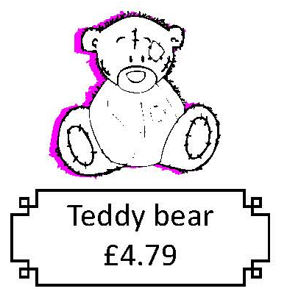

Use counting up (Frog) to calculate change from £5, £10 and £20.
The Teddy costs £4.67.
You’ve given the shopkeeper £5. How can the shopkeeper calculate the change?
£4.67
Jump 3p to the next 10p.
… then 30p to £5.
We can count up on a number line!
3p
30p
£4.67
£4.70
Add the jumps:
30p + 3p = 33p
£5
Draw a line and mark £4.67 on the left and
£5 on the right.
33p change!

Slide 2

Use counting up (Frog) to calculate change from £5, £10 and £20.
Now someone is buying the Teddy bear but only has a £10 note!
£4.67
We can draw a bar model to represent the problem…
£10
£4.67 | ?
What does each part of the bar model represent?
Now let’s count up on a number line to find the change…

Slide 3
Use counting up (Frog) to calculate change from £5, £10 and £20.
£4.67
Jump 3p to the next 10p.
… then 30p to £5.
… and then £5 to £10.
3p
30p
£5
£4.67
£4.70
£5
Add the jumps:
£5 + 30p + 3p = £5.33
£10
Draw a line and mark £4.67 on the left and £10 on the right.
£5.33 change!

Slide 4

Use counting up (Frog) to calculate change from £5, £10 and £20.
What if you paid with a £20 note instead? What would be the same? Different?
£4.67
The last jump would be £15.
3p
30p
£15
£5
£4.67
£4.70
£5
£10
£20
£20 would go on the right.
£15.33 change!

