Slide 1

Punctuating Speech

Slide 2
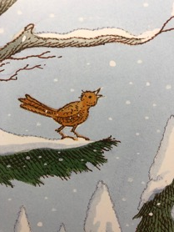
Punctuating Speech – direct speech & reporting clauses
Speech bubbles can show us what a character is saying.
All is quiet, all is quiet.
The words that are spoken are called direct speech.
“All is quiet, all is quiet,”
sang the bird.
Bubbles would take up too much room in a story so we use speech marks instead.
Speech marks work in pairs to hug the direct speech.
We report who is speaking using a reporting clause.
Speech marks are also called inverted commas.

Slide 3
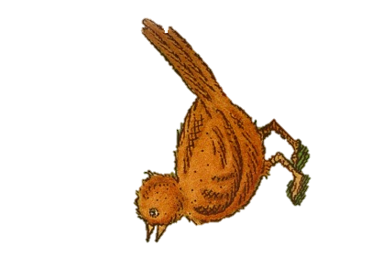
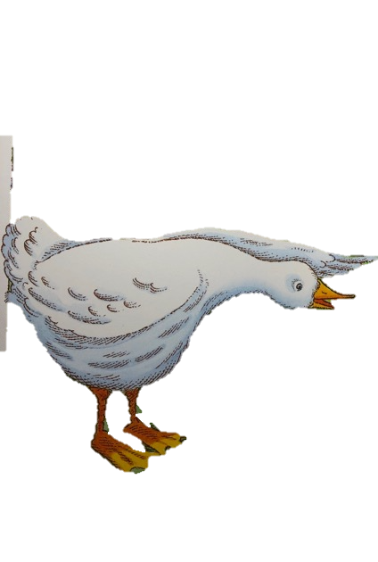
Punctuating Speech – direct speech & reporting clauses
EXAMPLE
“What kind of bird are you if you can’t fly?” said the bird.
“What kind of bird are you if you can’t swim?” replied the duck.
Bird
What kind of bird are you if you can’t fly?
What kind of bird are you if you can’t swim?
Duck
Write this conversation as punctuated speech.
Remember to hug the direct speech with speech marks
and add reporting clauses.

Slide 4
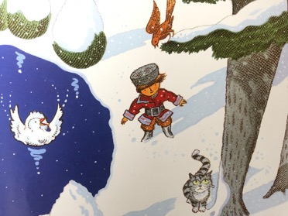
Punctuating Speech – capital letters open direct speech
Direct speech begins with a capital letter, even if it is in the middle of a sentence.
The cat was thinking, “While he argues, I’ll just grab him.”
Peter shouted, “Look out!”
It is the beginning of the speaker’s sentence so a capital letter is used.

Slide 5
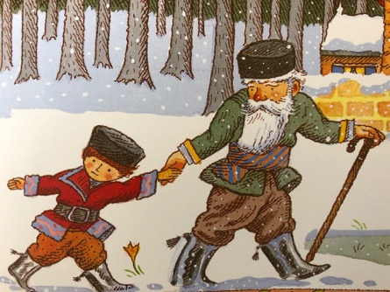
Punctuating Speech – interrupted direct speech
Direct speech begins with a capital letter, even if it is in the middle of a sentence.
One exception - If the speech sentence is interrupted by a reporting clause,
the speech sentence continues with a lowercase word.
“ A wolf might appear from the forest at any moment,” warned Grandfather.
“A wolf,” warned Grandfather, “might appear from the forest at any moment.”
lowercase

Slide 6

Punctuating Speech – commas separate clauses
Direct speech and reporting clauses are usually separated by a comma.
“I want to say outside,” complained Peter. He pulled his grandfather’s arm.
Grandfather insisted, “It’s too dangerous!”
The comma is placed at the end of the first clause.
If it is after the direct speech,
the comma is placed inside the speech marks.

Slide 7
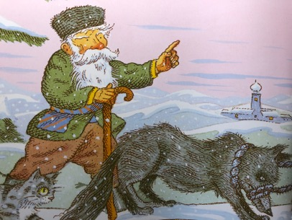
Punctuating Speech – exclamations and questions
If the speech ends in a ! or ? we do not need a comma after the speech.
“Don’t shoot!” called out Peter.
“What if Peter hadn’t caught the wolf?” asked Grandfather.
The punctuation is placed inside the speech marks.
The reporting clause still starts with a lower-case letter.

Slide 8
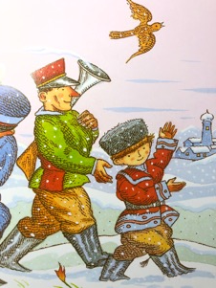
Punctuating Speech – a new line shows a change of speaker
The zoo-keeper asked, “What do we have here?” “A wolf!” Peter replied. “Is it a tame wolf?” continued the zoo-keeper, backing away. “This wolf,” grumbled Grandfather “is dangerous and wild.”“But we caught it!” triumphed the bird.
It’s hard to see who is speaking when the dialogue is squashed together.
The zoo-keeper asked, “What do we have here?”
“A wolf!” Peter replied.
“Is it a tame wolf?” continued the zoo-keeper, backing away.
“This wolf,” grumbled Grandfather “is dangerous and wild.”
We show each change of speaker by starting a new line.
“But we caught it!” triumphed the bird.

Slide 9
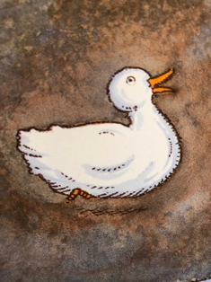
Punctuating Speech – Identifying mistakes.
“Could somebody help me please” pleaded the duck.
“Could somebody help me please?” pleaded the duck.
Peter frowned, “did anyone else hear that?”
Can you spot the 5 mistakes?
Peter frowned, “Did anyone else hear that?”
“I didn’t hear a thing”, responded the bird.
“I didn’t hear a thing,” responded the bird.
ANSWERS

Slide 10

This is a Hamilton Trust Presentation. For more fantastic resources visit our website
https://www.hamilton-trust.org.uk/ .

