Slide 1
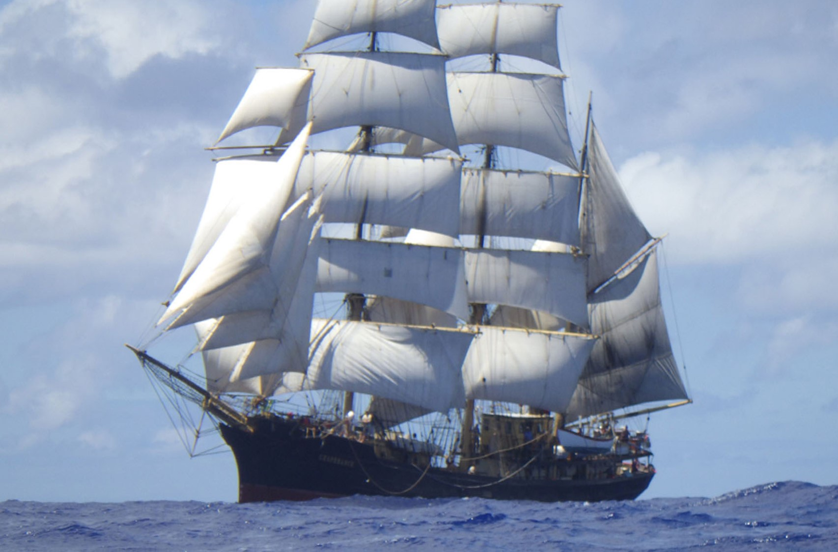

Possessive – ’s

Slide 2
Do you know the difference between plural - s and possessive – ’s?
ship’s flag
the flag belongs to the ship
ships
more than one ship

Slide 3
Plural - s
A noun names a person, place, idea, thing or feeling.
seas
clouds
fellow-rover
call
I must go down to the seas again.
… a windy day with the white clouds flying.
… a merry yarn from a laughing fellow-rover.
… for the call of the running tide…
Plurals
Which of the four nouns are plural?
Where in the poem are these nouns used?
If there is more than one of the noun we say it is plural.
We often show a noun is plural by adding an s.

Slide 4
Possessive – ’s
To show possession we add ’s to the end of the noun.
wheel
wind
sail
gull
whale
the wheel’s kick
the wind’s song
the white sail’s shaking
the gull’s way
the whale’s way
kick
song
shaking
way
way
Possession means that something is owned by the noun.
The ’s goes at the end of the noun.

Slide 5
Plural -s and possessive - ’s
The white clouds were flying.
The white cloud’s were flying.

Plural
- add s
Possessive
- add ’s
The winds song was calling.
The wind’s song was calling.

Which sentence is correct in each pair?

Slide 6
Plural Possessive - s
If the noun already ends in s because it is plural…
add ’ to the end of that noun.
wolf
wolf
wolves
wolf
wolves
the wolf’s fangs
the wolves’ fangs
the wolf’s blood
the wolves’ blood
The ’ goes at the end of the noun.
wolves
If we added another s to a plural noun it would be hard to say!

Slide 7
Plural Possessive - s
ANSWERS
The wolves’ fangs were bared at the doe.
The wolf’s fangs were bared at the doe.
The fangs which belonged to one wolf were bared at the doe.
The fangs which belonged to all of the wolves were bared at the doe.
The wolves sheltered under the tree’s branches.
The wolves sheltered under the trees’ branches.
The branches which belonged to one tree had wolves sheltering underneath.
The branches which belonged to several trees had wolves sheltering underneath.
Match the punctuation to the description.

Slide 8

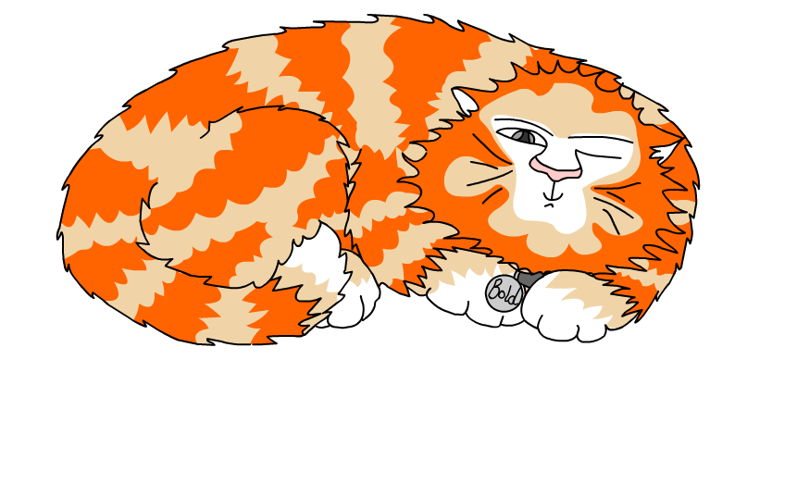
Explore more Hamilton Trust Learning Materials at https://wrht.org.uk/hamilton/ .

