Slide 1

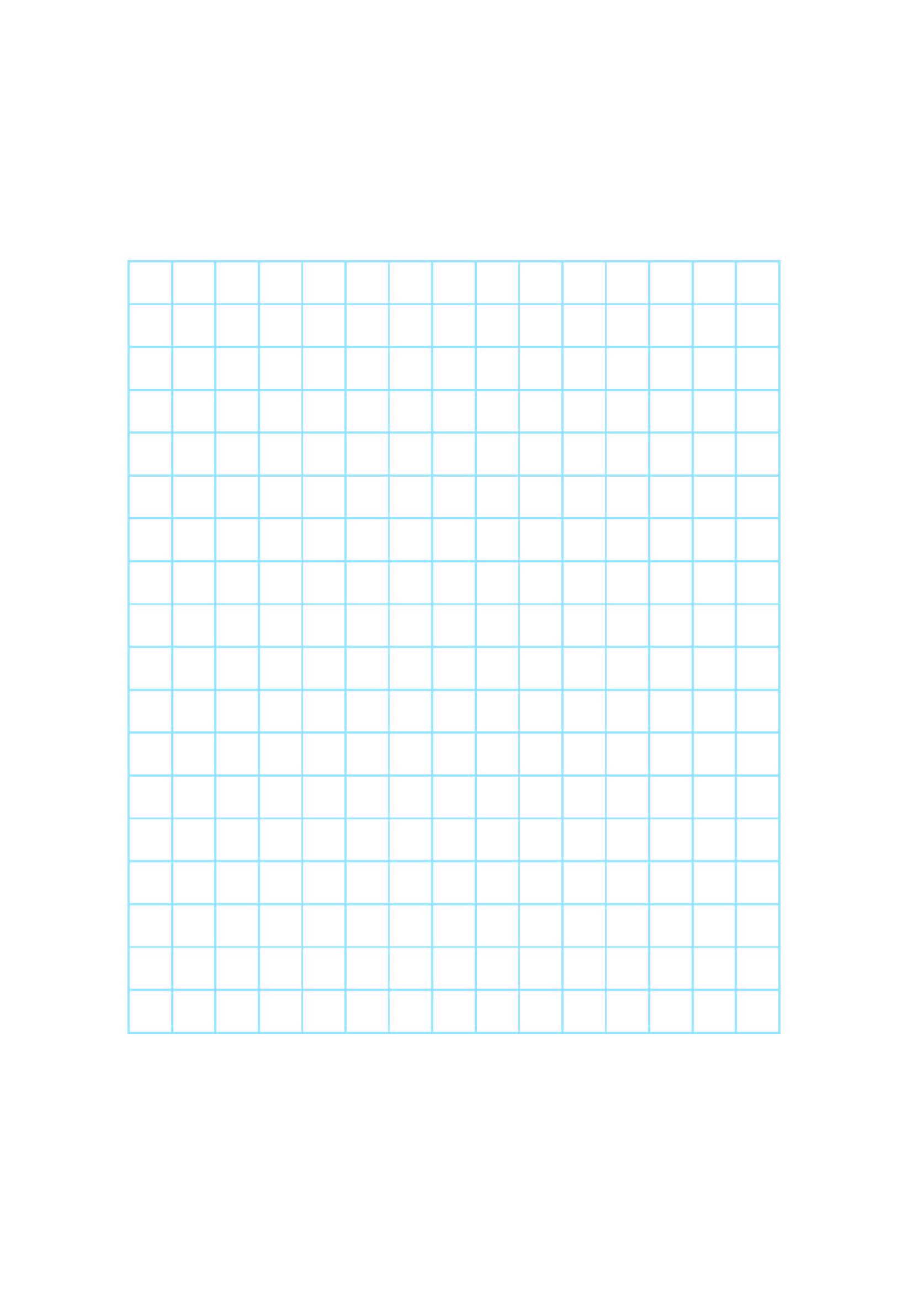
Find the area of rectangles.
James drew a rectangle on centimetre squared paper.
We can find how many squares are inside this rectangle without counting every one!
40cm²
The small ‘2’ after cm stands for square centimetres.
5 rows…
Each row has 8 squares.
5 x 8 = 40
This is a way of measuring the area of the rectangle. It is the amount of surface it covers.

Slide 2
Find the area of rectangles.
How many rows? How many squares in each row?
Carla drew this rectangle on centimetre squared paper.
21cm²
What times table fact can we use to find the area of this rectangle?
3 x 7 = 21

Slide 3
Find the area of rectangles.
Kirk drew 2 rectangles.
12cm²
12cm²
4 rows…
each has 3 squares.
4 x 3 = 12
2 rows…
each has 6 squares.
2 x 6 = 12
Different rectangles can have
the same area!

