Slide 1


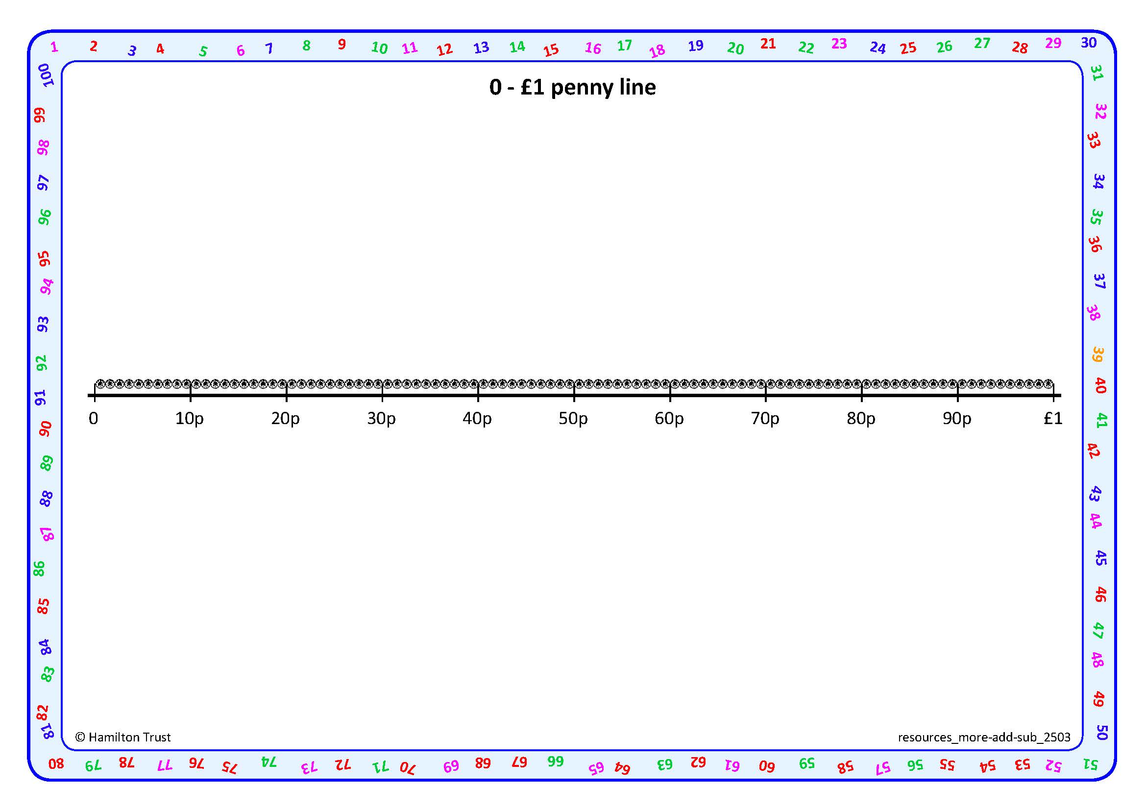
Subtract by counting up or counting back.
I have 87p in my purse and want to spend 33p.
How much money will I have left?
We can count back in 10s and 1s from 87p on a penny number line.
3
30
54p
57p
87p
First count back
three 10s….77, 67, 57.
Then count back 3 … 56, 55, 54.
54p left. What number sentence can I write?
87p - 33p = 54p

Slide 2

Subtract by counting up or counting back.
Now I have 54p in my purse and I want to spend 38p.
How much money will be left?
54 and 38 are close together, so we can use Frog to count up to find the difference.
2
10
4
38p
54p
Mark 38p and 54p on
the line.
Then Frog hops to 50, then 54.
Frog starts at the smaller number and hops to the next 10.
How far has he hopped altogether? What subtraction number sentence can we write?
54p - 38p = 16p

Slide 3

Subtract by counting up or counting back.
We have two ways of subtracting…
We can count back or
we can count up (Frog).
Try 72p - 55p and 57p - 25p.
There is no ‘right’ or ‘wrong’ choice of method but think about which might be more efficient, or straightforward for each.
Notes:
Children can now go on to do differentiated GROUP ACTIVITIES. You can find Hamilton’s group activities in this unit’s TEACHING AND GROUP ACTIVITIES download.
WT/ARE/GD: Subtract two numbers involving money, using different methods OR Find the difference between two 2-digit number cards, explaining reasons for choosing methods used.

