Slide 1

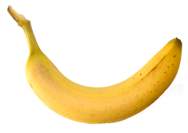

Find fractions of amounts using sharing and number facts.
I am going to give half of these bananas away and keep the rest.

Slide 2
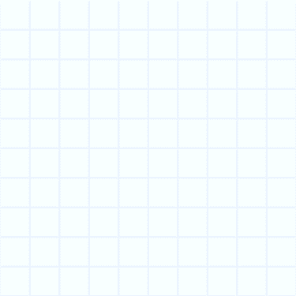
Find fractions of amounts using sharing and number facts.
The fraction tells us what to do with this amount.
The 1 tells us that we just want to know what is in one of those groups.
¹/₂
The 2 tells us
to share the whole amount between two.

Slide 3
Find fractions of amounts using sharing and number facts.

Slide 4
Find fractions of amounts using sharing and number facts.
We can also use number facts to split the bananas…
… we know that half of 12 is 6 (because double 6 is 12).
_{½ of 12 = 6}

Slide 5

Find fractions of amounts using sharing and number facts.
How could we find ¼ of the bananas?
We could halve each half.
_{¼} _{of 12 = ?}

Slide 6
Find fractions of amounts using sharing and number facts.
_{¼} _{of 12 = 3}

Slide 7
Find fractions of amounts using sharing and number facts.
What should we do to solve this?
_{¾} _{of 12 = ?}

Slide 8
Find fractions of amounts using sharing and number facts.
_{¾} _{of 12 = ?}
Let’s see what the fraction tells us to do.
_{¾} _{of 12 = ?}
The 3 tells us that we want to know what is in three of those groups.
³/₄
The 4 tells us
to share the whole amount between four.

Slide 9

Find fractions of amounts using sharing and number facts.
_{¾} _{of 12 = 3 lots of 3 bananas}
_{¾} _{of 12 = 9}

Slide 10
Find fractions of amounts using sharing and number facts.
What about this one? How can we solve it?
This says one third.
¹/₃ of 12 = ?
A third tells us that we share the whole lot of bananas three ways.

Slide 11
Find fractions of amounts using sharing and number facts.
¹/₃ of 12 = 4

Slide 12
Find fractions of amounts using sharing and number facts.
This time we have 18 bananas.

Slide 13
Find fractions of amounts using sharing and number facts.
¹/₃ of 18 =
?
6

