Slide 1


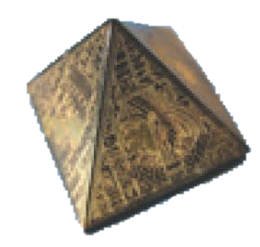
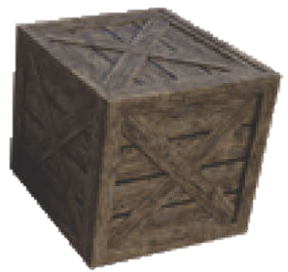
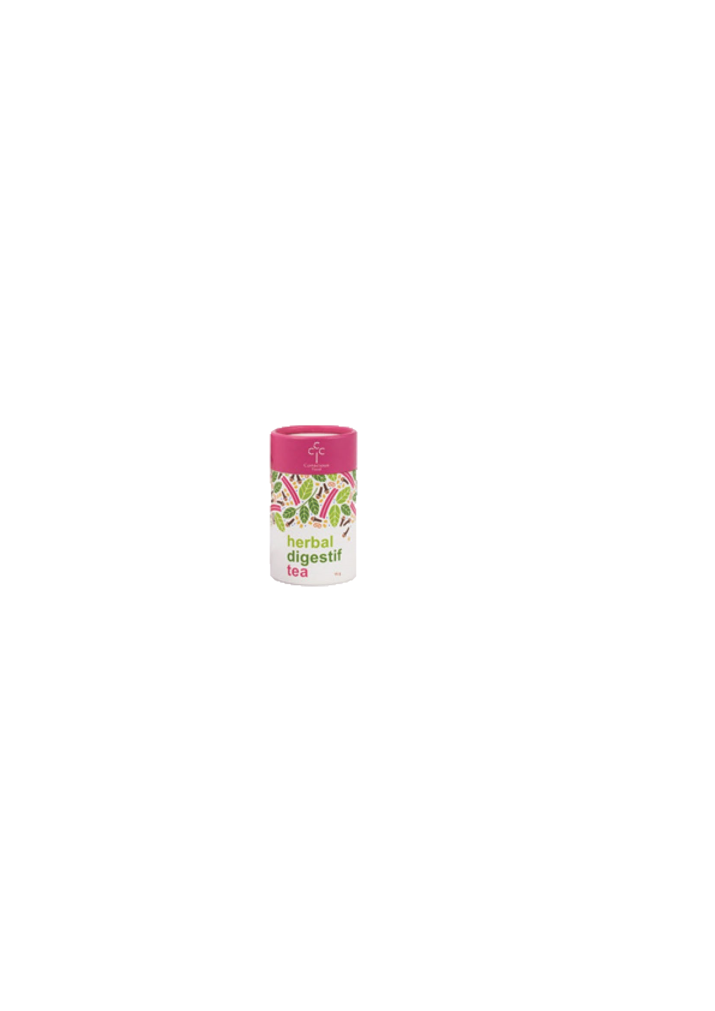


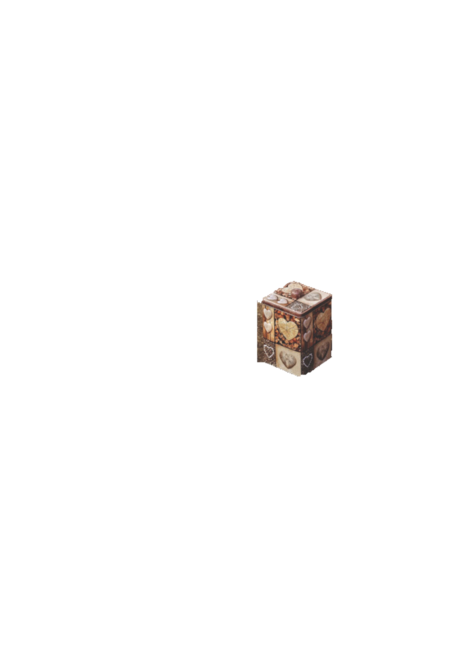
Naming 3-D shapes and identifying their properties.
Can you name each shape?
Cube
Pyramid
Cylinder
Sphere
Cone
Cuboid

Slide 2
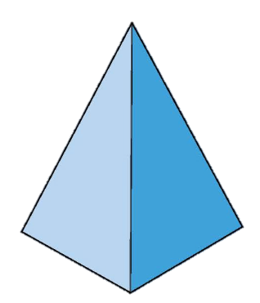
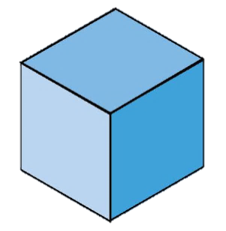
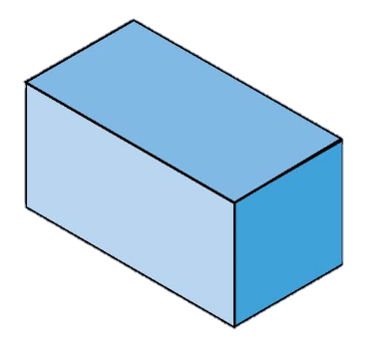
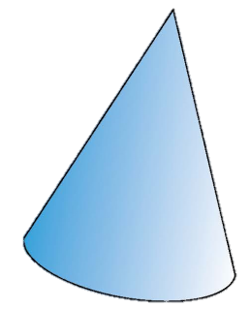

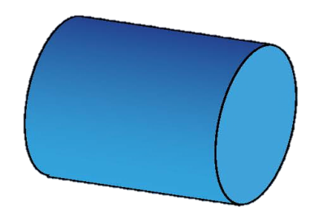


Naming 3-D shapes and identifying their properties.
The cylinder and cone have both flat faces and curved faces.
Let’s sort these shapes into those with flat faces and those with curved faces.
Where do you think we should put each shape?
flat faces
curved faces
Notes:
This activity can also be done with real 3-d shapes and 2 labelled sorting shapes; each pair can be given a shape to place.

Slide 3
Naming 3-D shapes and identifying their properties.
Which shapes do you think will
roll well? Why?
Which will slide well? Why?
Which shapes do you think will
stack well?
You could find some shapes and try out your ideas...

Slide 4

Naming 3-D shapes and identifying their properties.
This shape has flat faces, but do you think it would be good to build with?
What shapes are its faces? Pyramids can have different shapes on the base but the other faces are always triangles.
People don’t use this shape like a brick for building, but the Egyptians, among others, made buildings in this shape.
This shape is called a square-based pyramid.

Slide 5
Naming 3-D shapes and identifying their properties.
These are all cuboids.
The shapes might look a bit different, but all are cuboids because they have 6 faces which are oblongs and squares.
Their opposite faces are always the same shape and size.
Notes:
Children can now go on to do differentiated GROUP ACTIVITIES. You can find Hamilton’s group activities in this unit’s TEACHING AND GROUP ACTIVITIES download.
WT/ARE/GD: Play 3-D shape bingo OR Sort 3-D shapes according to properties.

