Slide 1
Read time on analogue clocks to the nearest quarter hour.
12
This circle has been divided into 4 equal parts. What do we call these parts?
The circle is a bit like a clock face. Let’s put 12 at the top.
What number goes at the bottom?
Where should 3 go on the circle?
Where should 9 go on the circle?
9
3
When the minute hand is at 9, it has ¹/₄ of an hour to go until the next o’ clock time.
3 is ¹/₄ of the way round the clock face. When the minute hand is here, it is ¹/₄ of an hour past an o’ clock time.
6

Slide 2
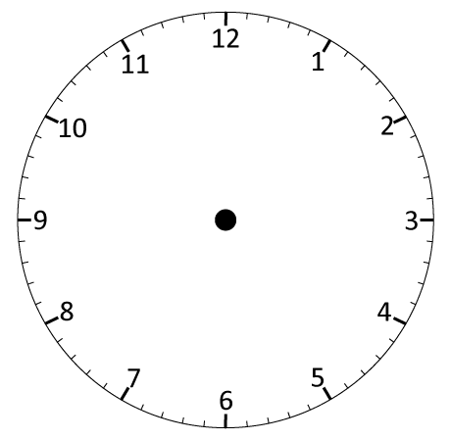
Read time on analogue clocks to the nearest quarter hour.
Now it’s only ¹/₄ of an hour before 10 o’ clock. We can write that as quarter to 10 or
¹/₄ to 10.
It’s 9 o’ clock. On this clock, the pink tells as ‘past’ times and the blue tells us ‘to’ times.
What time is it now?
Now it’s ¹/₄ of an hour after 9 o’ clock. We can write that as quarter past 9
or ¹/₄ past 9.
What time is it now?
What time is it now?

Slide 3
Read time on analogue clocks to the nearest quarter hour.
Quarter past 10.
Watch carefully what happens each time the clock moves forward
1 hour.
Write the new times.
What changed?
What stayed the same?

