Slide 1
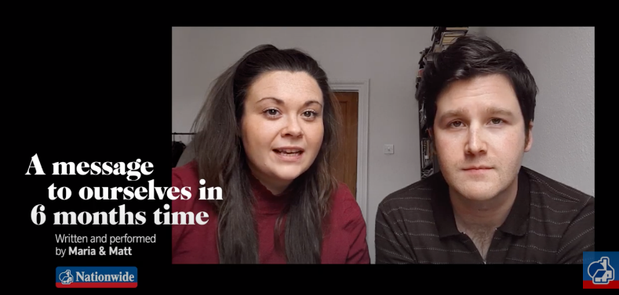

Adverbs of Possibility
What are adverbs of possibility?
Why and where might we use them?

Slide 2
Adverbs
An adverb can tell you more about a verb.
Some adverbs tell us how certain we are about the verb.
We will probably eat crisps.
We will possibly make decorations from pasta.
We will definitely have an amazing day.
These adverbs are useful for talking about the future.

Slide 3
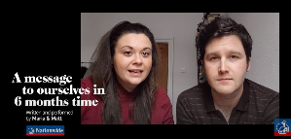
ANSWER
Adverbs
You can order these adverbs by possibility/certainty.
certainly
surely
definitely
perhaps
possibly
maybe
probably
LESS CERTAIN |  |  |  | CERTAIN
What order would you put these in?

Slide 4
ANSWER
Adverbs
You can order these adverbs by possibility/certainty.
certainly
surely
definitely
perhaps
possibly
maybe
probably
LESS CERTAIN |  |  |  | CERTAIN
What order would you put these in? Do you agree with this ordering?

Slide 5
Adverbs
Adverbs of possibility usually go before the main verb.
They certainly need to think creatively.
Matt and Maria definitely want to be married.
Some adverbs of possibility can go at the beginning of the sentence .
Maybe, they will be able to hold a party later.
Perhaps, they will celebrate with friends using video-calls.
When the adverb opens the sentence, punctuate with a comma.
These adverbs modify the whole clause.

Slide 6

ANSWER
Adverbs
Which sentence is most certain?
Maybe, they’ll drink fizzy pop in champagne flutes.
Perhaps, they’ll drink fizzy pop in champagne flutes.
Surely, they’ll be drinking fizzy pop in champagne flutes.
Definitely, they’ll drink fizzy pop in champagne flutes.
Adverbs of possibility: perhaps, maybe, possibly, probably, surely, definitely, certainly

Slide 7

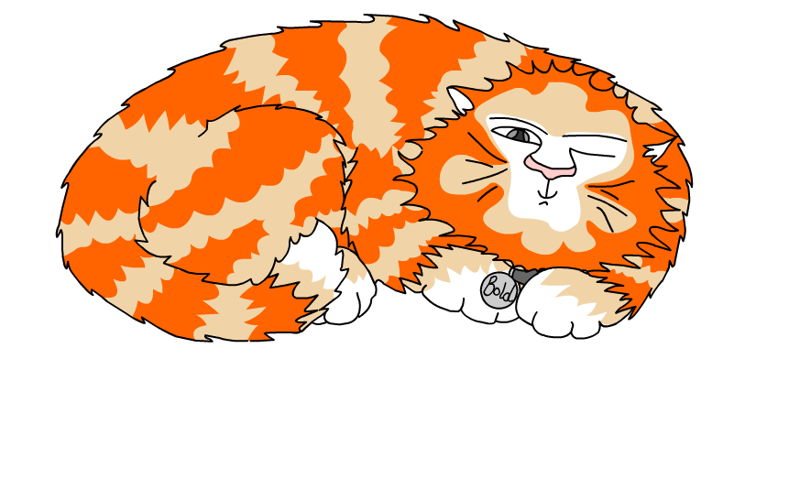
Explore more Hamilton Trust Learning Materials at https://wrht.org.uk/hamilton/ .

