Slide 2
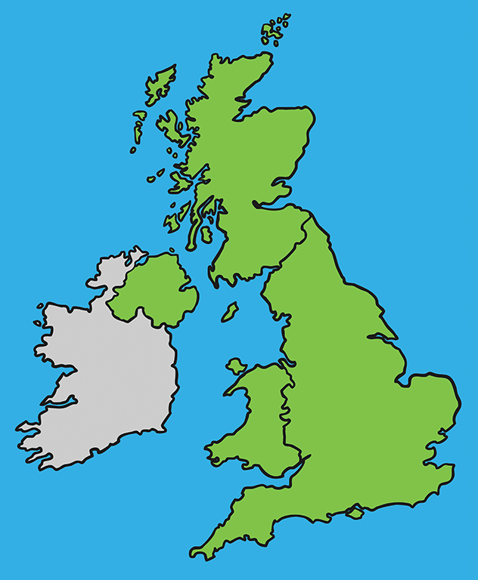
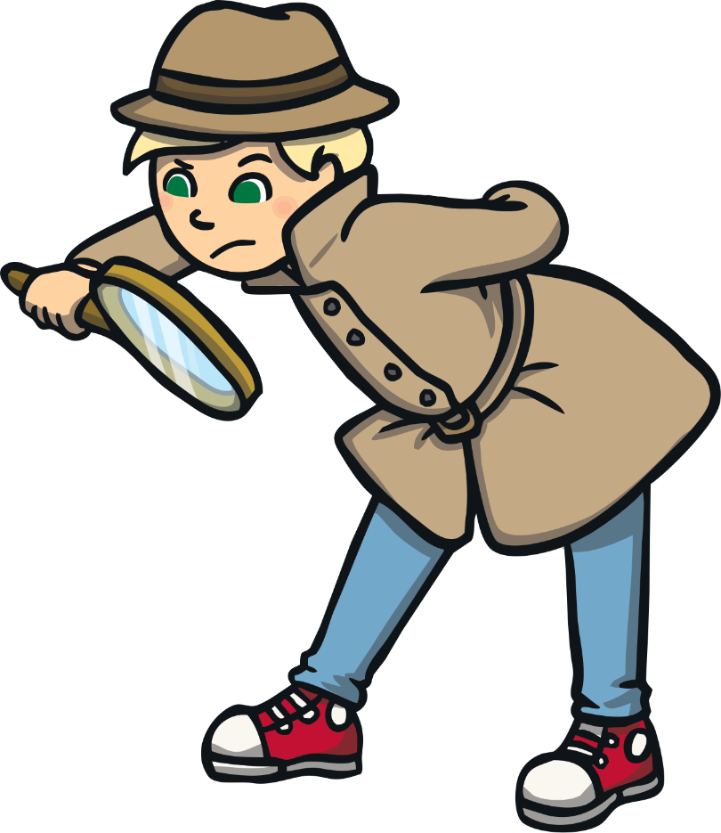
United Kingdom
The official name of the UK is ‘The United Kingdom of Great Britain and Northern Ireland’.
Scotland
Northern
Ireland
England
Wales

Slide 3
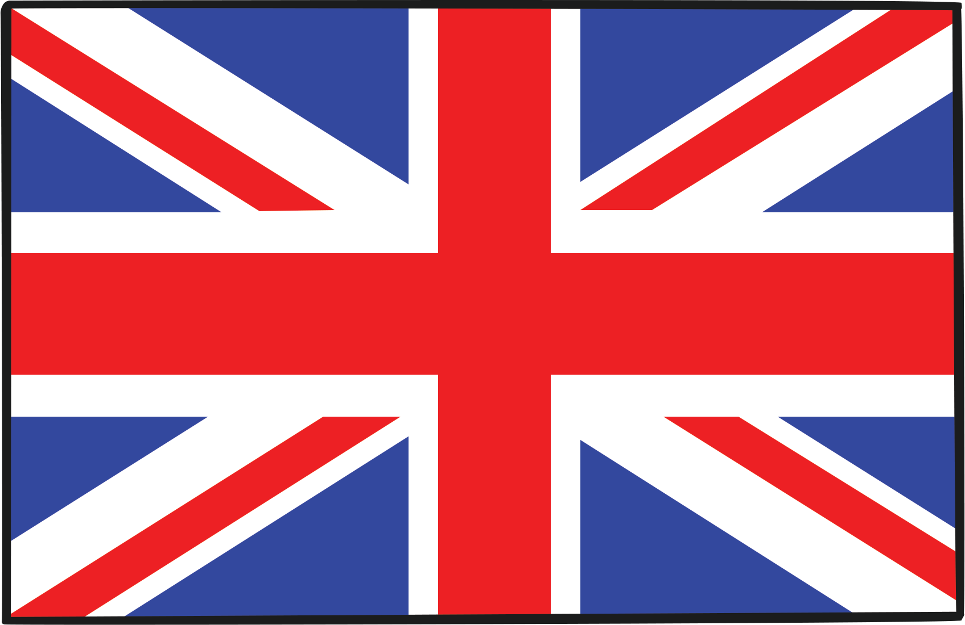
Union Jack
The official flag is the Union Flag, nicknamed the Union Jack.
It was designed to include the English, Scottish, Welsh and Northern Irish flags.

Slide 4

Population
England has the largest population (number of people who live there) in the UK.
The population of the UK is around 64 million!

Slide 5
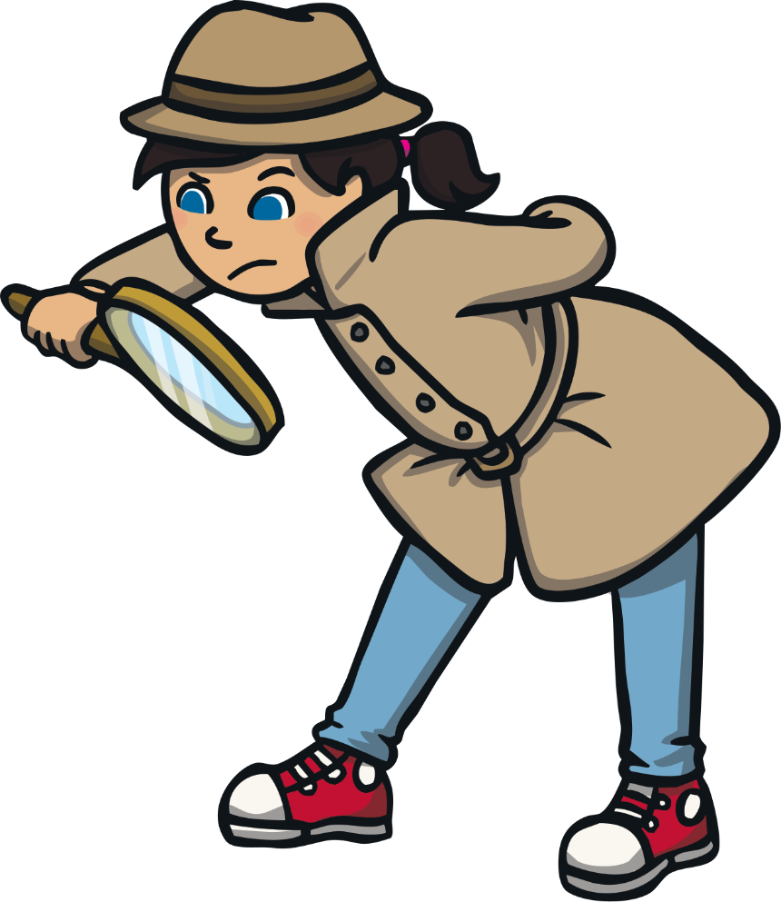
Islands of the United Kingdom
Many small islands belong to the UK, such as the Isle of Wight.
Isle of
Wight

Slide 6
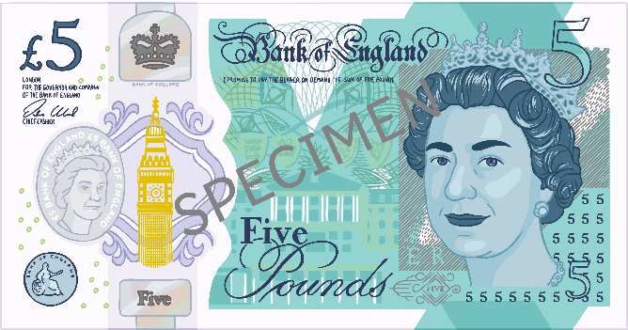
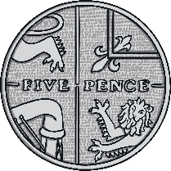
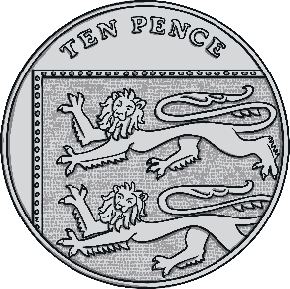
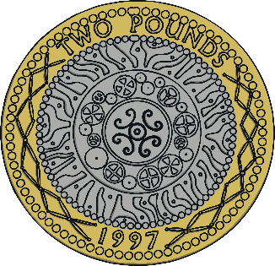
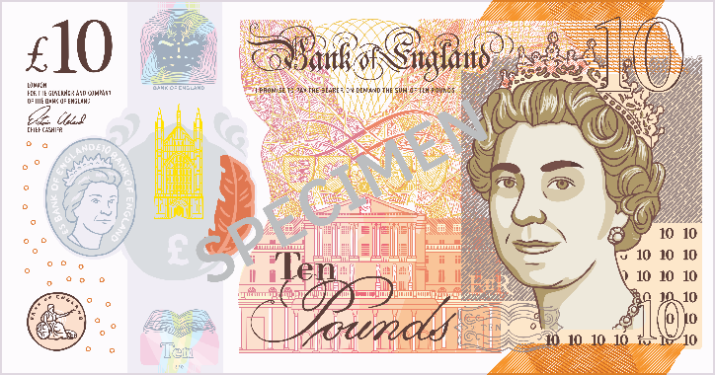
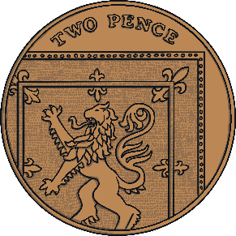
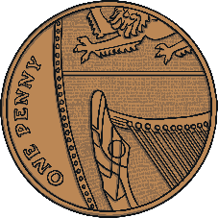
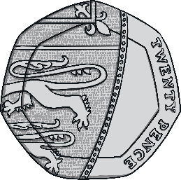
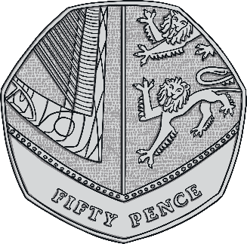
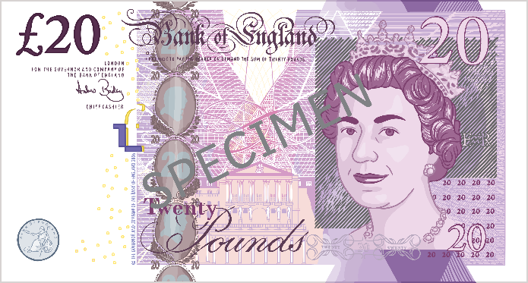
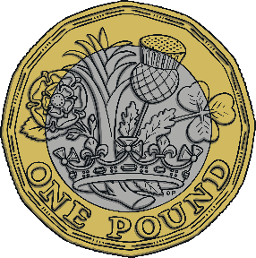
Currency
The currency in the UK is the pound sterling.

Slide 7
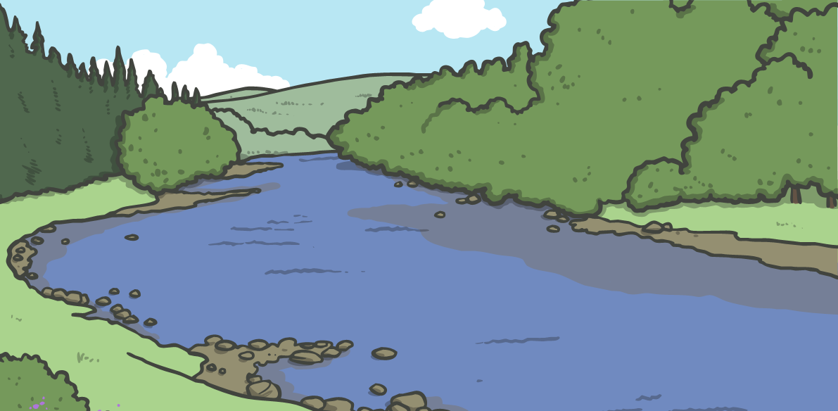
Rivers
The longest river is the River Severn. Other main rivers are the Thames, Tay and Tyne.

Slide 8
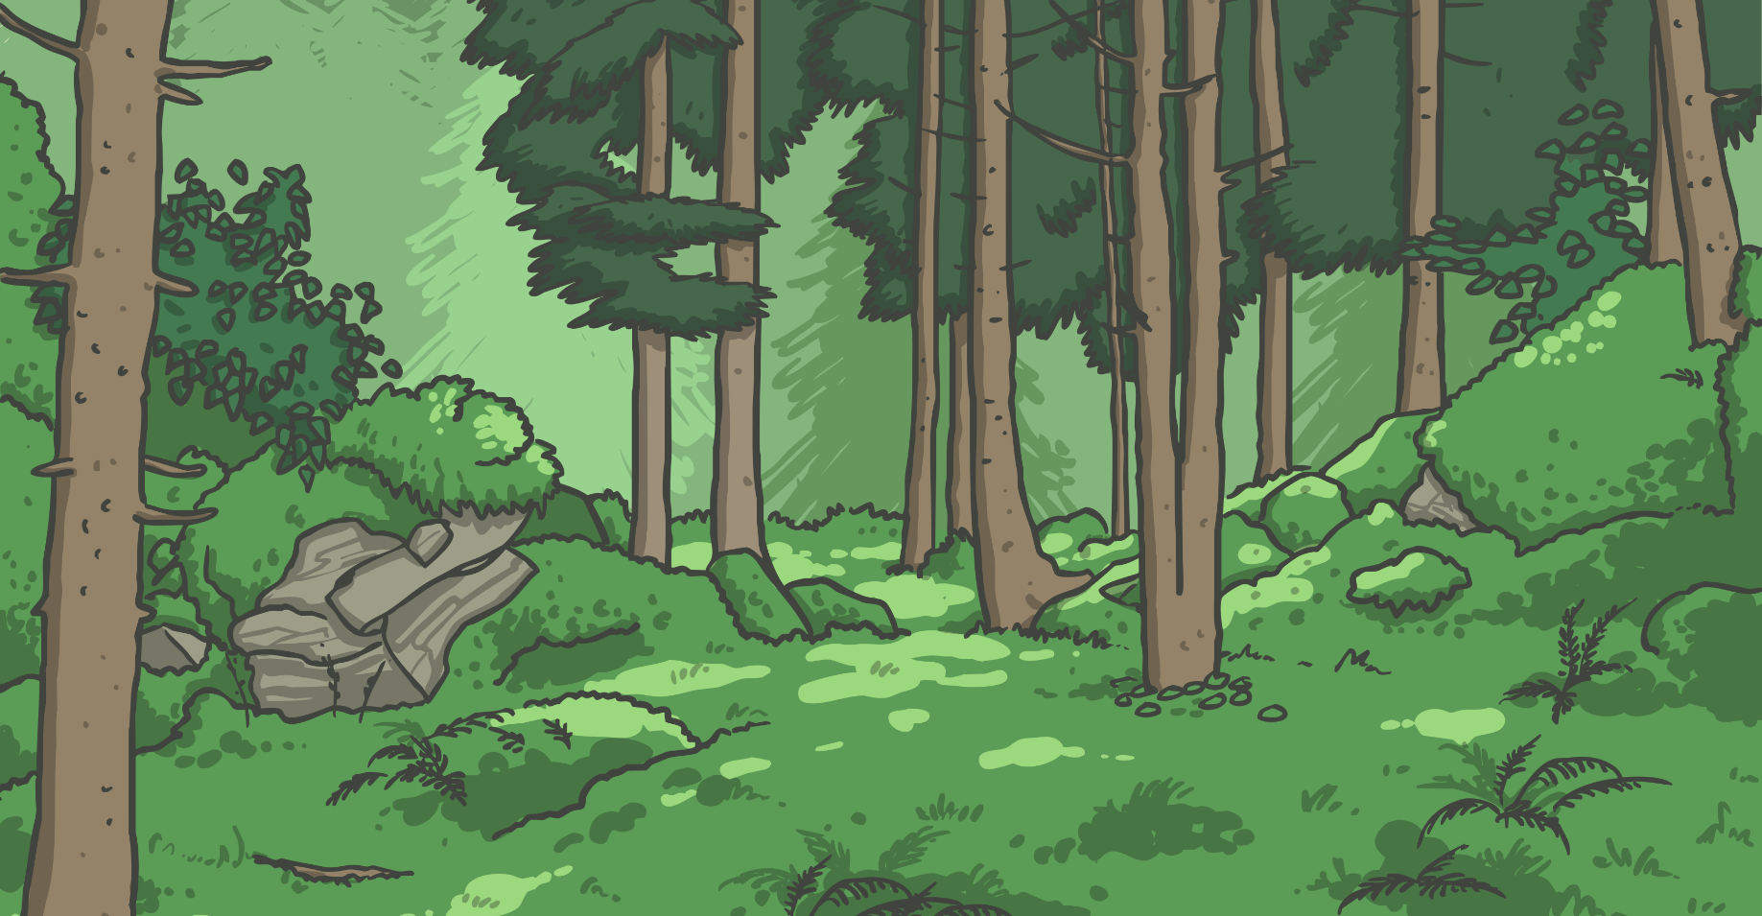
History
5,000 years ago the UK was covered in thick forest.

Slide 9
Ben Nevis
The mountain, Ben Nevis is the highest point in the UK at 1344m.

Slide 10
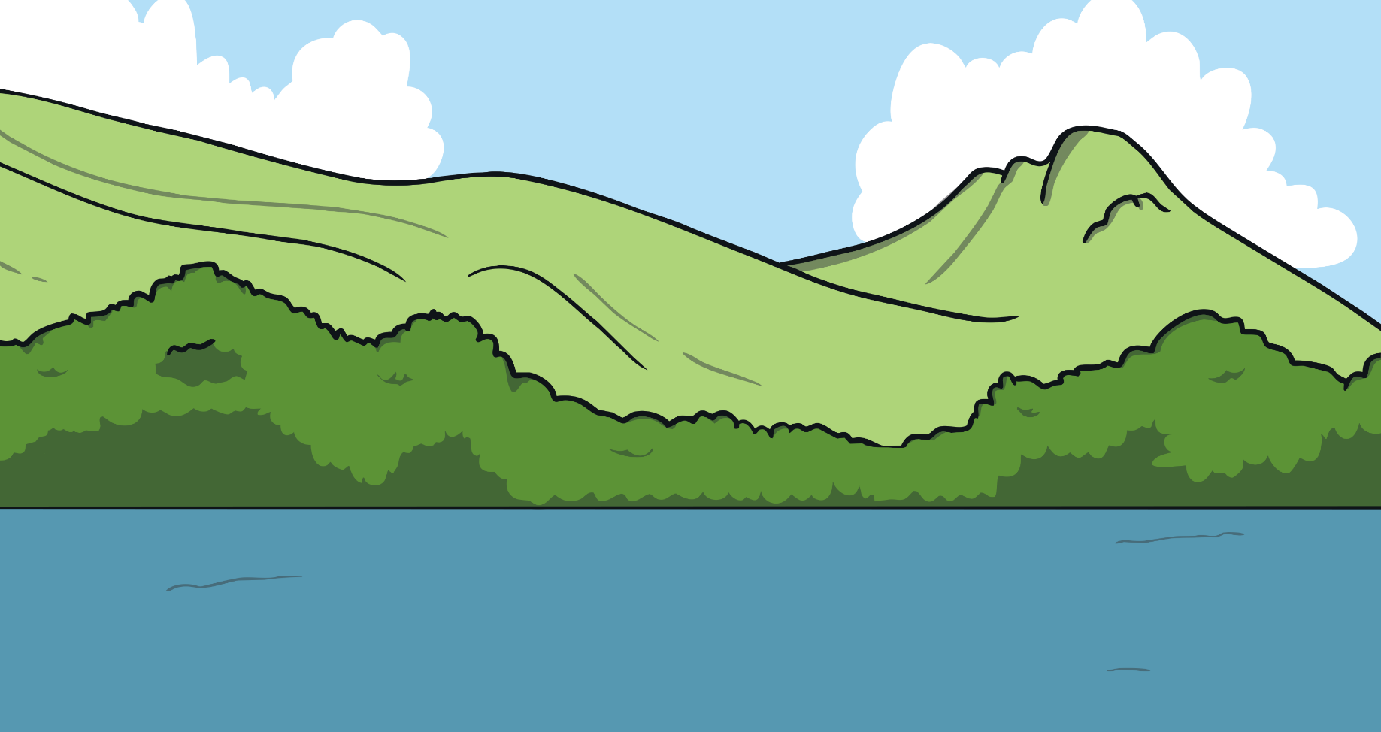
Lough Neagh
The largest lake is Lough Neagh, Northern Ireland at 151 square miles.

Slide 11
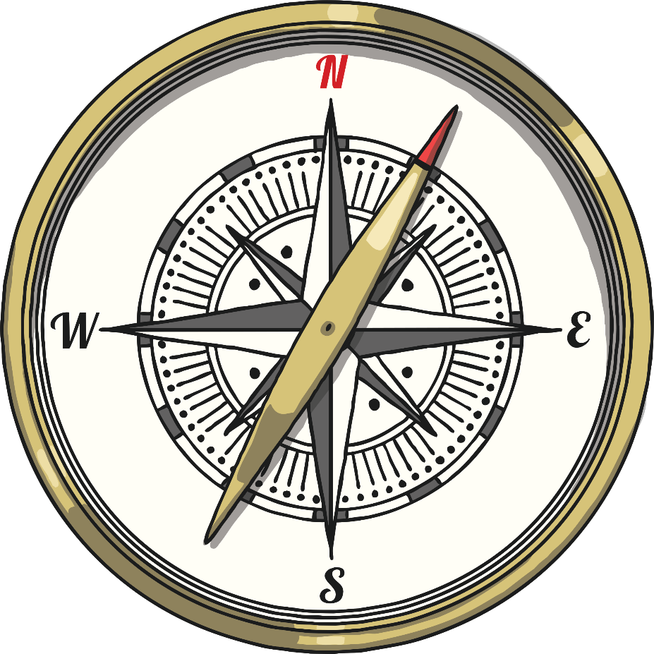
Dunnet Head
The most northern point is Dunnet Head in the North of Scotland.

Slide 12
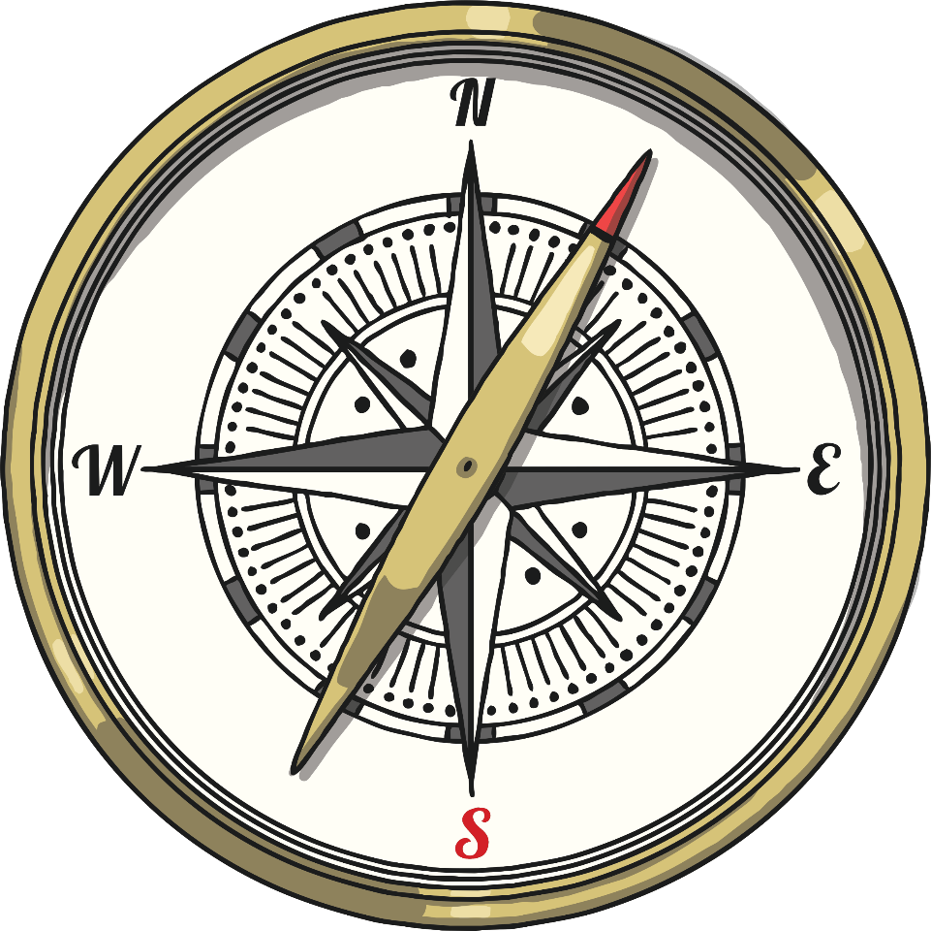
Lizard Point
The most southern point is Lizard Point in Cornwall.

Slide 13

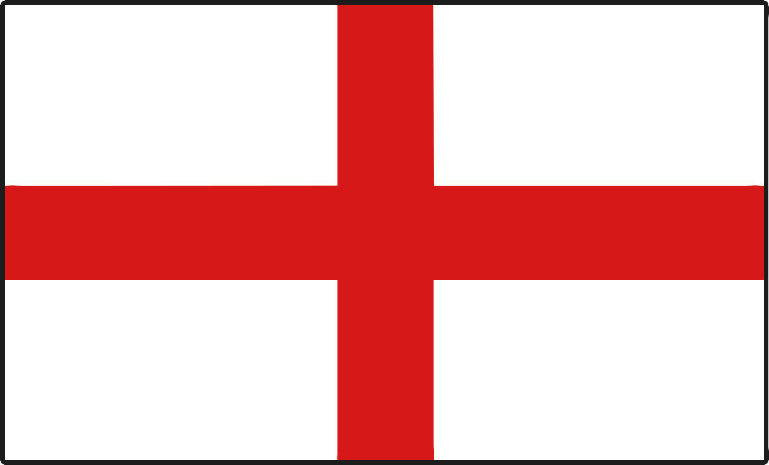
England National Flower
A rose is the English national flower.

Slide 14

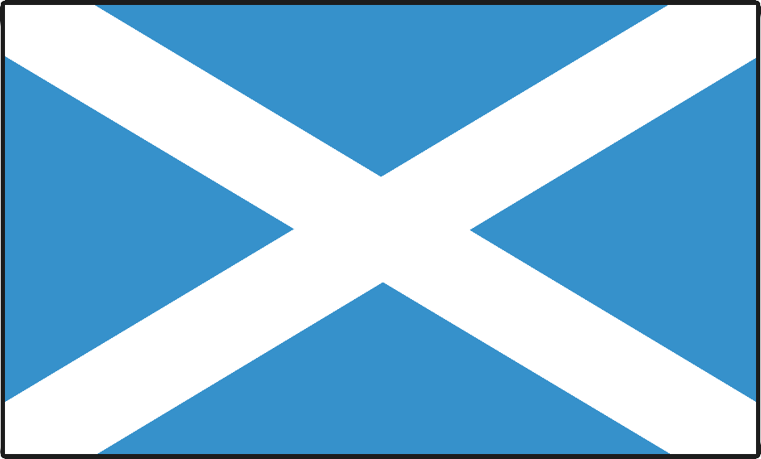
Scotland National Flower
A thistle is the Scottish national flower.

Slide 15

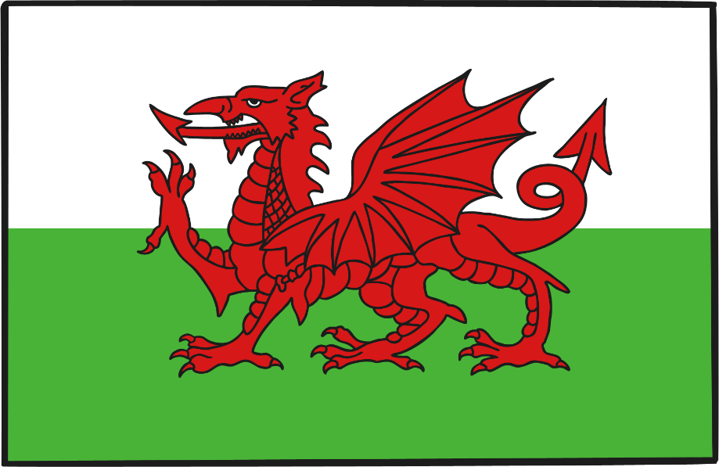
Wales National Flower
A daffodil is the Welsh national flower.

Slide 16
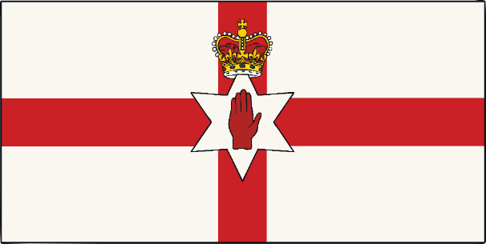
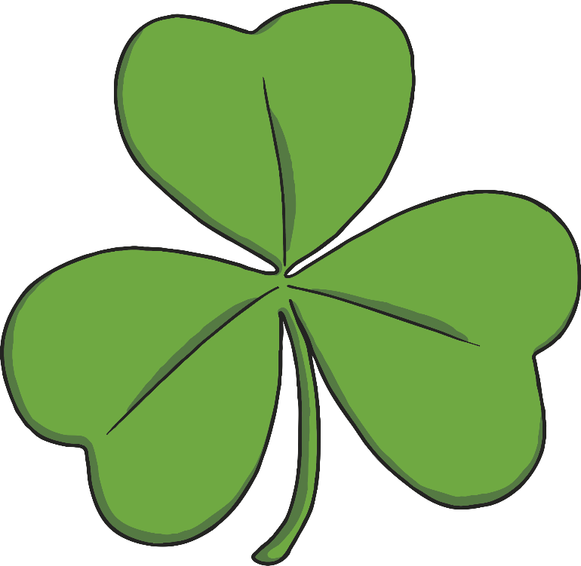
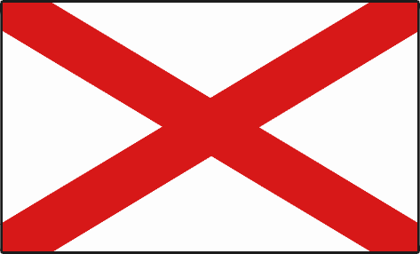
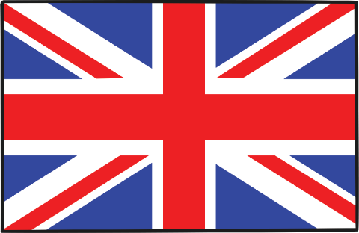
Northern Ireland National Flower
A shamrock is the Northern Irish national flower.

Slide 17
UK Cities
Top 5 biggest Cities of the UK:
London
Birmingham
Glasgow
Leeds
Leeds
Manchester
Glasgow
Birmingham
London
Manchester

Slide 18
Capital Cities
England
London
Scotland
Edinburgh
Edinburgh
Belfast
Wales
Cardiff
Northern Ireland
Cardiff
London
Belfast

Slide 19
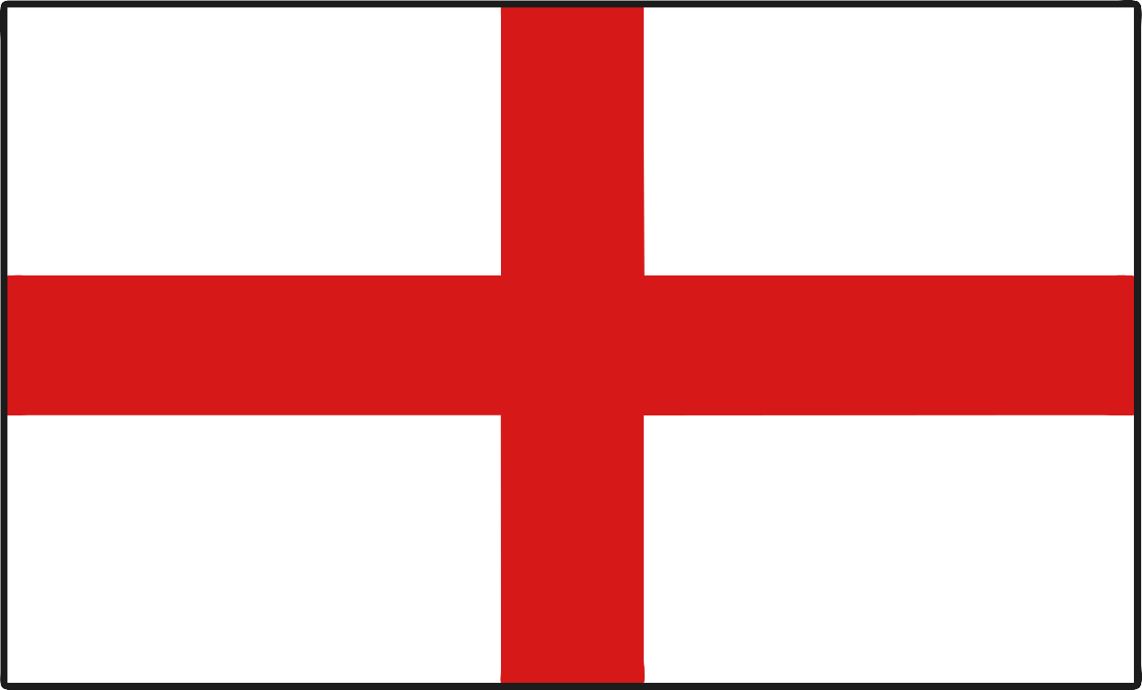
London
The capital city of England is London.

Slide 20
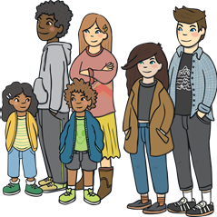
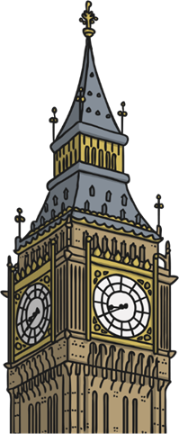
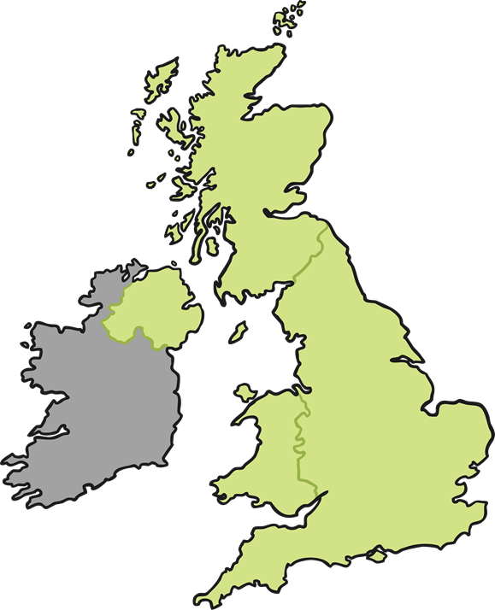
Facts about London
London is the biggest city in Britain and Europe. 8,900,000 people live in London (2018).
London

Slide 21
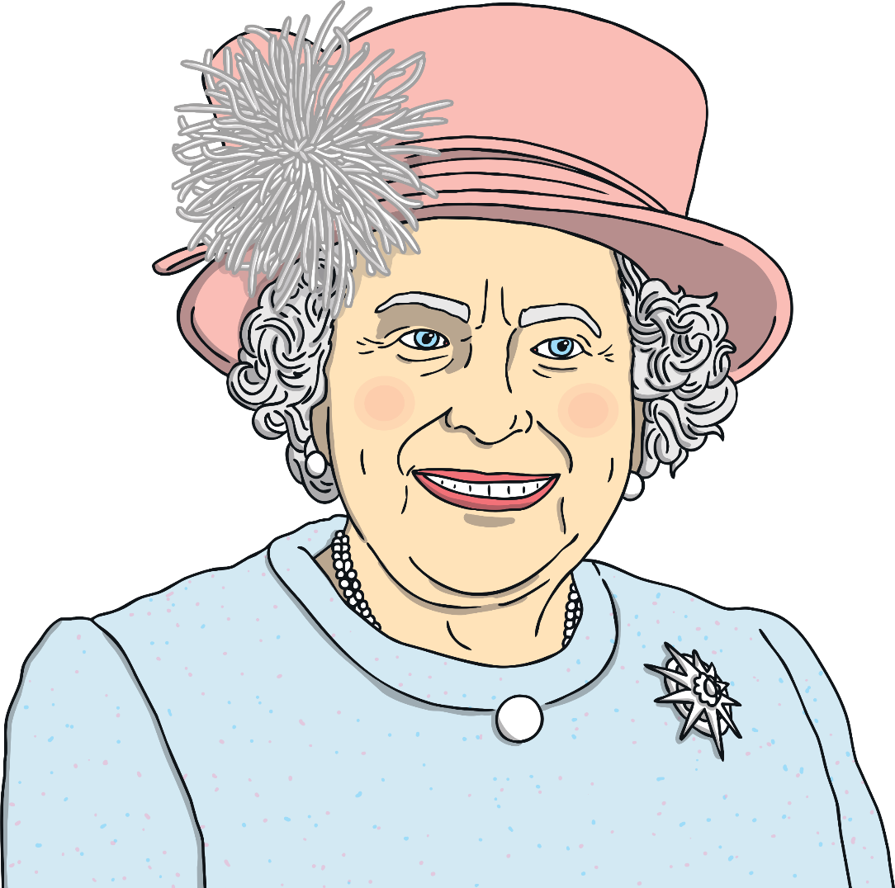
Queen Elizabeth II
Elizabeth II lives in London and is the Queen of the UK.

Slide 22
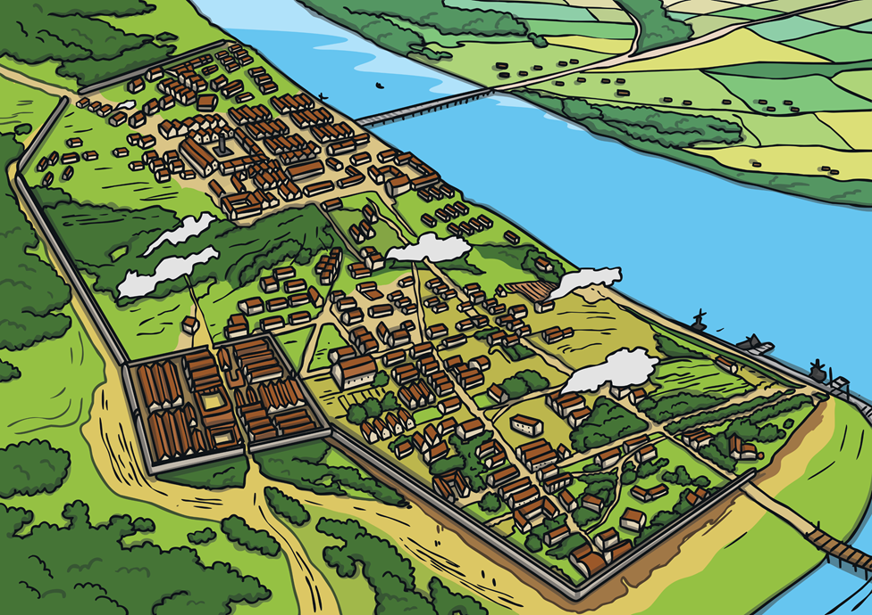
Invaders and Settlers
The Romans were first to settle where London is today, they named it Londinium.

Slide 23
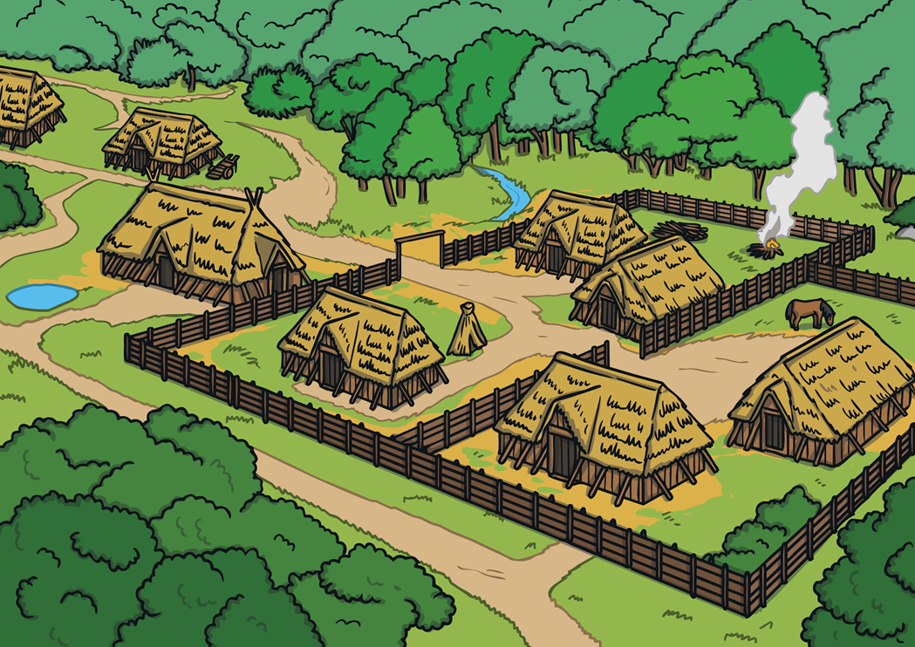
Invaders and Settlers
When the Saxons occupied London, it was known as Lundenwic.

Slide 24
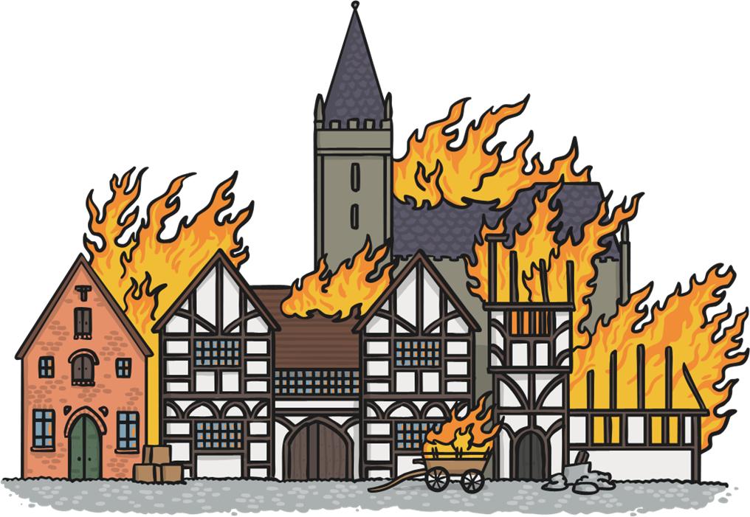
The Great fire of London
In 1666 the Great Fire of London swept through central parts of London. Much of the city had to be rebuilt.

Slide 25
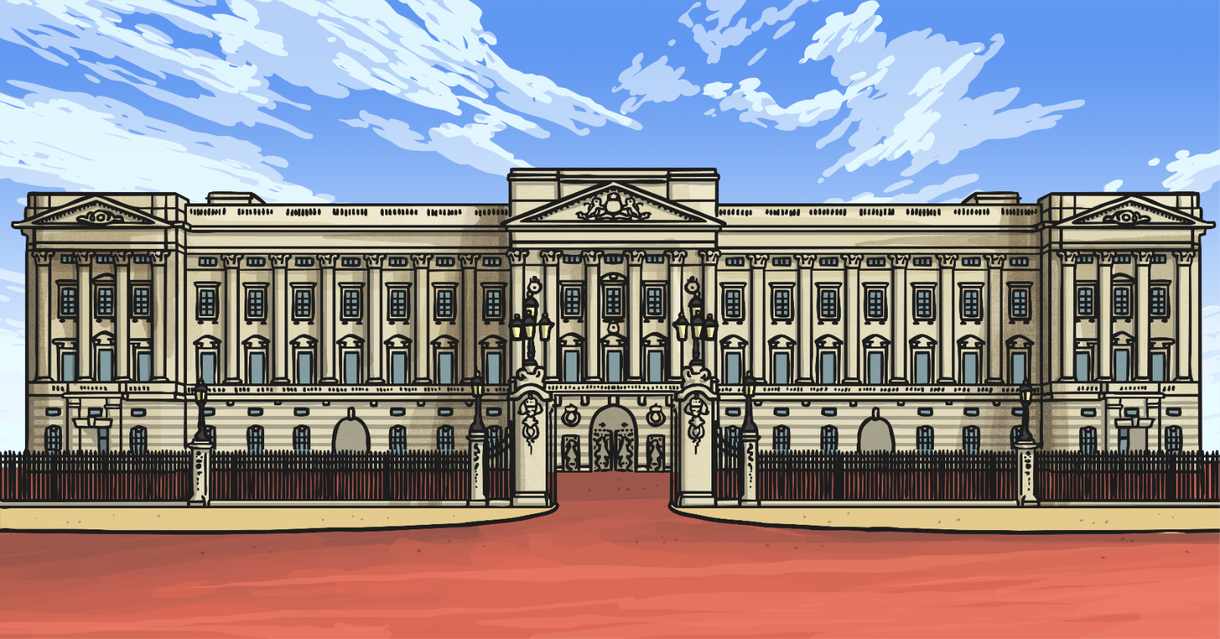
Buckingham Palace
The official London home of the Queen is Buckingham Palace. Buckingham Palace has 775 rooms including 52 royal and guest bedrooms, 188 staff bedrooms and 78 bathrooms.

Slide 26
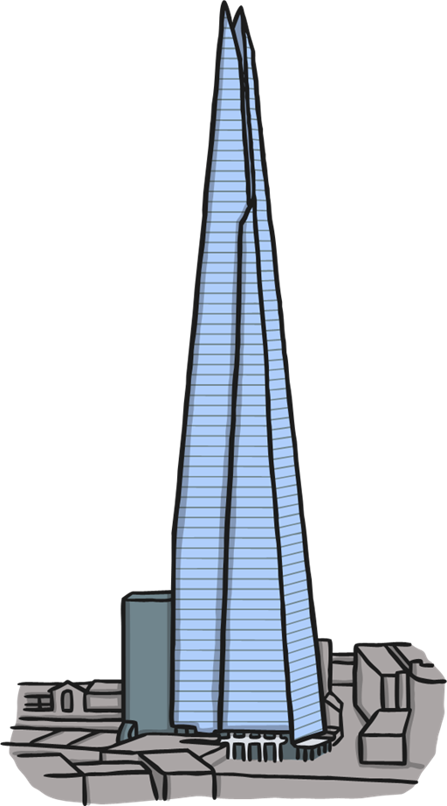
The Shard
The tallest building in London is The Shard, standing at 310 metres tall.

Slide 27
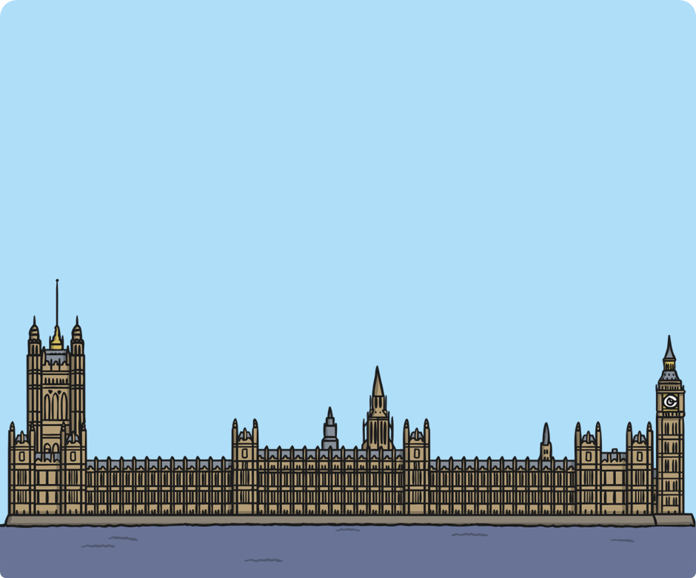
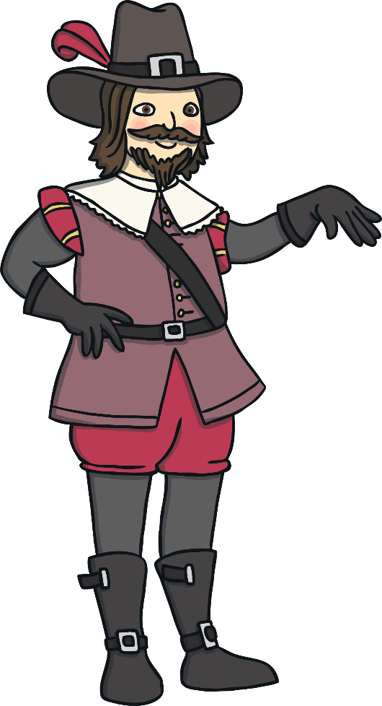
The Houses of Parliament
The Houses of Parliament (also known as Palace of Westminster) is the home to the English government. There are 1000 rooms, 100 staircases and 11 courtyards within The Houses of Parliament.
In 1605 a group including Guy Fawkes plotted to blow up Parliament. Fortunately, they were caught before this could happen.

Slide 28
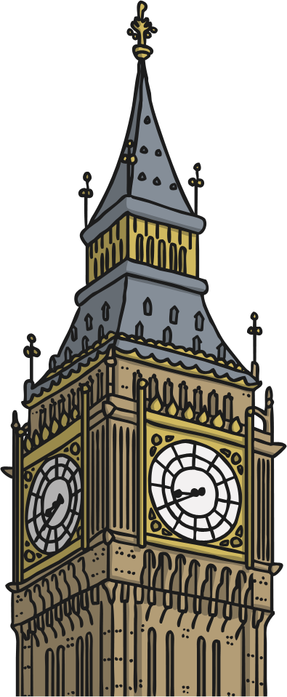
Big Ben
The tower is known as Elizabeth Tower but most people call it Big Ben. However, Big Ben is actually the name of the 13-ton bell inside the clock.

Slide 29
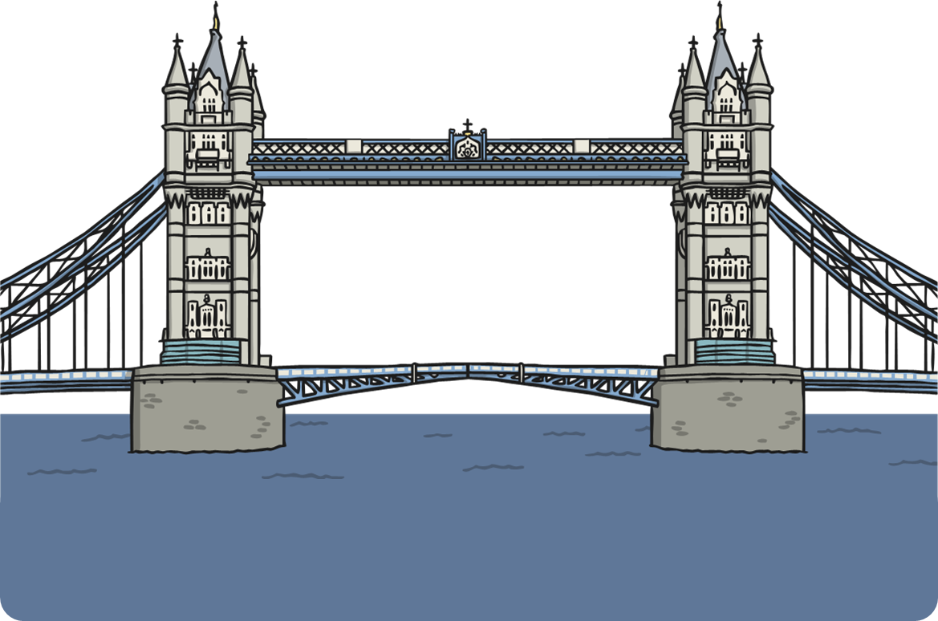
Tower Bridge
Tower Bridge, standing at 244m high, was opened in 1894. It is named after The Tower of London.

Slide 30
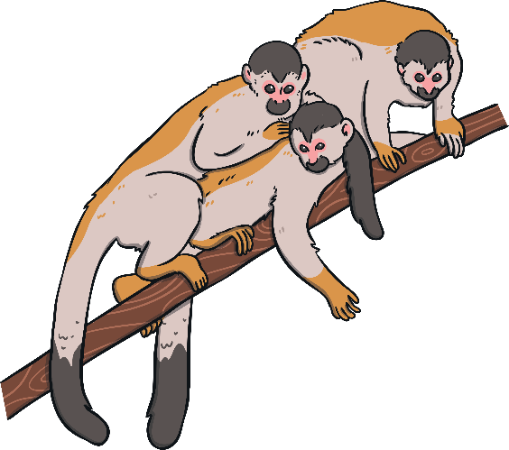
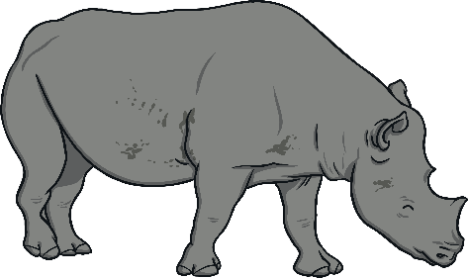
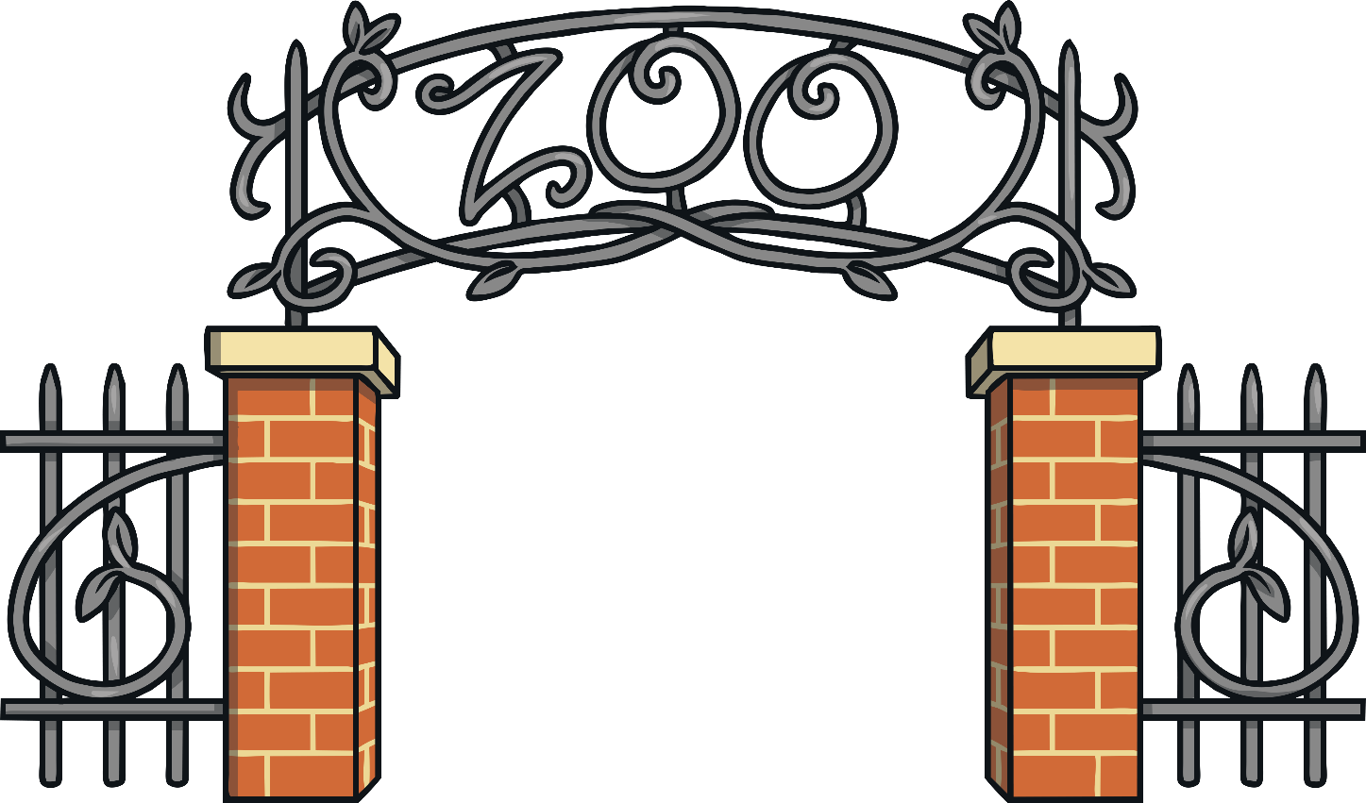
London Zoo
London Zoo was the world’s first public zoo. It opened in 1829.

Slide 31
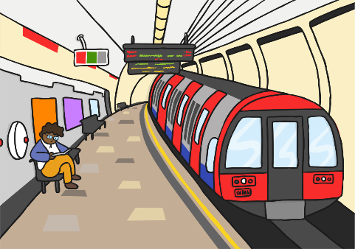
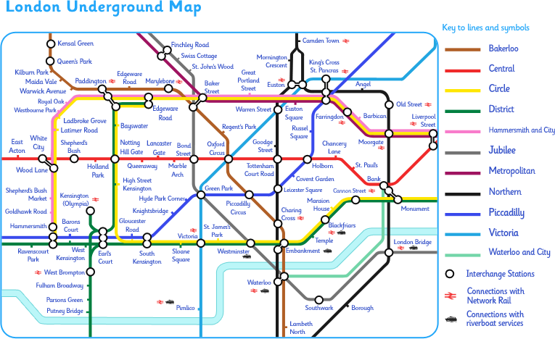
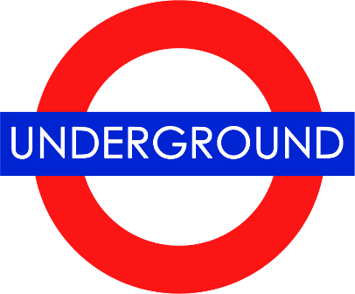
London Underground
The London Underground is the oldest underground railway network in the world.

Slide 32
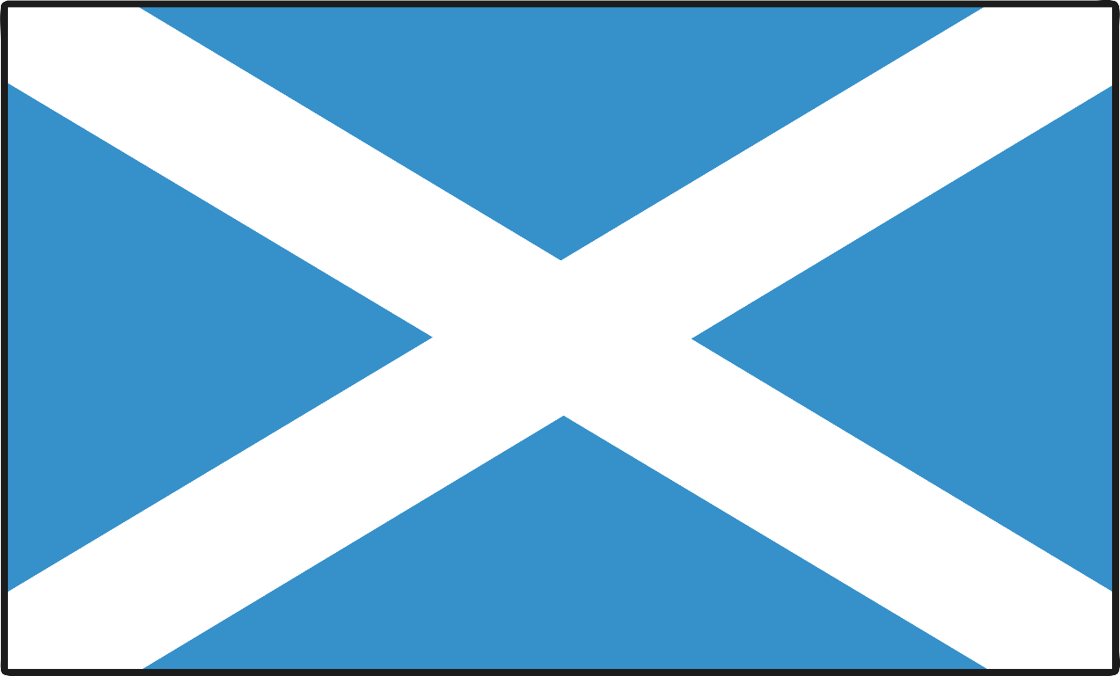
Edinburgh
The capital city of Scotland is Edinburgh.

Slide 33
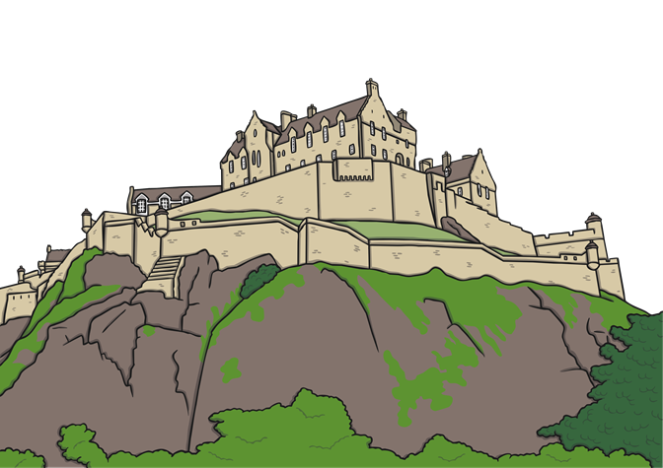
Facts about Edinburgh
Edinburgh is the second biggest city in Scotland. It is estimated 489,000 people live in Edinburgh (2019).
The main spoken language is English. In addition to this 1.4% of the population also speak Gaelic.
Edinburgh

Slide 34
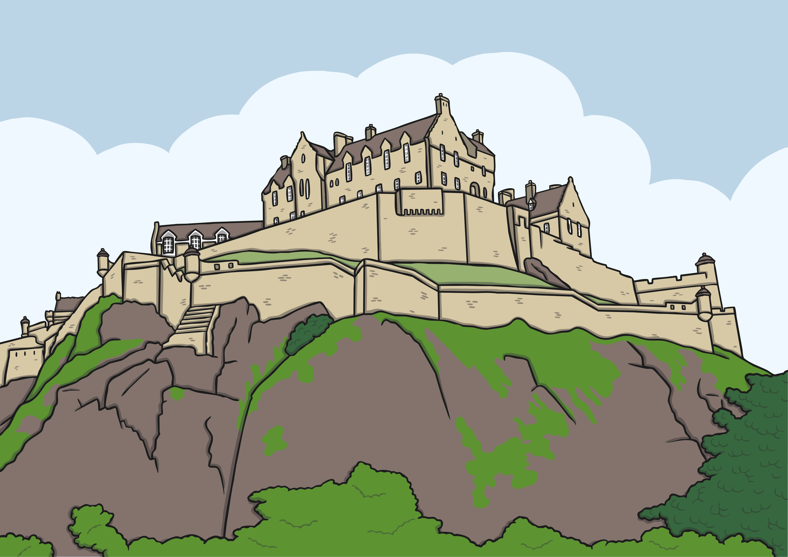
Edinburgh Castle
Edinburgh castle is built on an extinct volcano.

Slide 35

Edinburgh Fire Service
Edinburgh was the first city in the world to have its own fire service.

Slide 36

Alexander Graham Bell
Alexander Graham Bell, who invented the telephone, was born in Edinburgh.

Slide 37

Cardiff
The capital city of Wales is Cardiff. It is the smallest capital city in Europe.

Slide 38

Facts about Cardiff
Cardiff is the largest city in Wales. It is estimated that 477,627 people live there (2020). The main spoken language is English and only 10% of the population in Cardiff speaks Welsh.
Cardiff

Slide 39



City of Castles
There are three castles still standing in Cardiff: Cardiff Castle, St Fagan’s Castle and Castell Coch Castle.
Cardiff Castle
St Fagan’s Castle
Coch Castle

Slide 40

Roald Dahl
Roald Dahl, a famous children’s author, was born in Cardiff.

Slide 41


The Principality Stadium
The Principality Stadium is home of the Welsh national rugby team. It was opened in 1999 and used to be known as the Millennium Stadium.

Slide 42



Belfast
The capital city of Northern Ireland is Belfast.

Slide 43

Facts about Belfast
Please include an illustration of a UK map labelling Belfast and some people alongside to show population
Belfast
Belfast is the largest city in Northern Ireland.
It is estimated 585,000 live in and around the Belfast area (2019).

Slide 44


C.S Lewis
CS Lewis, author of The Chronicles of Narnia, was born in Belfast.

Slide 45

The Titanic
The world famous ship, The Titanic, was constructed in Belfast.

