Slide 1
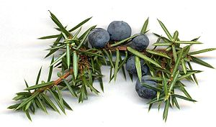
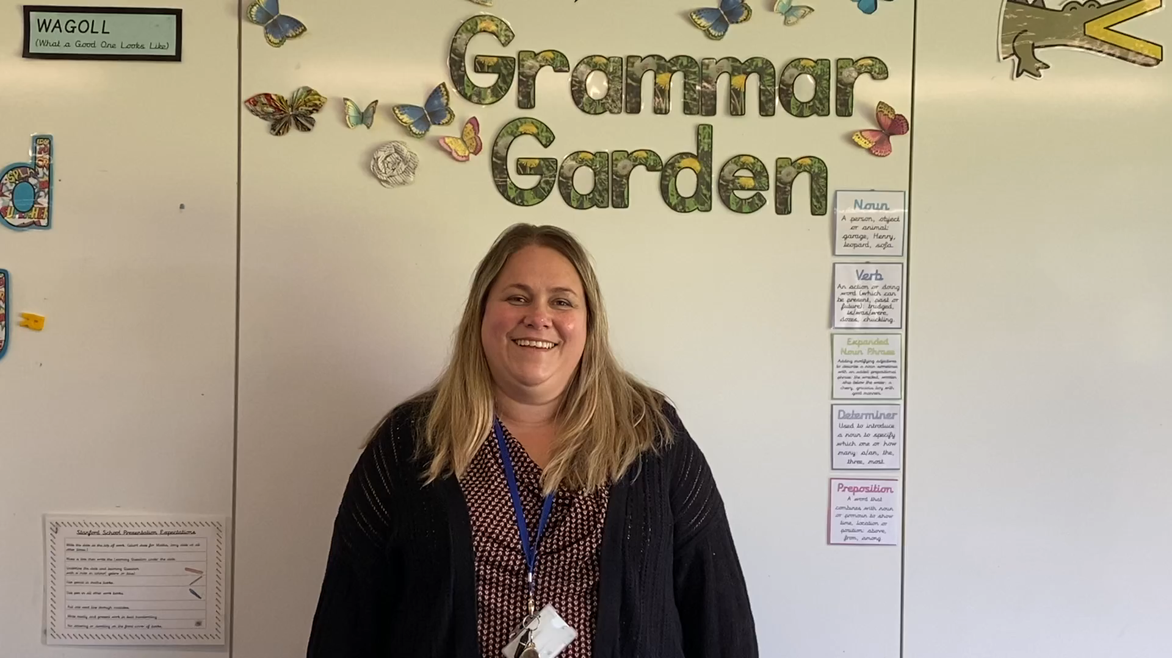
Welcome to Juniper Class

Slide 2
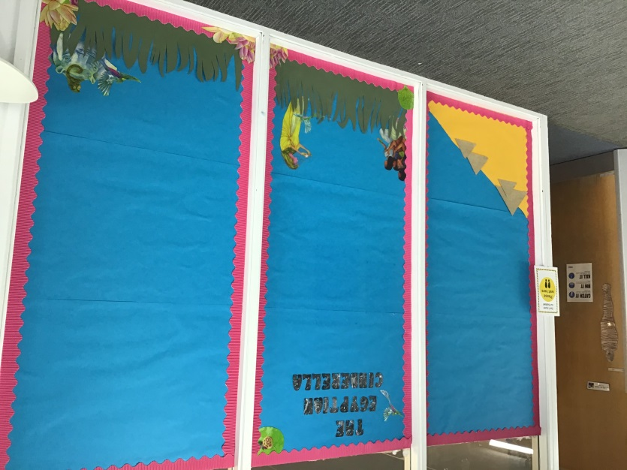
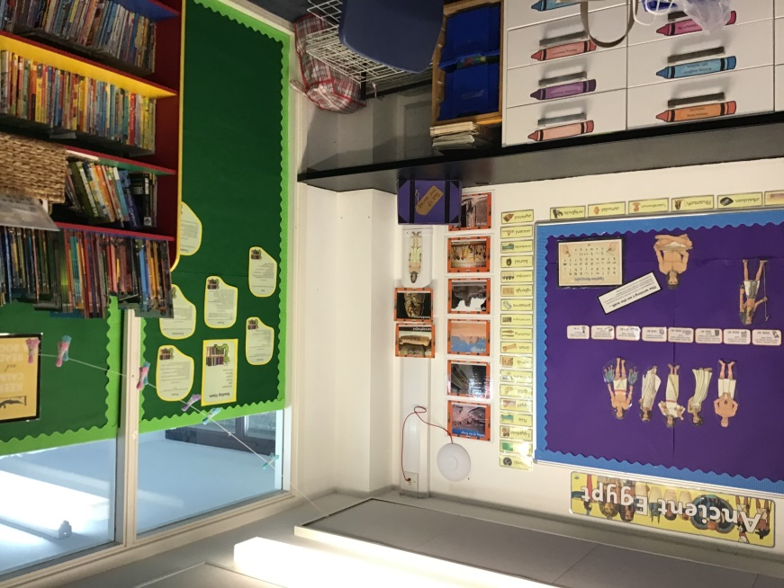
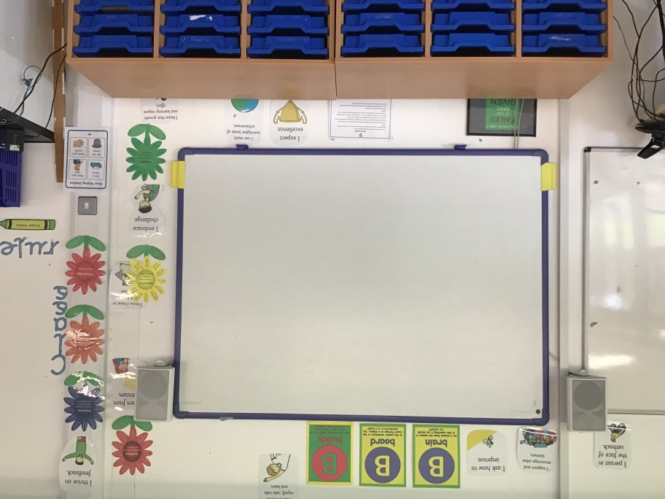
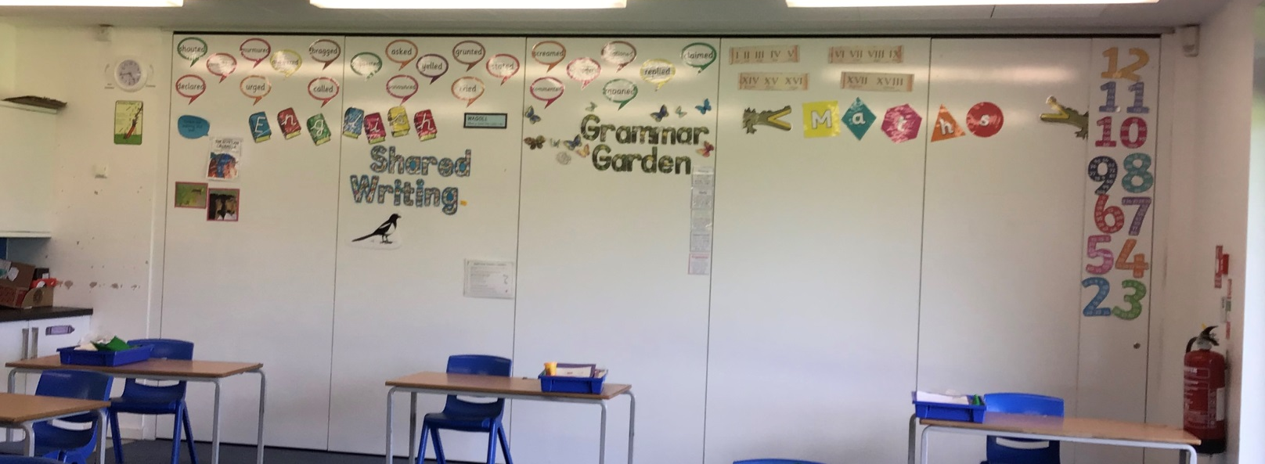
Our classroom…..
All ready for you in September.

Slide 3
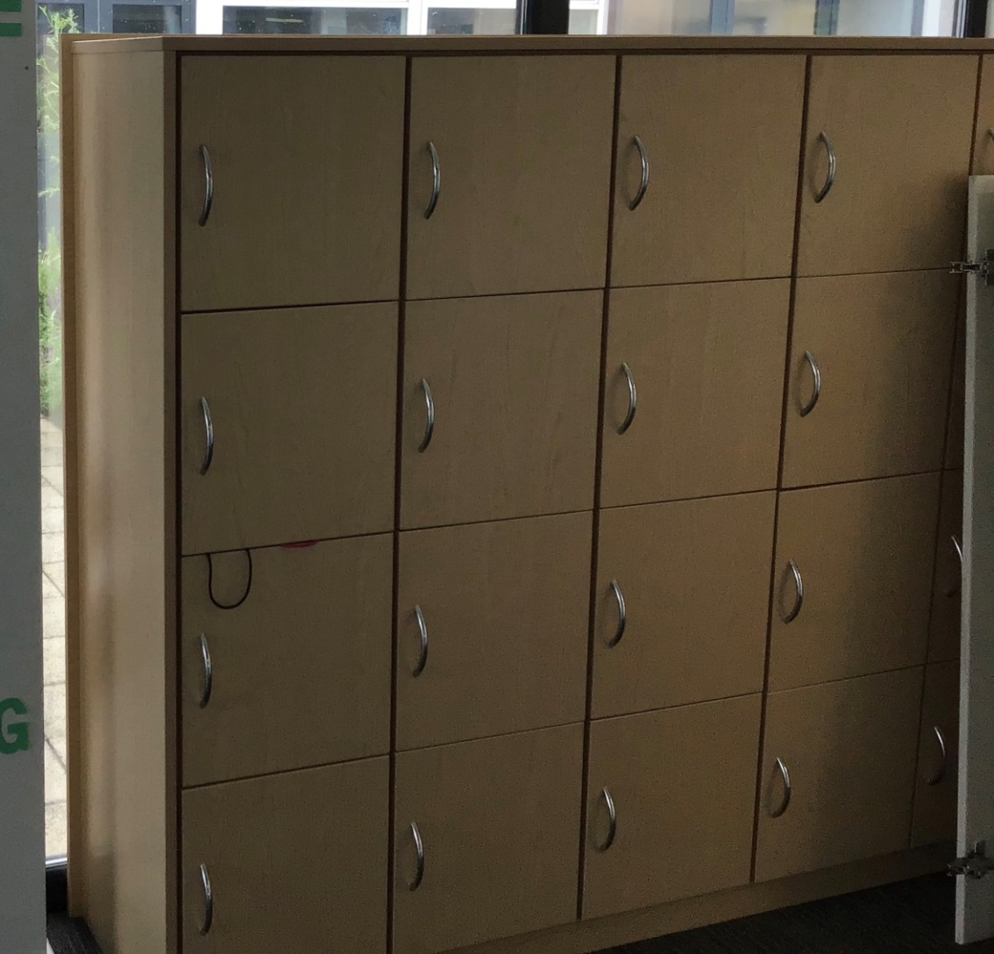
These are our lockers.
(There isn’t lots of space so please only bring to school what you really need.)

Slide 4
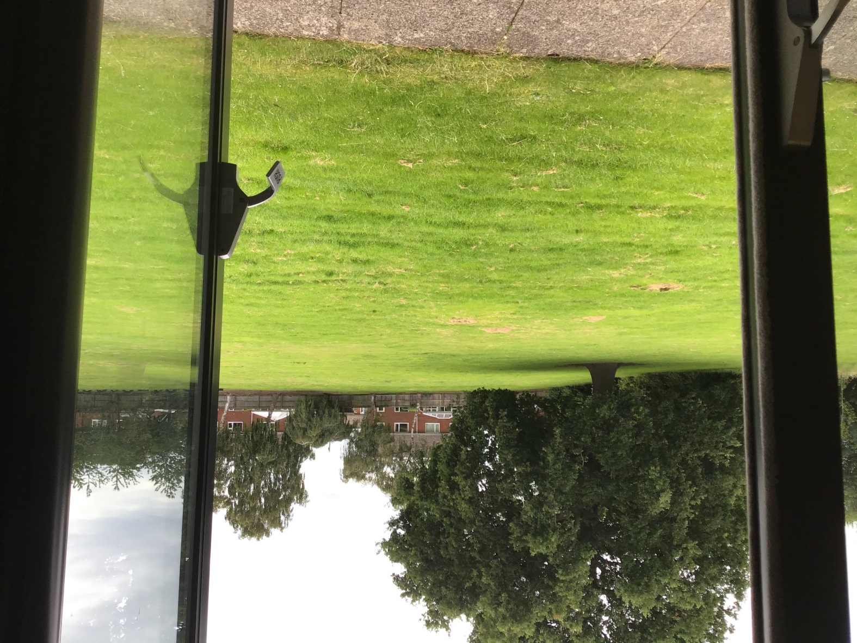
Our Classroom opens up onto the field which is fantastic for outdoor learning.

Slide 5

We will be using our Learning Powers to help us.

Slide 6
Our learning is going to be really interesting and fun.
In the Autumn term our learning journey will start by :
* Exploring the text “The Egyptian Cinderella”
*Learning to “Talk like an expert” – improving our vocabulary
*Developing our understanding of place value – Hundreds, Tens and ones
*Investigating about forces and magnets
* Learning about Ancient Egypt
* Getting creative with clay
*Recognising what they are good at; setting goals. Describing feelings; conflicting feelings and how to manage feelings
*Keeping safe – online safety
*exploring Hinduism – Believing How are deities and key figures described in Hindu sacred texts and stories?

Slide 7




Staying safe in the classroom
We need good hygiene at all times

Slide 8
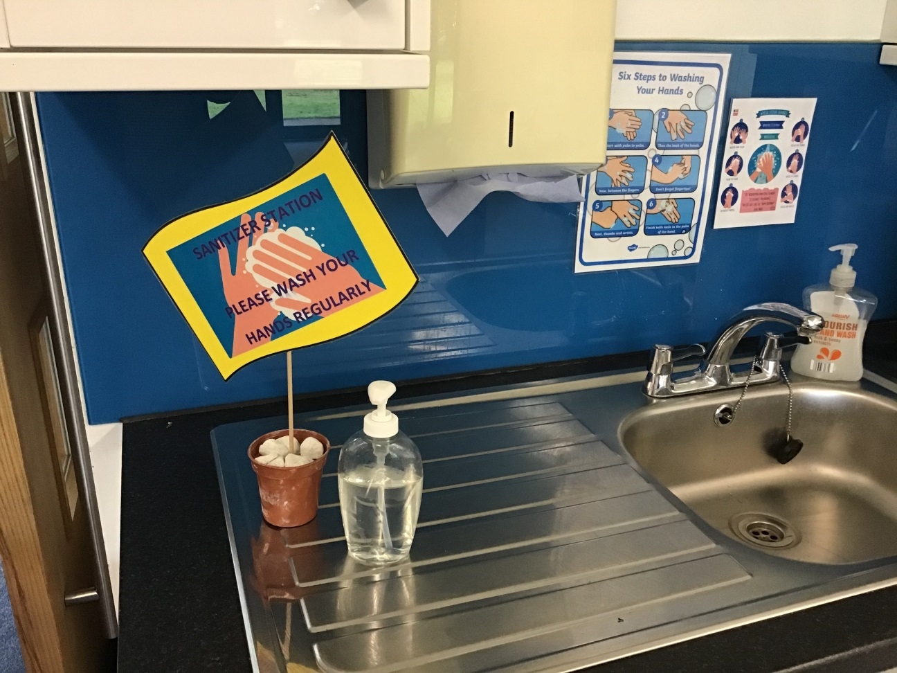
Every classroom has a hand washing station
There are hand gel stations round the school

Slide 9
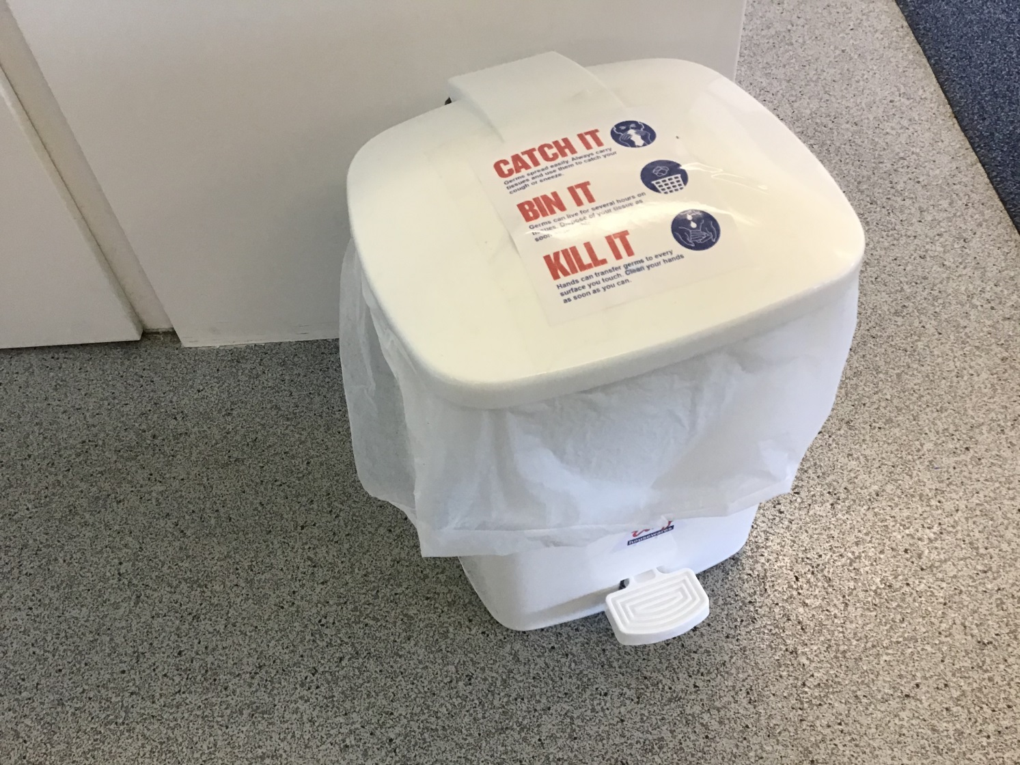
If you use a tissue please place in the special lidded bin

Slide 10
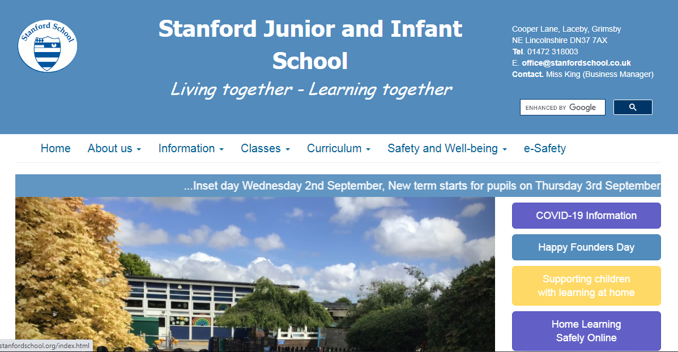
Remember to look at our Class blog for the most up-to-date information.

Slide 11
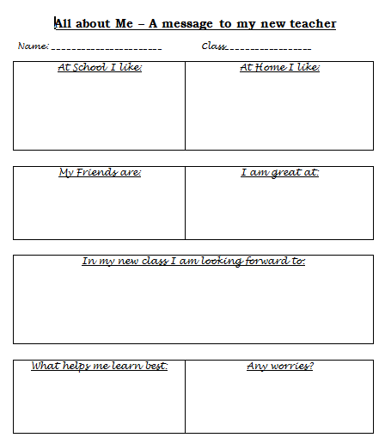
All about
You
I am looking forward to getting to know you.
It would be fabulous if you could complete your “All about me” message.

Slide 12

Wishing you a happy and safe Summer Holidays.
See you all in September.
Mrs Hill

