Slide 1
Welcome to Pumpkin Class!

Slide 2
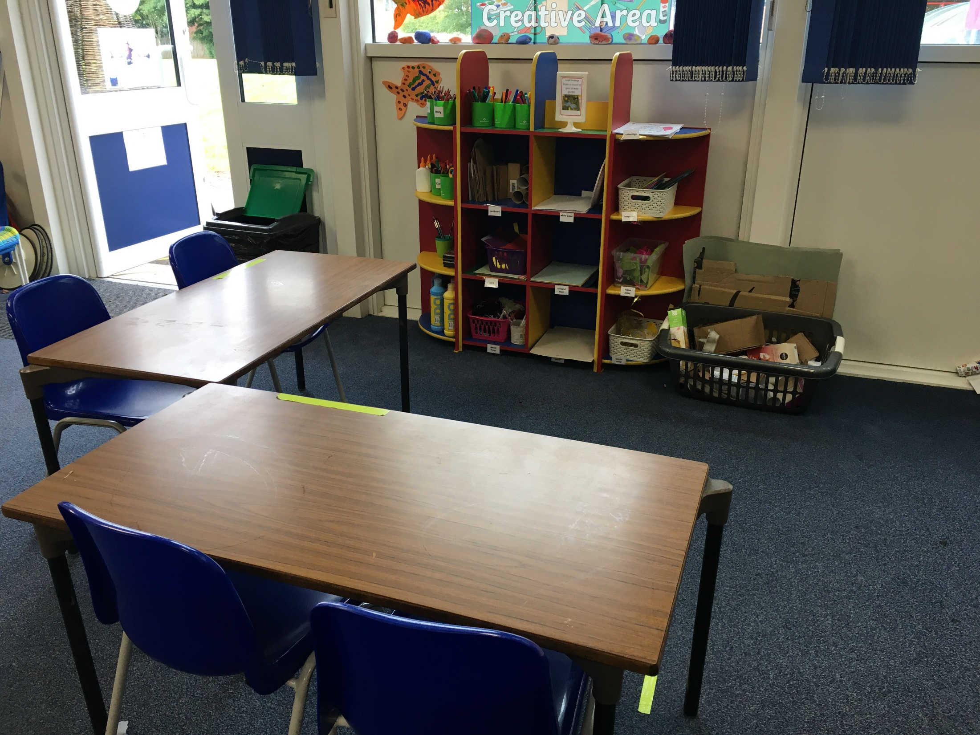
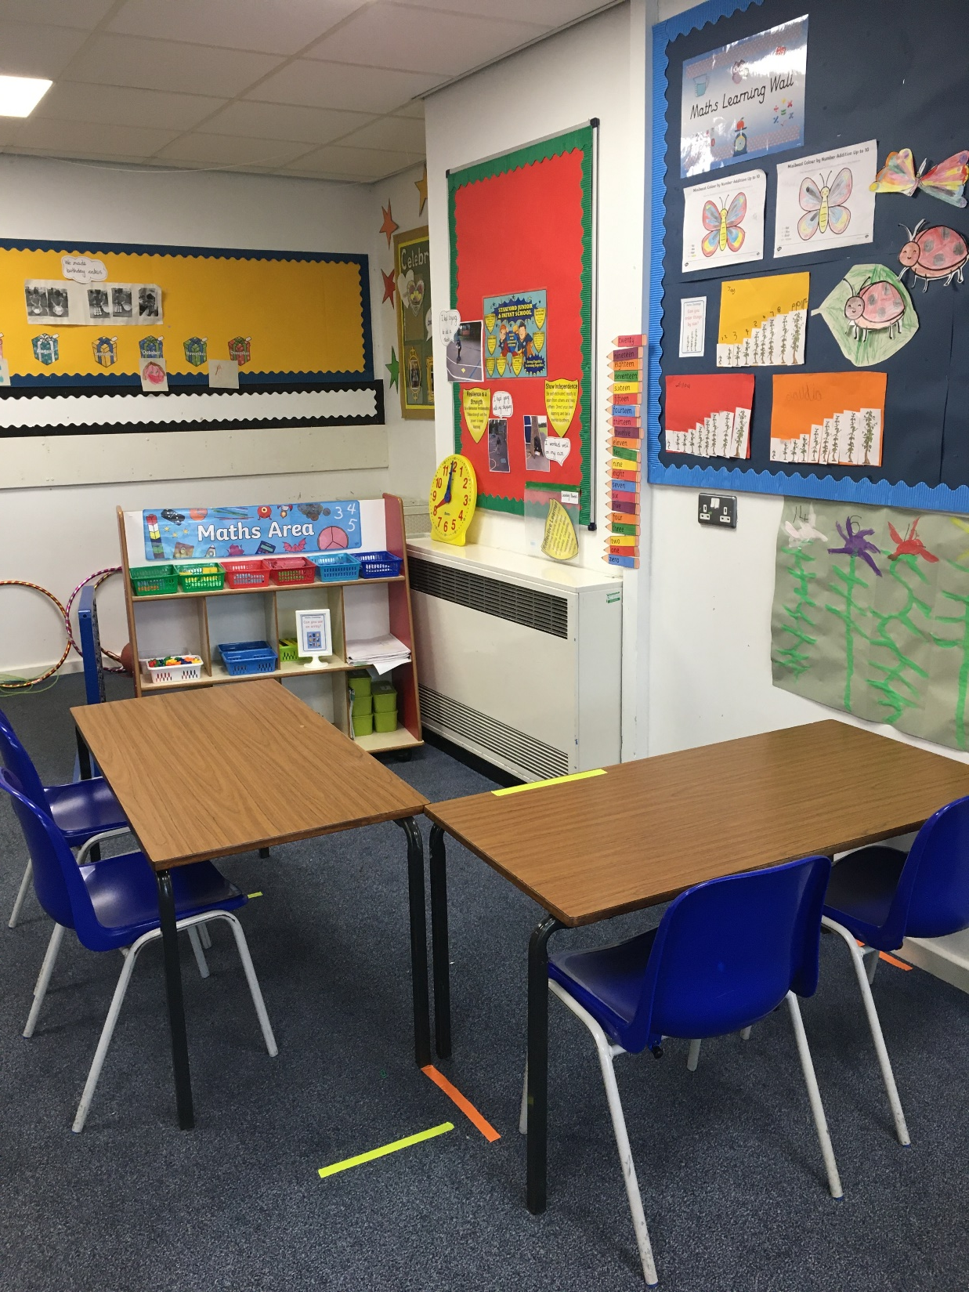
Our classroom
is ready for you.

Slide 3
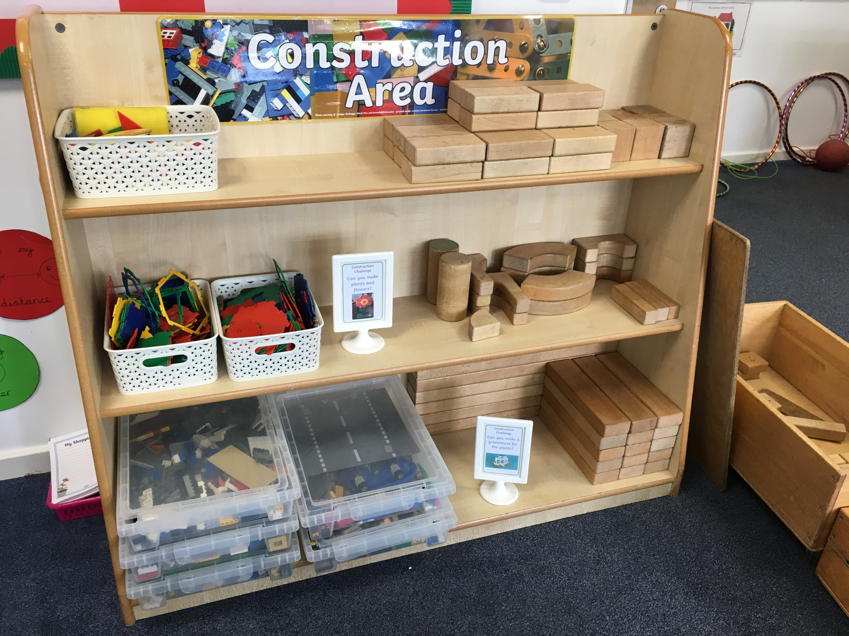
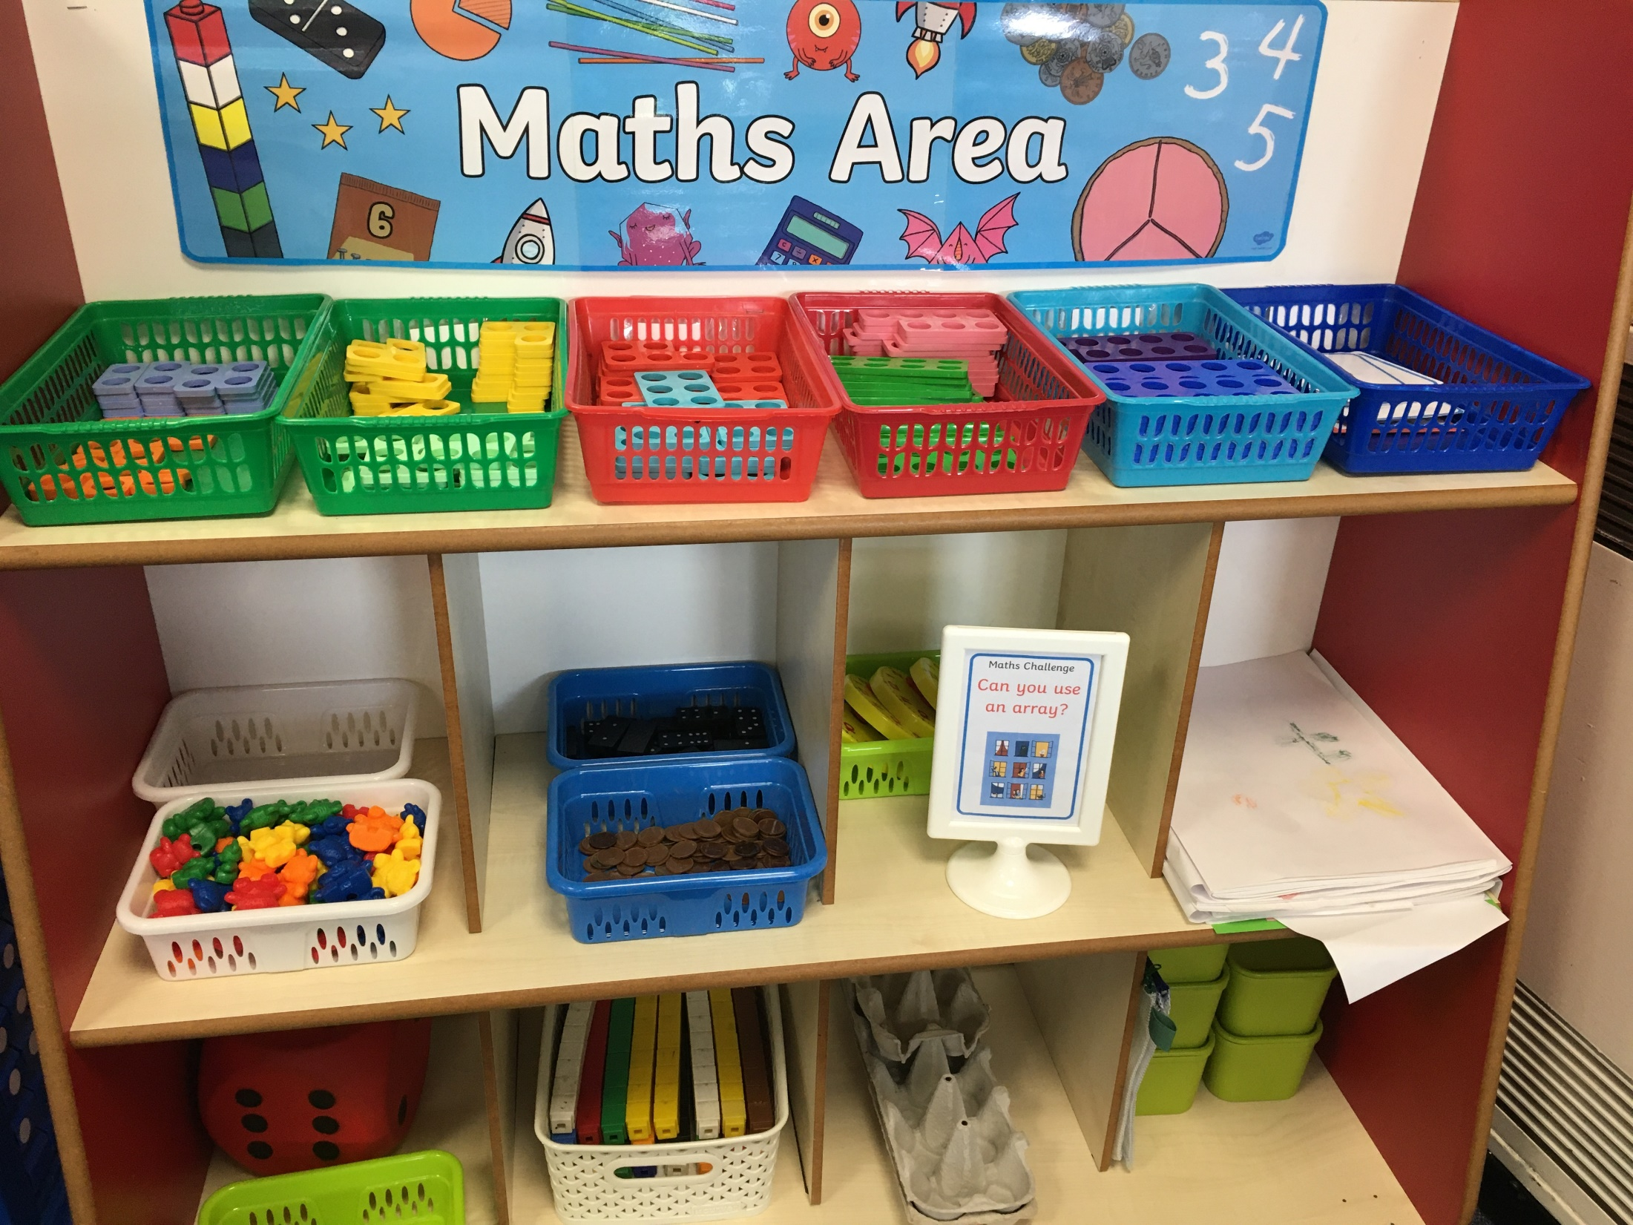
In Pumpkin classroom there are different areas where you can do your learning.

Slide 4
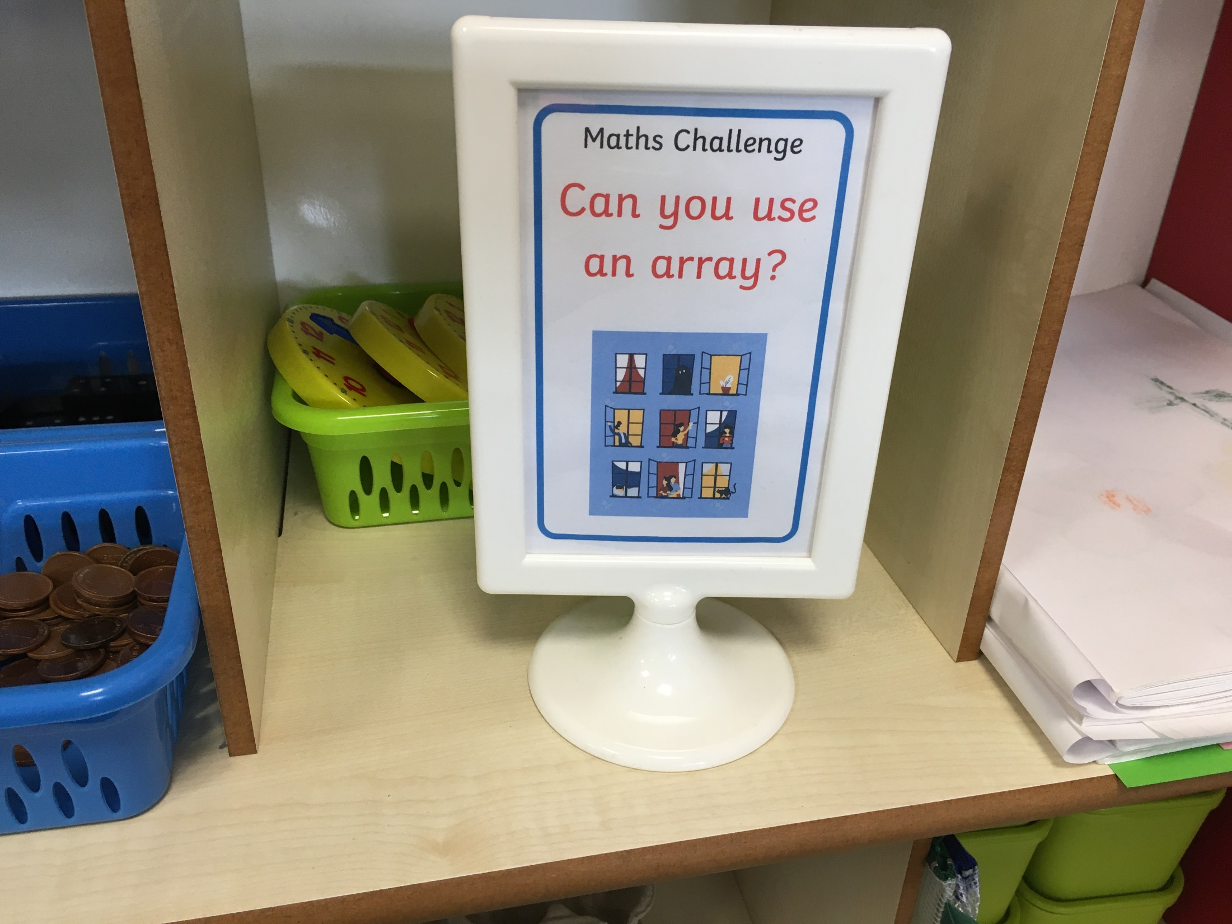
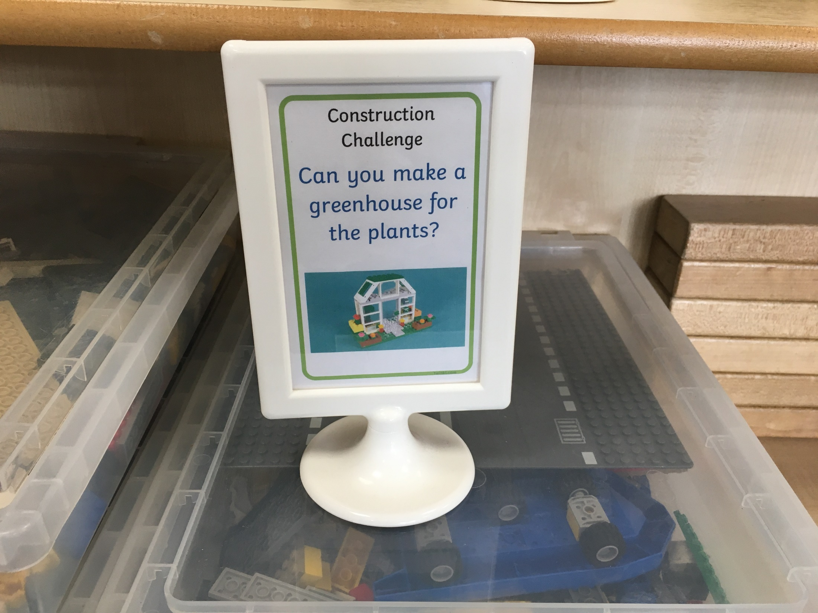
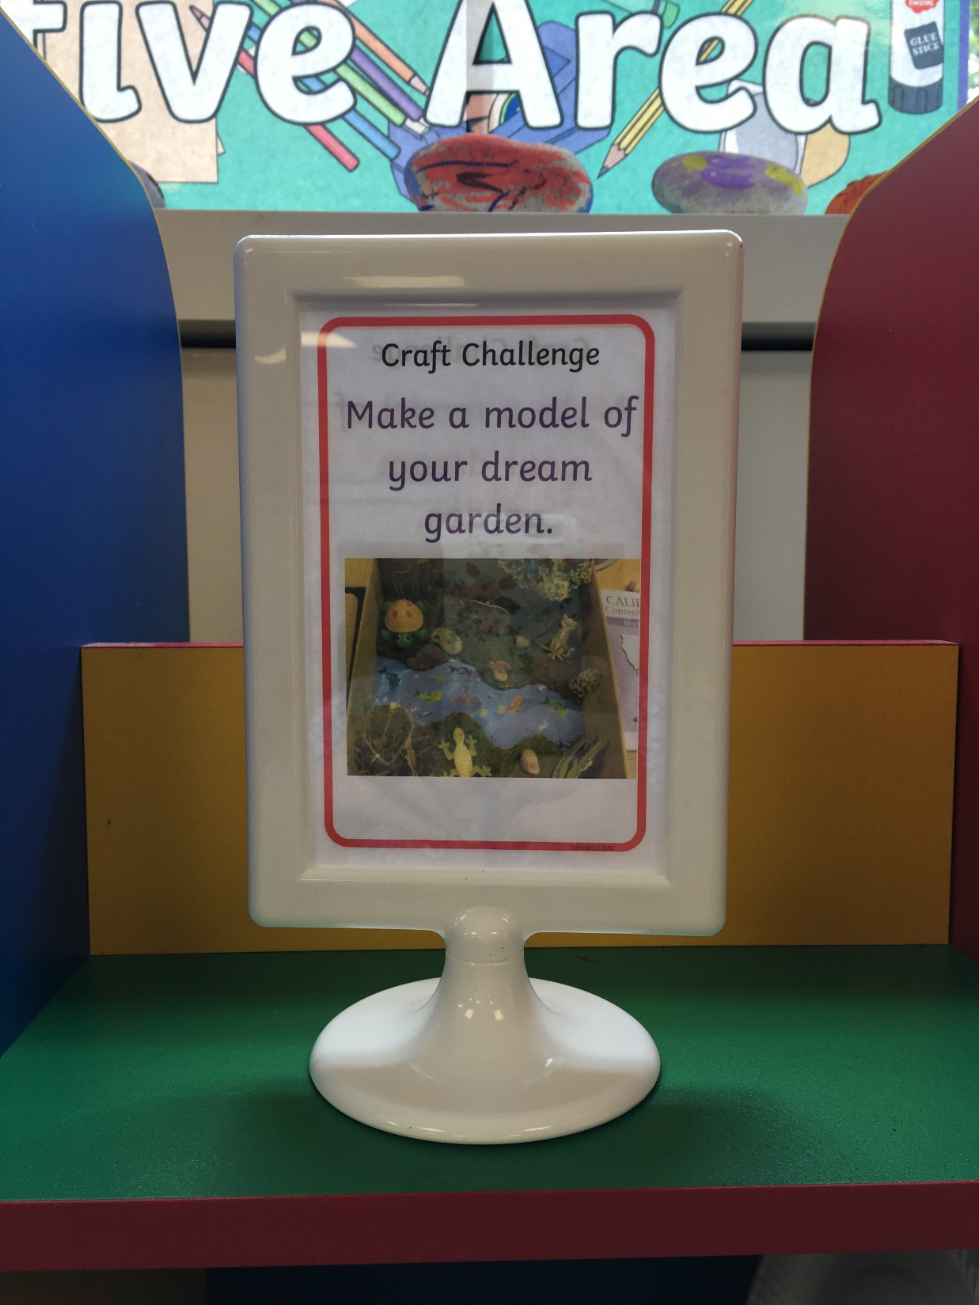
There will be challenges in each learning area.

Slide 5
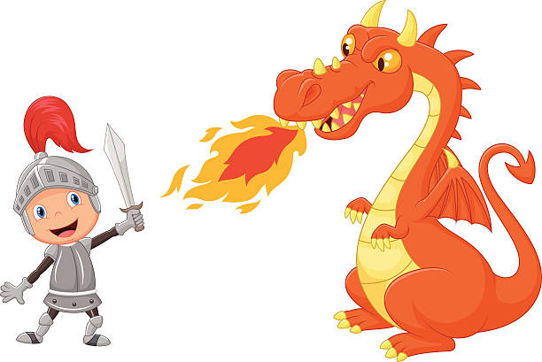
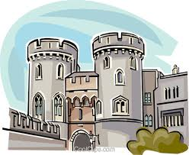
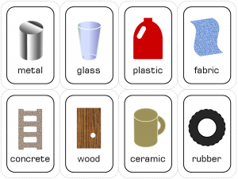
Here are some clues
about what we
will be learning.

Slide 6
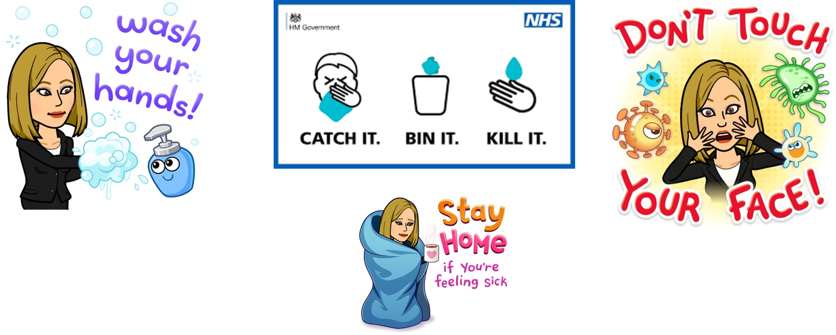
Staying safe in the classroom is important,
we need good hygiene.

Slide 7
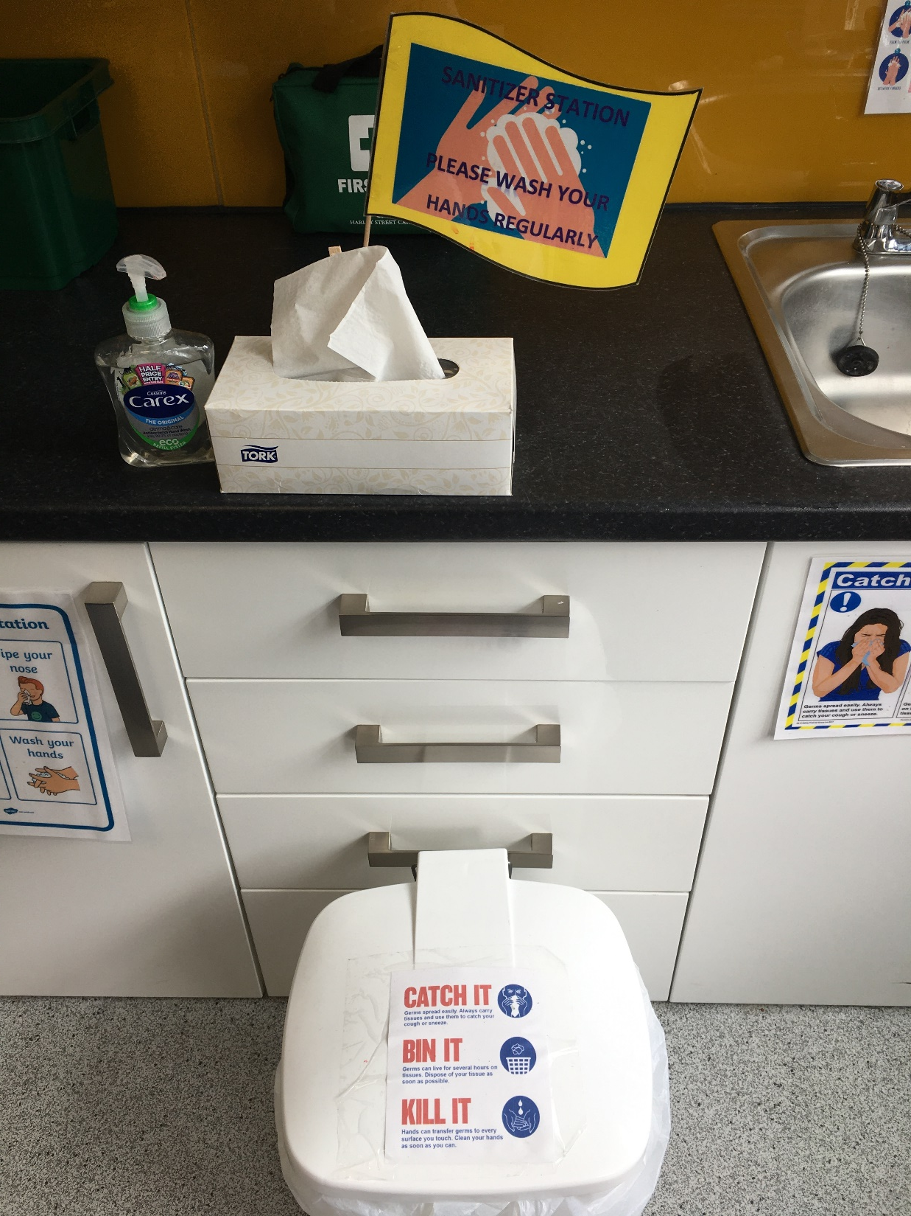
In our classroom we have a hand cleaning station.

Slide 8
These are our coat pegs, do you recognise them? We will come in this door and go through
to Pumpkin
Classroom.

Slide 9
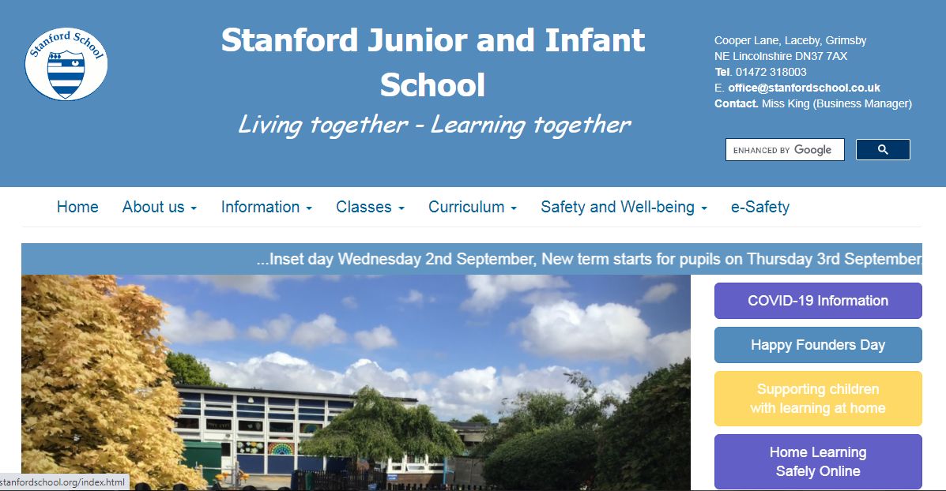
Remember to look on our blog page for up to date information.

Slide 10
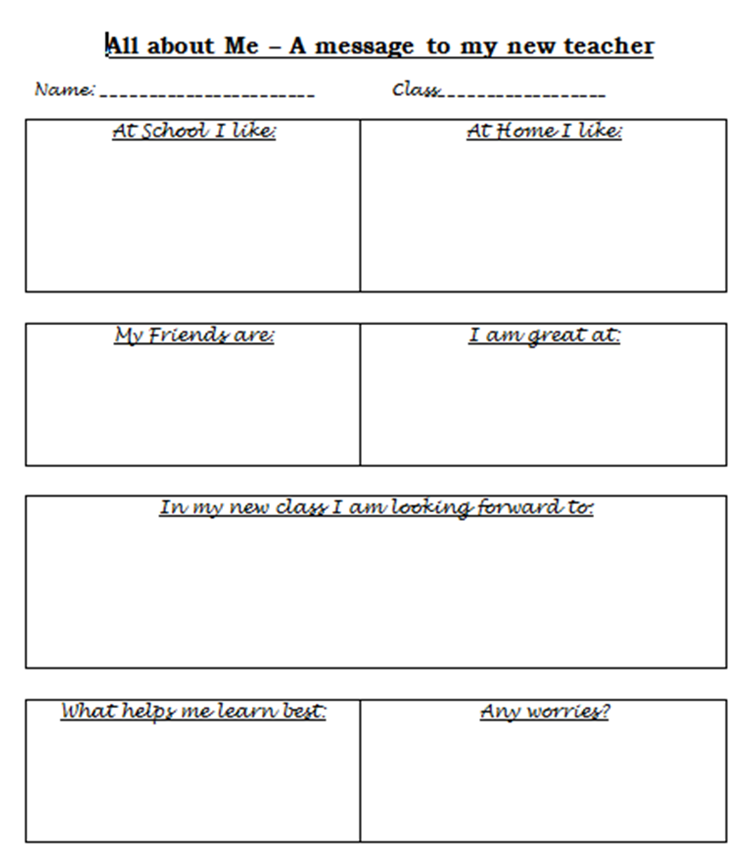
‘All about Me’ challenge.
I can’t wait to see you all.
It would be fabulous if you could complete your ‘all about me’ challenge for me to read.

Slide 11
Have a super summer holiday.
See you in September.

