Slide 1

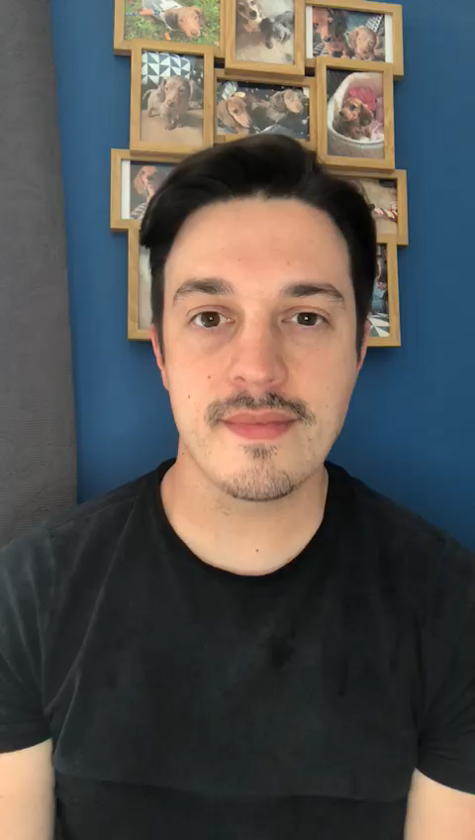
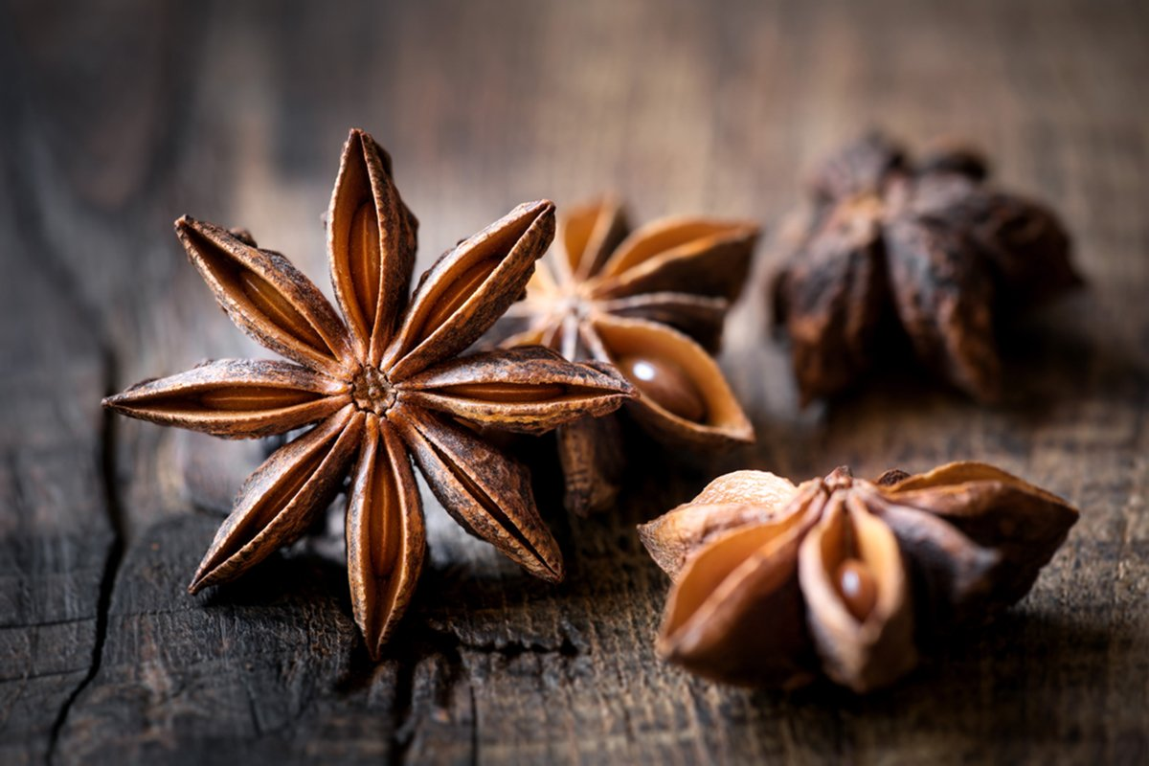
Welcome to Star Anise!

Slide 2
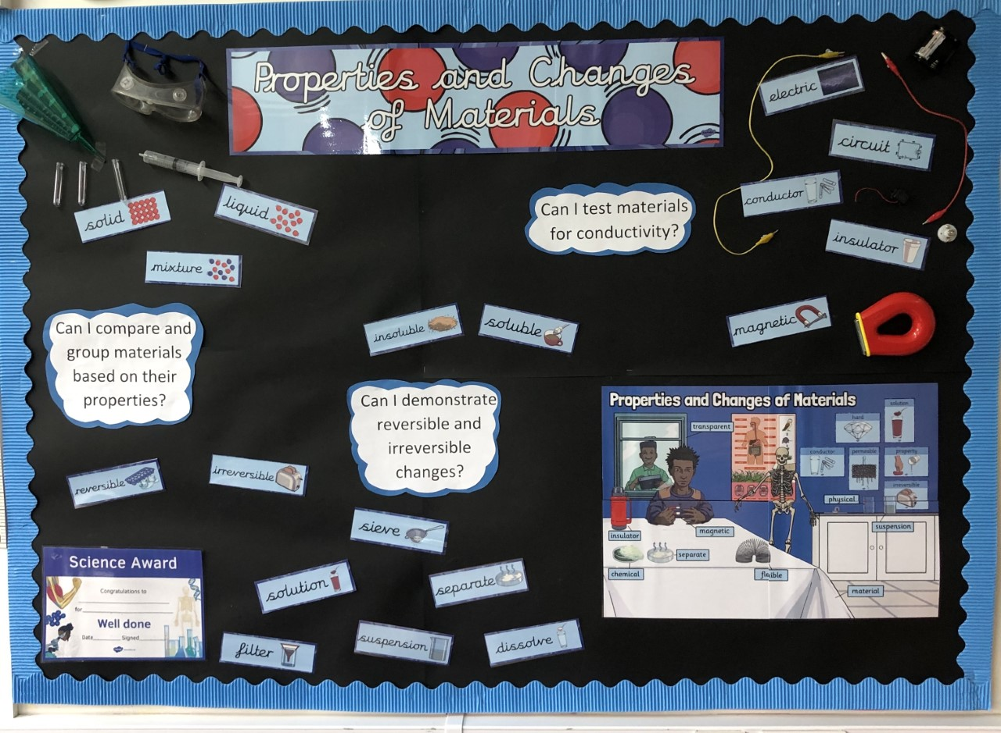
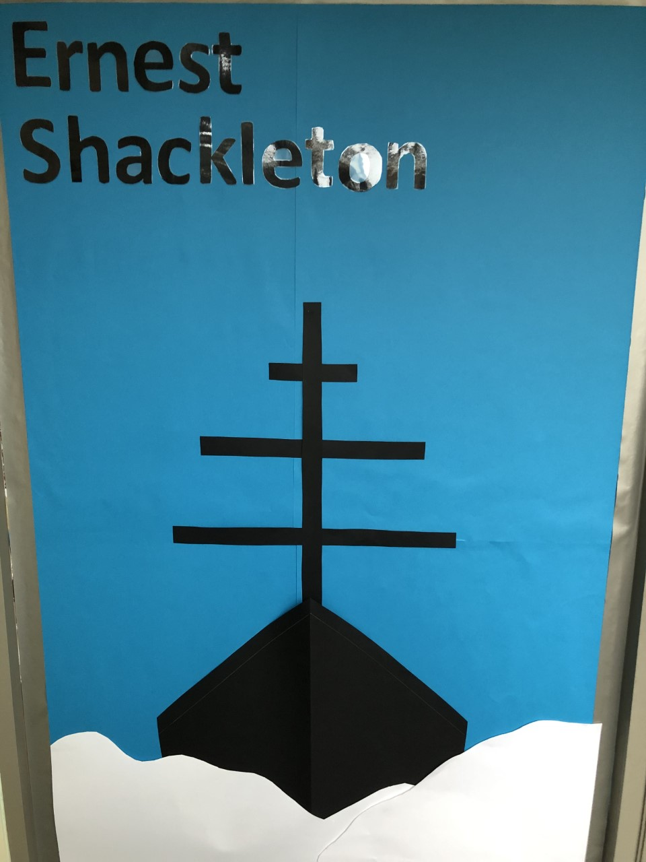
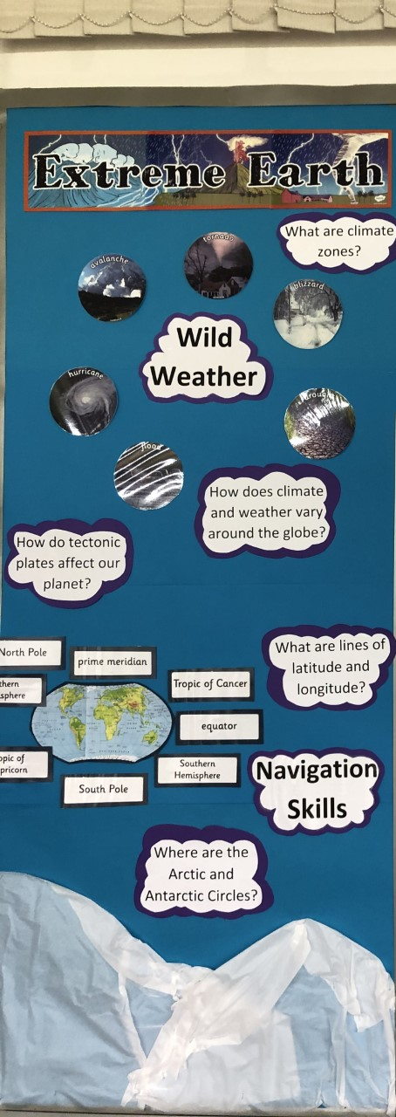
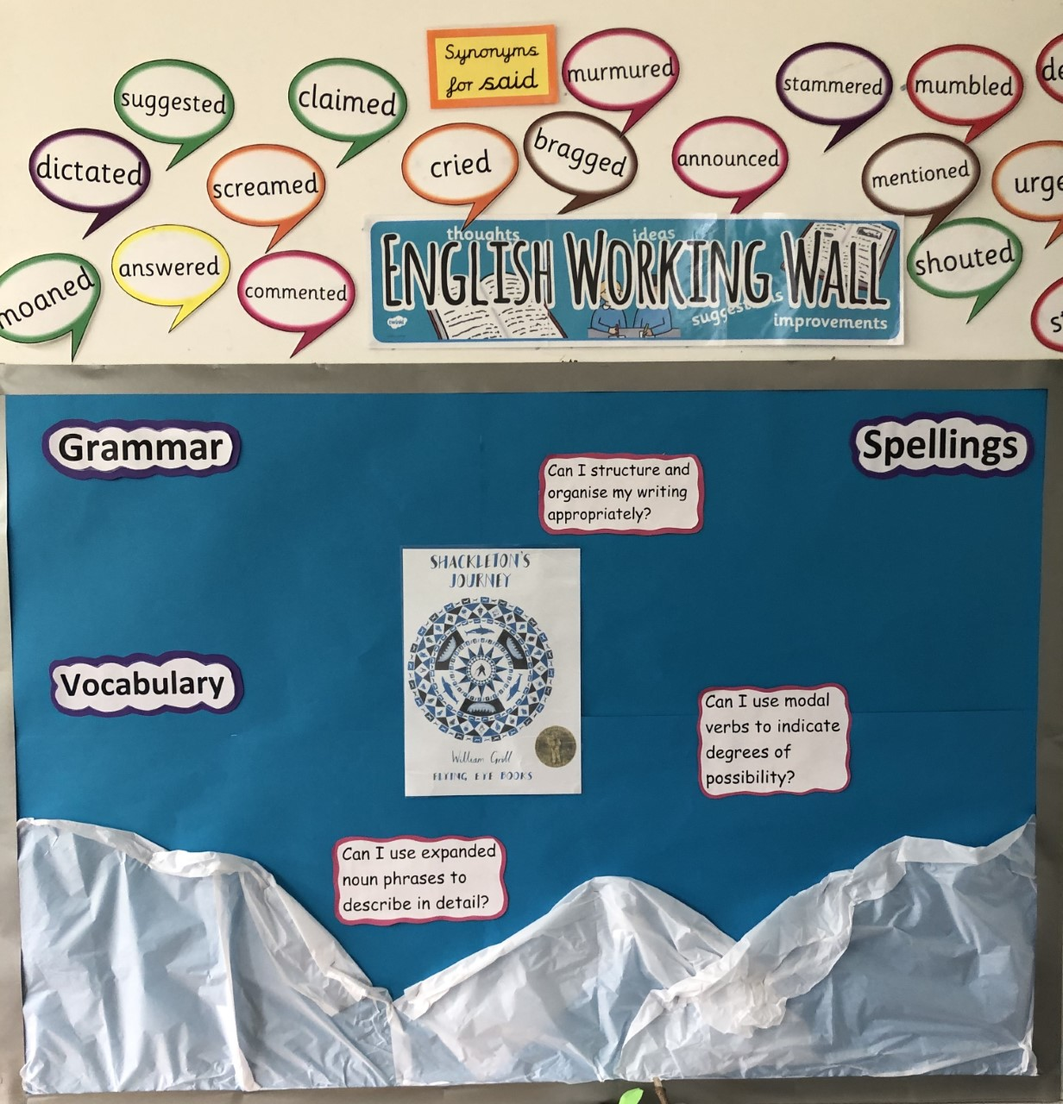
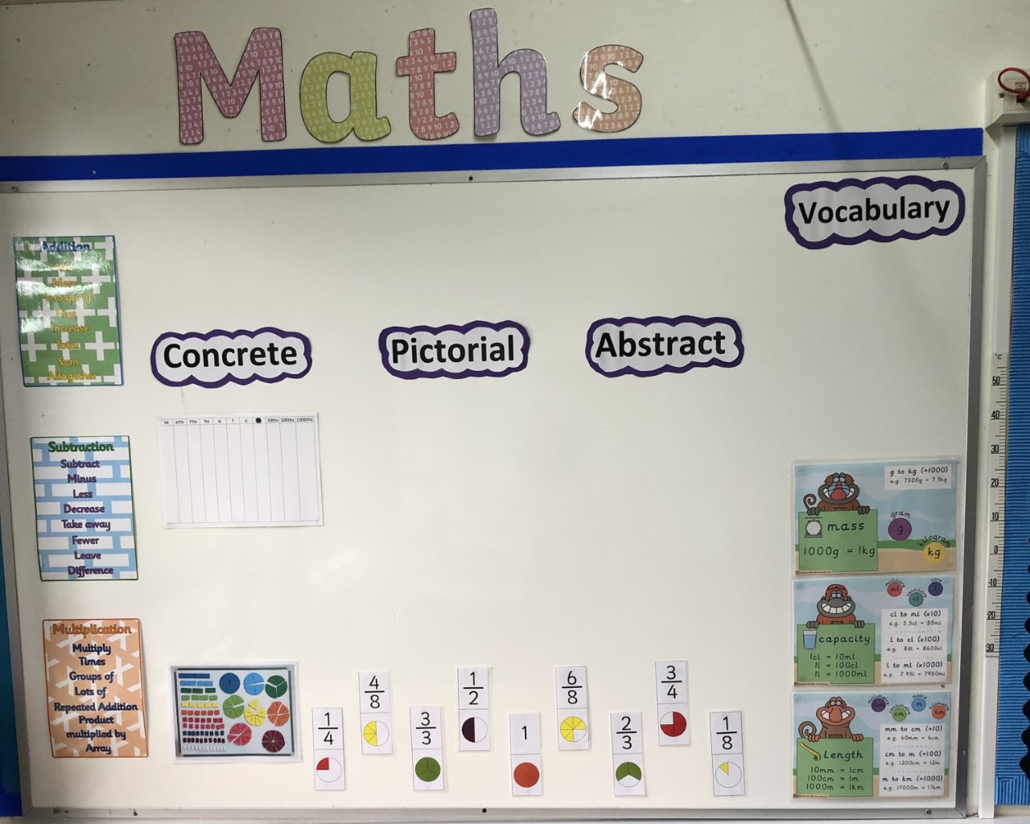
The classroom is all ready for you…

Slide 3

When you return, it is very important to focus on superb hygiene!

Slide 4
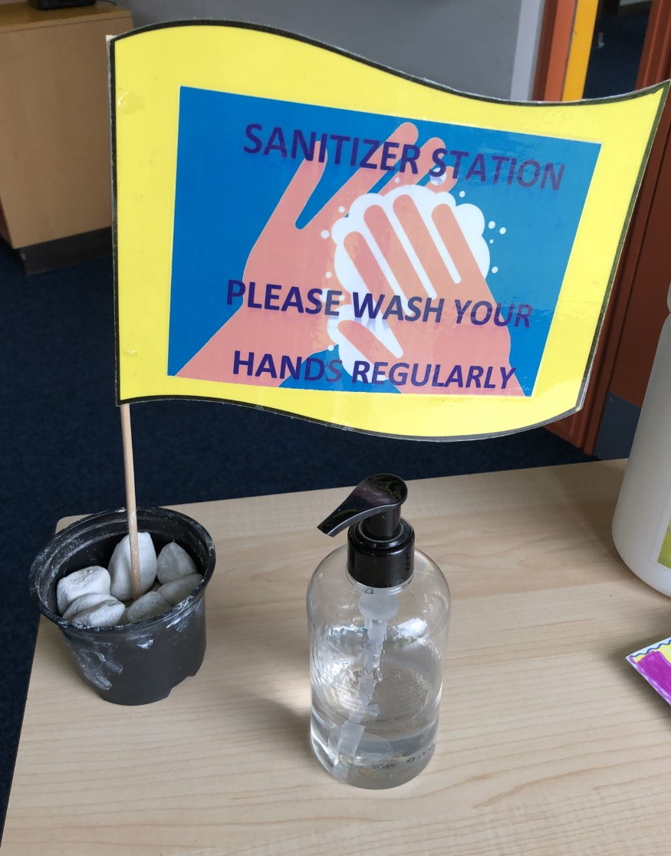
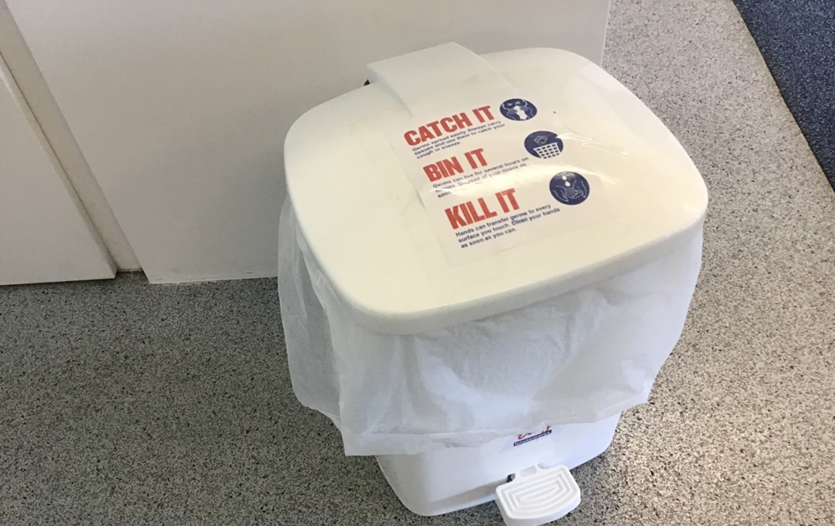
Each class has a sanitation station and a special lidded bin, for your safety.
There will be other health and safety regulations which we will update you on before September ☺

Slide 5
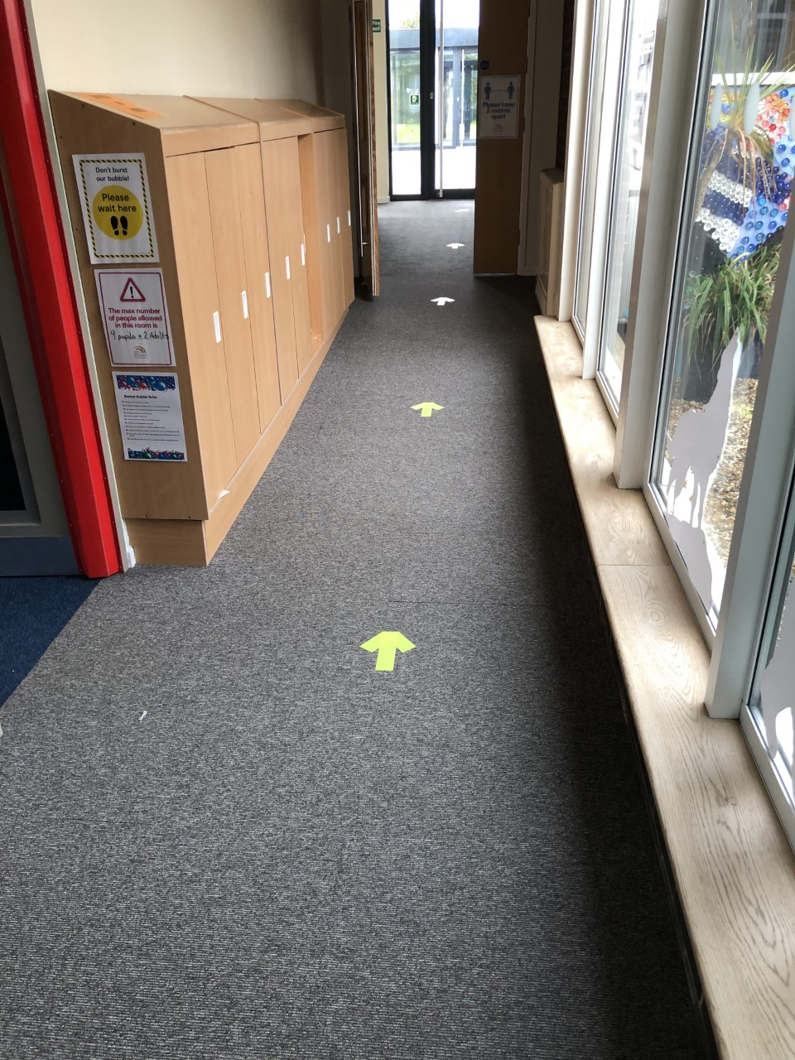
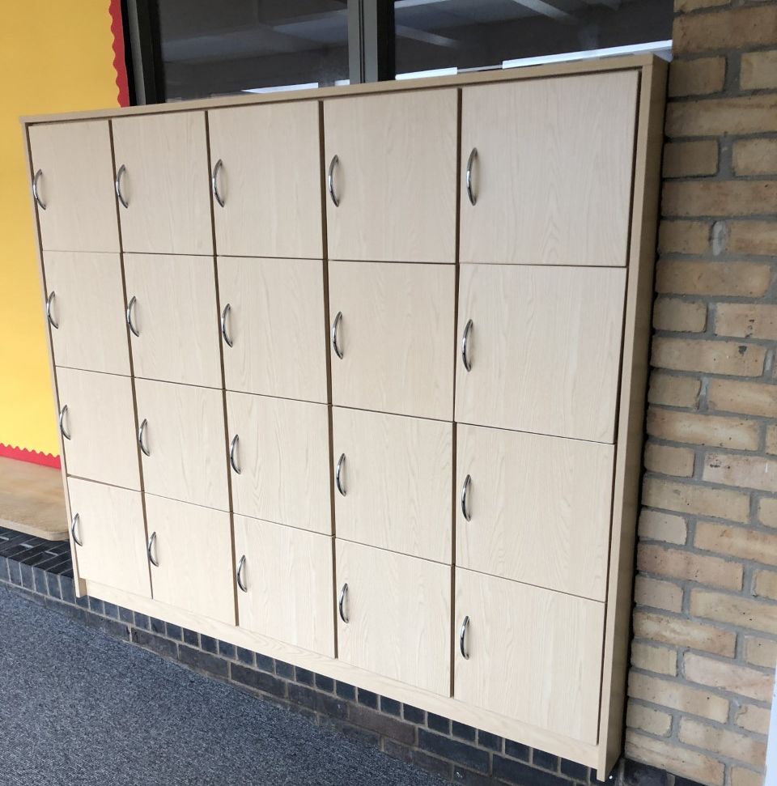
These are the lockers that you will be using.

Slide 6
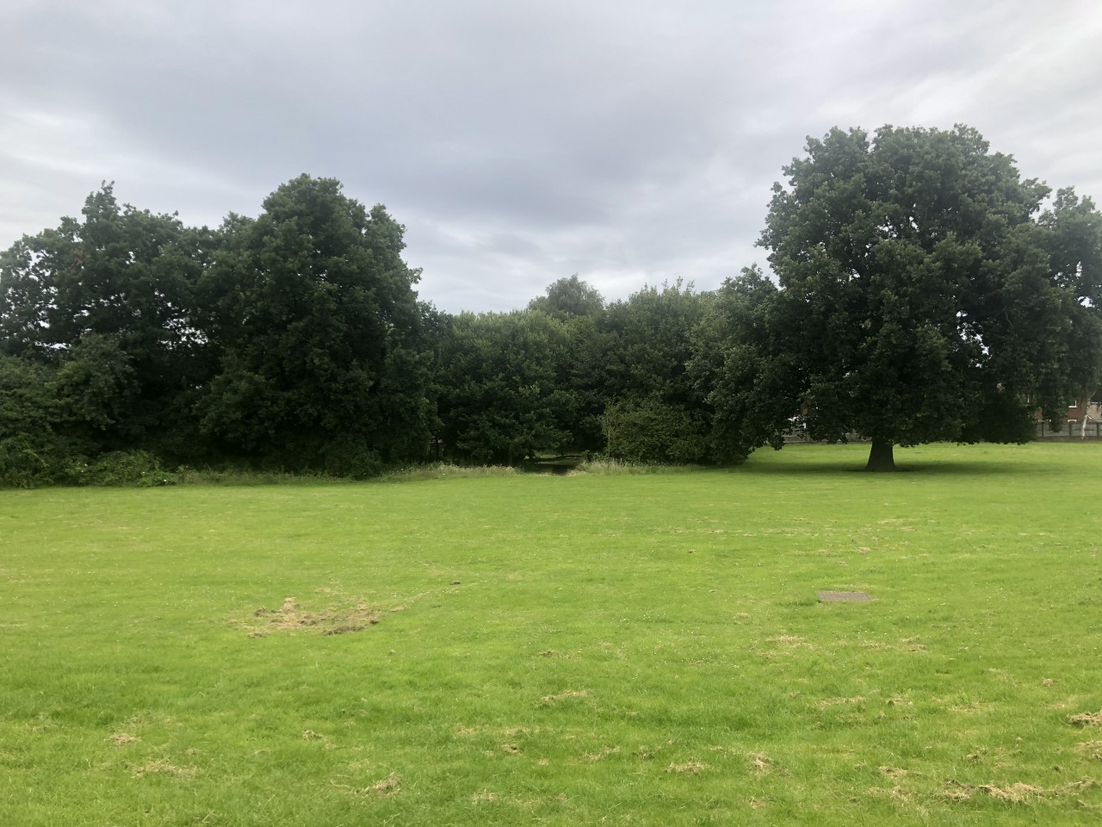
This is the lovely view from our classroom!

Slide 7

I can’t wait to explore the year 5 curriculum with you!
In English, we will be focusing at first on the book ‘Shackleton’s Journey’, which is a really exciting book about an expedition to the South Pole, at the beginning of the 20th Century. Not everything went to plan for Sir Ernest Shackleton!
We will find lots of writing opportunities from the book, while also focusing on learning new grammar and spelling rules.
Later in the term we will be exploring the fiction book ‘Sky Song’.

Slide 8


In maths we will be moving on to numbers beyond thousands – even up to millions, when we are ready.
We will be making sure that everyone feels confident with arithmetic skills – starting with addition and subtraction.
Keep practising your times tables, as we will be learning about multiples and factors of numbers this term as well.
In science we will be learning about properties of different materials.
We will be doing lots of investigative work to find out about: reversible and irreversible changes, conductivity and solubility.
As you can see, there we be lots of new vocabulary to learn!

Slide 9


Extreme Earth Topic!
Most of our geography, history, art and DT will be linked to the theme of ‘Extreme Earth’!
We will learn about wild weather, climate zones and the Earth’s tectonic plates, while also improving our locational knowledge and map skills.
Our ‘Hook Day’ for this topic will be on Monday 14th September.
The children will have the opportunity to play the roles of news reporters and use a range of multimedia skills.
We will not be dressing up this term due to increased hygiene precautions.

Slide 10

In addition, we will be learning:
Athletics & Orienteering skills
Gymnastics & Dance routines
How to code computer programmes
French phrases about family and friends
Local history of Stanford School, Laceby & Grimsby
How people of Hindu & Muslim faiths learn from their beliefs
All about rock music
How to manage our feelings and look after our mental health

Slide 11

We will be using our Learning Powers:

Slide 12
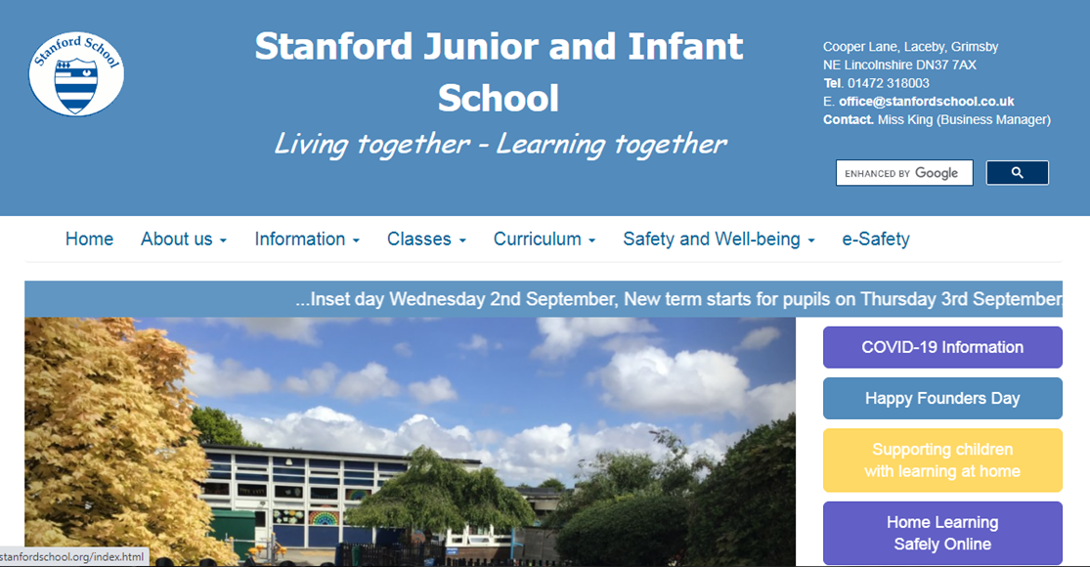
I look forward to reading your ‘All About Me’ messages from the web!
Remember to look at our class blog for the most up-to-date information.

Slide 13

Stay safe and have a great summer!

