Slide 1

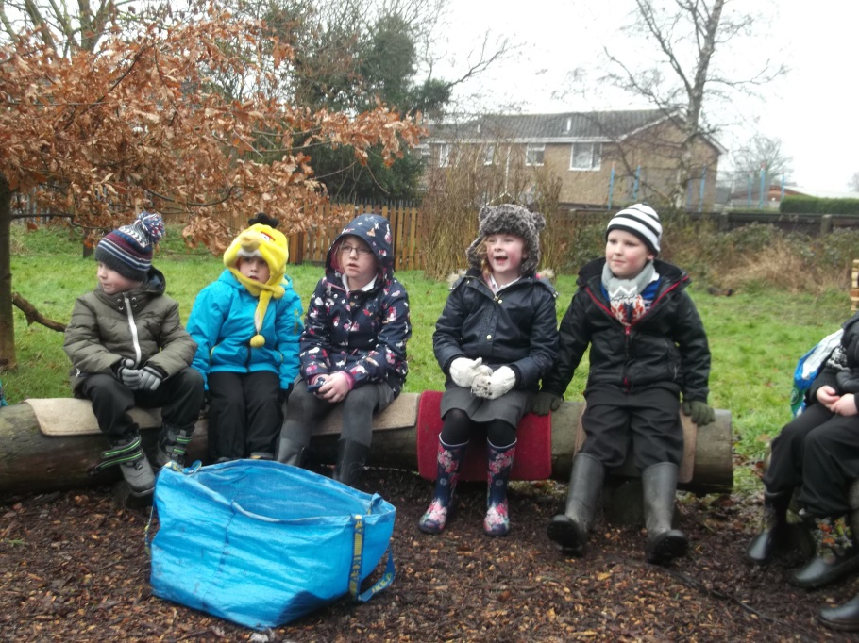
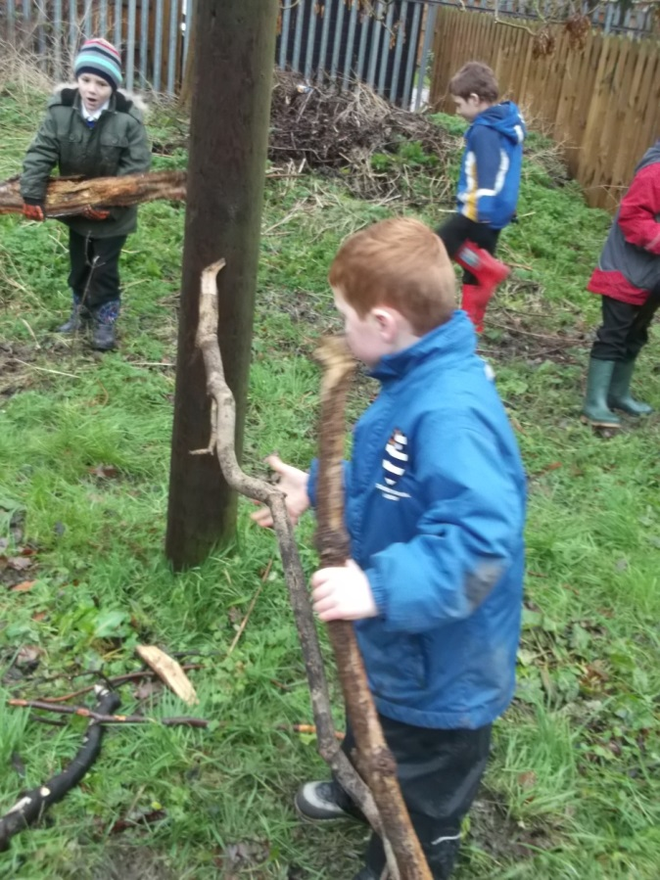
Outdoor Learning at Stanford
Stanford in Action Meeting
30th September 2015

Slide 2
Why Outdoor Learning?
At Stanford we recognise the value of Outdoor Learning and how beneficial this is to child development. Research evidence shows that learning outside the classroom can have a powerfully motivating effect on young people and a beneficial impact on learning, understanding, behaviour and well-being and health.

Slide 3
Our Journey so far….

Slide 4
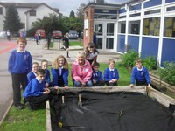
We created planting areas around the school and set up a gardening club.

Slide 5
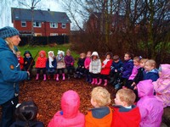
We looked at our curriculum and built in regular opportunities to work outside.

Slide 6
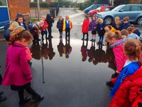

Slide 7
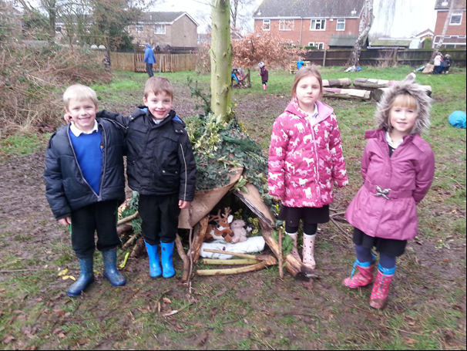

Slide 8
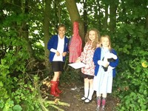
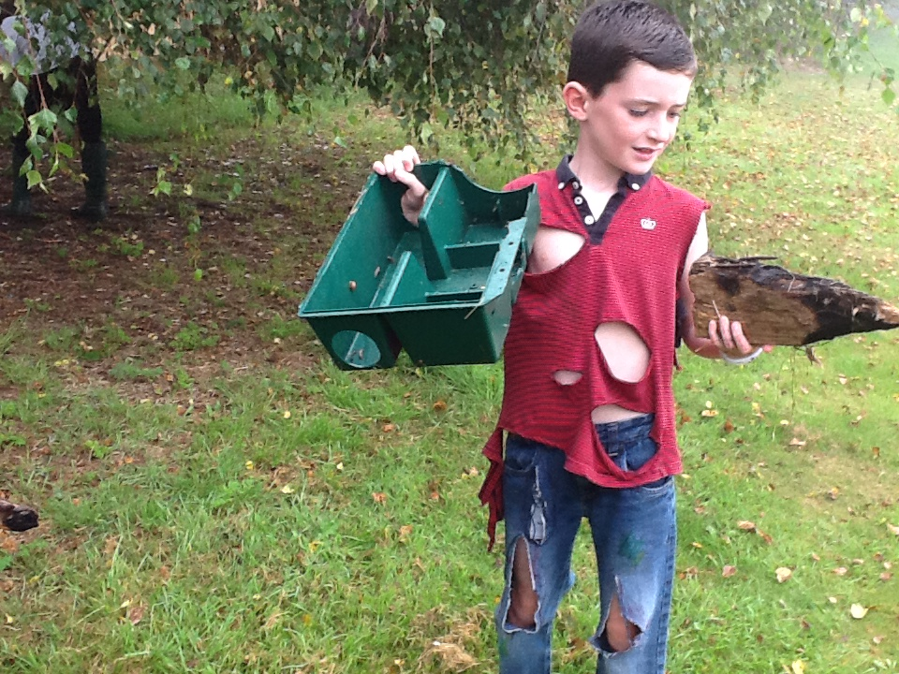
On a Hook for the topic day pupils had to find food, shelter and warmth following a disaster!

Slide 9
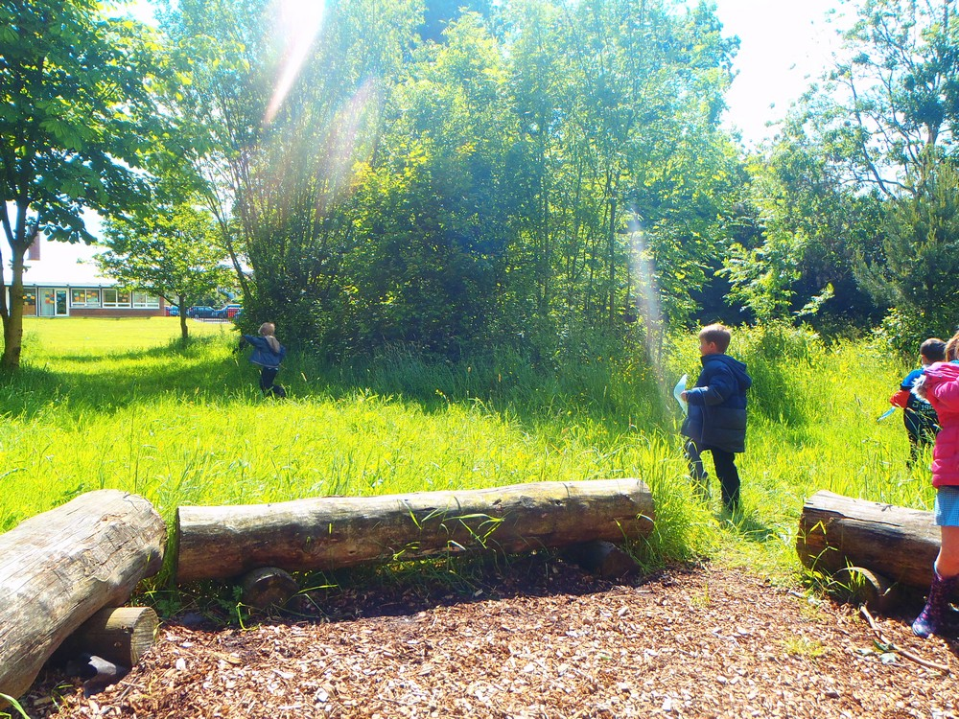

Slide 10
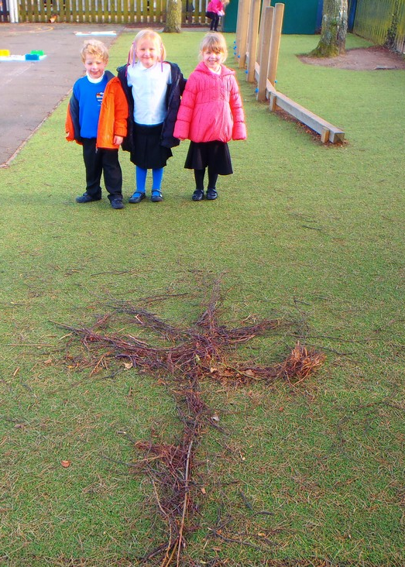
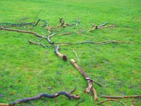

Slide 11
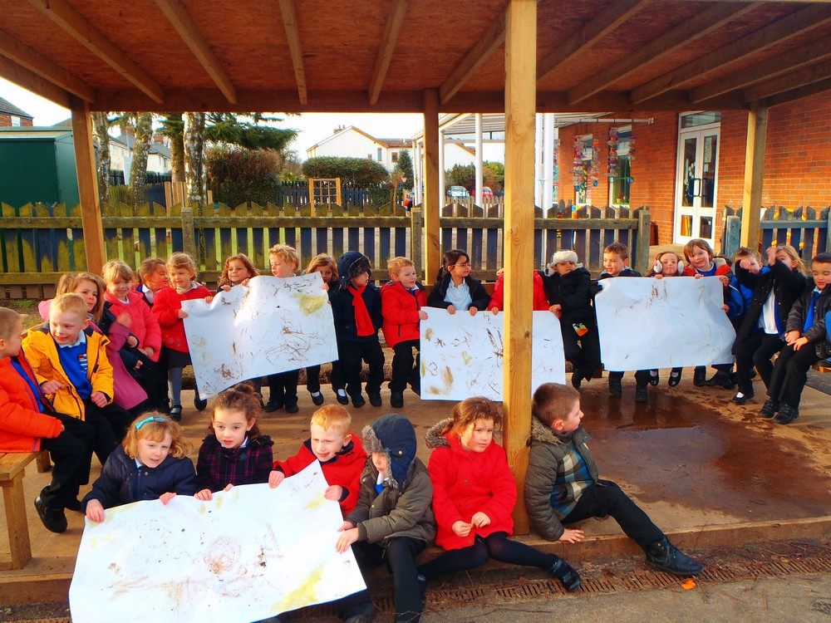

Slide 12
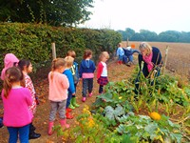
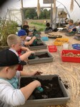
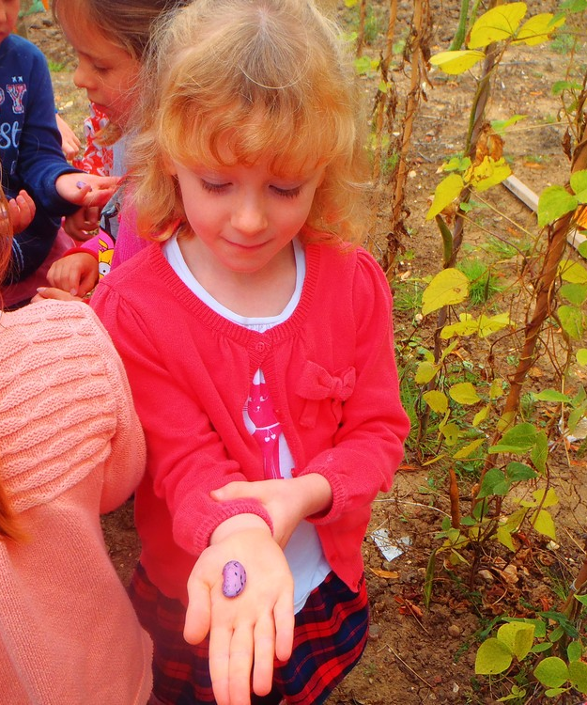
We planned trips to farms and woods…

Slide 13
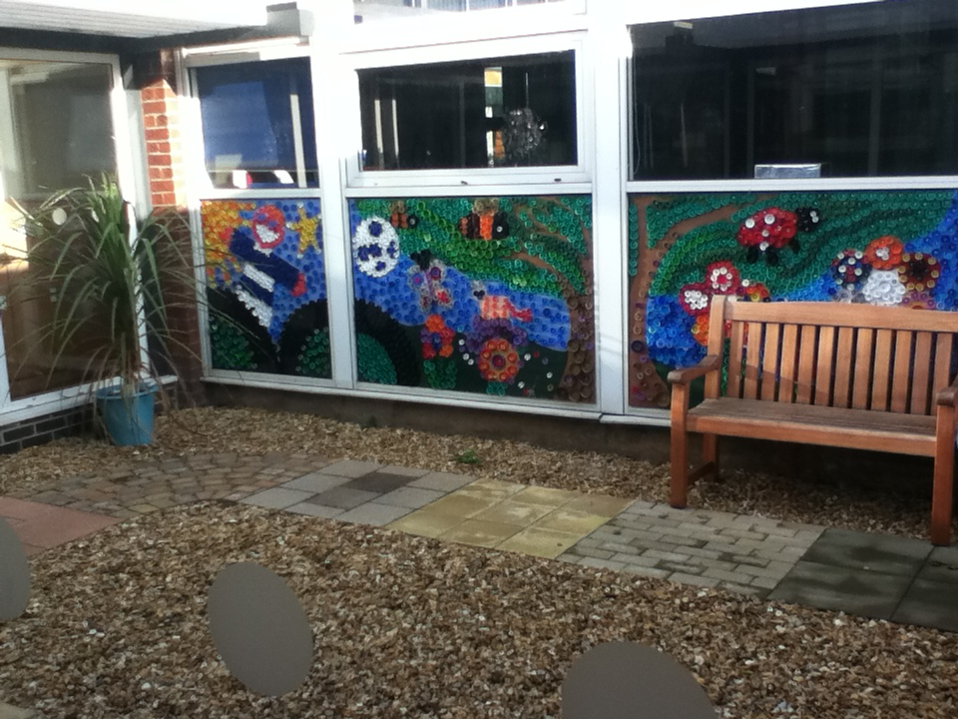
Support from Our Wonderful PTFA have helped us to transform our 2 quad areas.

Slide 14
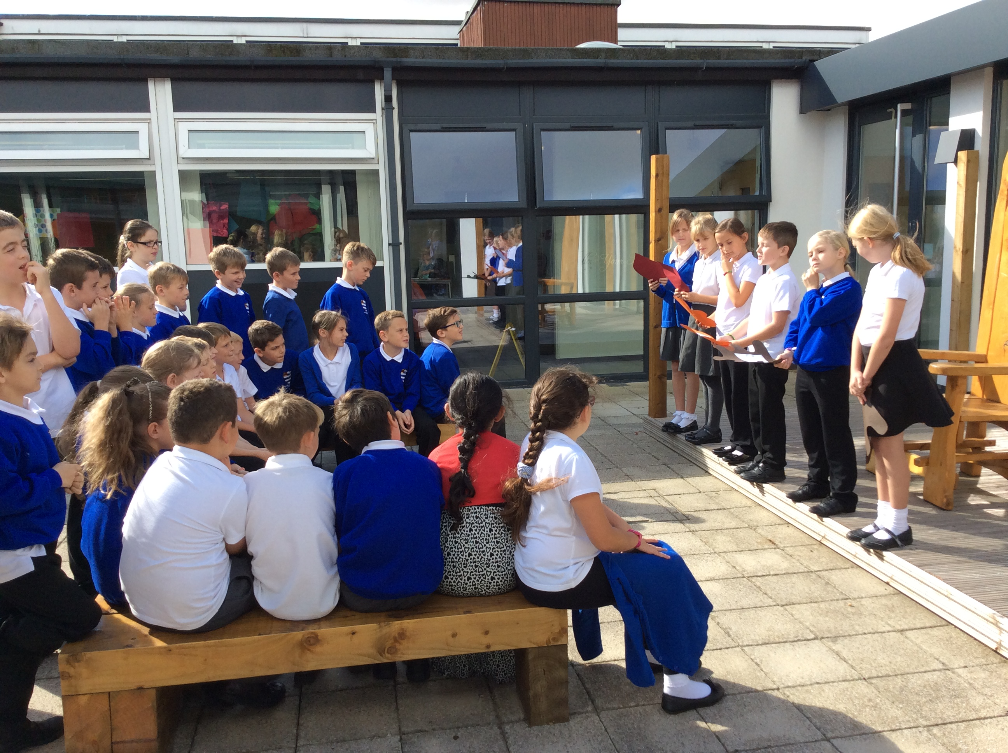
Out door reading area
Needs picture

Slide 15
Our Next steps….
Transform the Nature area by pupil voice led Re-designing (eg Encourage Butterflies and birds through planting)
Clean up pond area
move shed,
Outside tap
Timetables plan of responsibilities of planting veg – link to enterprise
Space seed experiment
Eco schools bronze award
Green Tree award Silver

Slide 16
Further Help and Support
We need:
Volunteers (a working party)
Old wellies
Any seeds, plant pots
Donations of top soil, compost
Help to clear pond area
PTFA funding to support Nature area revamp?

